Slide 1
LO: TBAT explain and apply correlation

Slide 2
What is correlation?
The relationship between two covariables
E.g., the older you are, the higher up in school you are
We can show correlations through a scatter graph
We can test the significance of correlations by using the Spearman or Pearson tests
Correlations can’t tell you causation (there is no IV or DV)

Slide 3
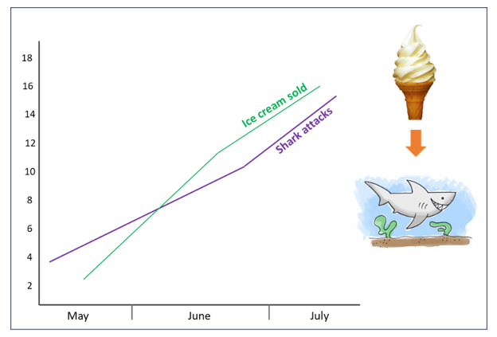
Notes:
Positive correlation – but what’s really going on?

Slide 4
Correlation values
Correlations are values between –1 and 1.
The sign tells you the direction (positive or negative)
The value tells you the strength.
The closer the value is to 1, the stronger the relationship
(1 = perfect relationship, 0 = no relationship)
-.85 is a strong negative correlation: as covariable A goes up, covariable B goes down

Slide 5
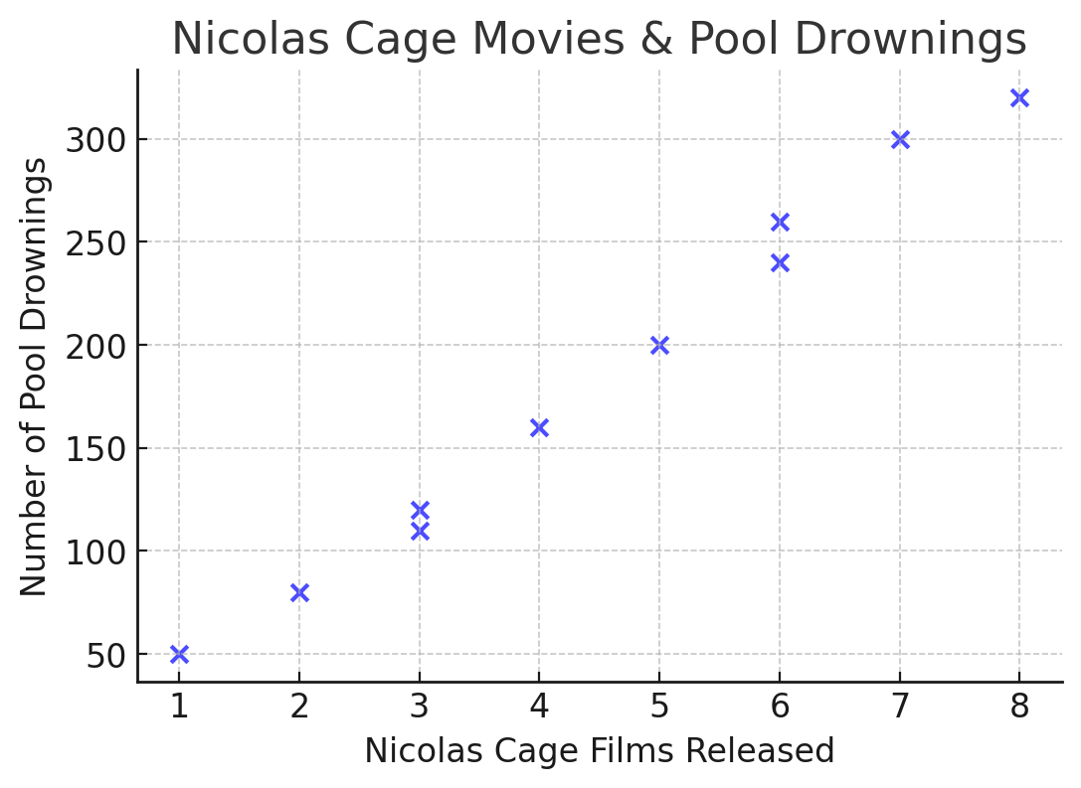
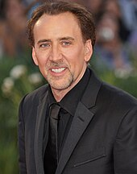
Nicolas Cage vs. Pool Drownings
The number of Nicolas Cage films released per year is strongly correlated with the number of pool drownings.
A Sim trapped in a pool because you thought it was funny
Nicolas Cage
The correlation is 0.99 – almost perfect!

Slide 6
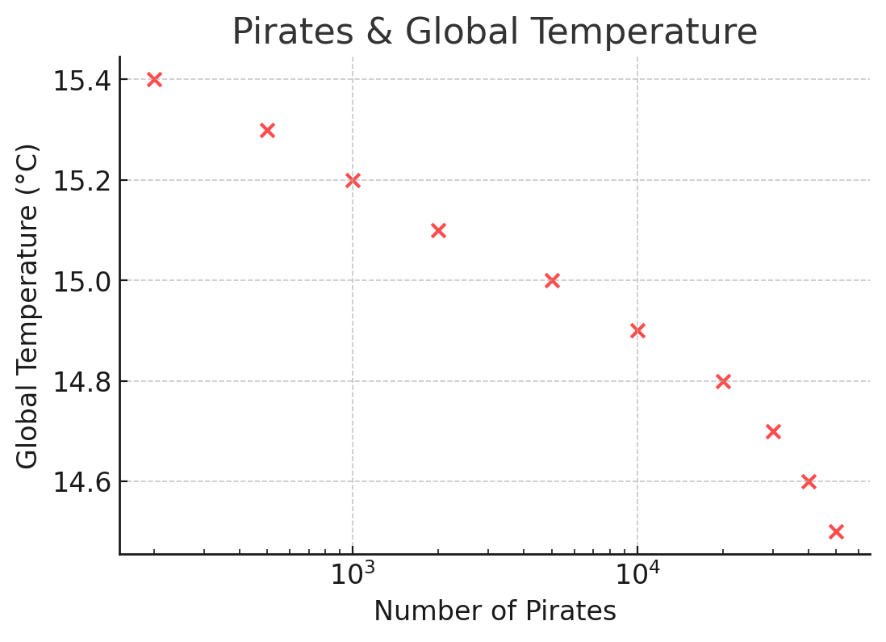
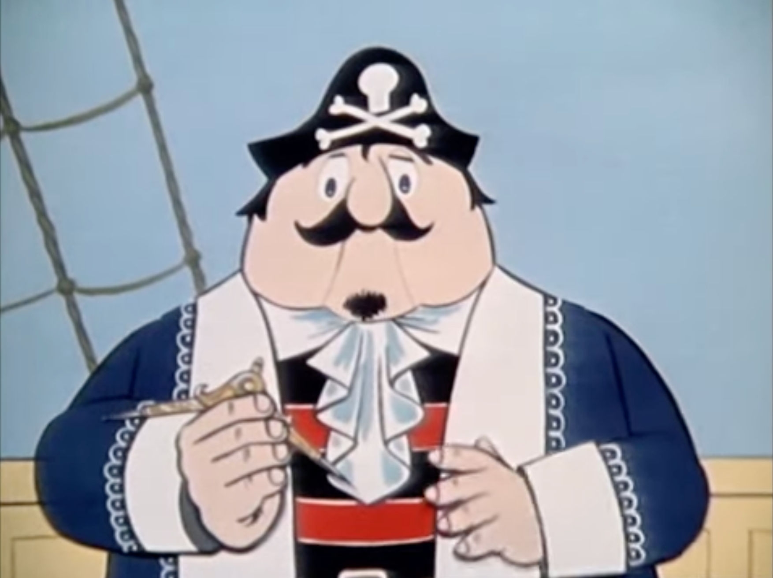
Pirates vs. Global Temperature
According to the Church of the Flying Spaghetti Monster, the decline in pirates is linked to global warming.
A real church.
You can join it.
But you have to believe in the miracle of pasta.
Captain Pugwash
Scourge of the Seas
The correlation is -0.89

Slide 7
Correlational method / concepts
Co-variables
Scatter graphs
Correlation coefficients
Statistical tests: Spearman and Pearson
Practical uses: studies, validity, reliability

Slide 8
Typical Correlation stem
A researcher investigated whether there was a correlation between the number of hours slept and how well rested students felt.
The researcher randomly selected 18 participants from first-year students at a university.
On the day of the study, each student participant was asked, ‘How many hours did you sleep last night?’ They then had to rate on a scale of 1 to 5 how well rested they felt.
The researcher hypothesised that there would be a positive correlation between the two co-variables.
😭 the research can only test for a +ve relationship, not cause and effect
😃 Get marks: the research can only a +ve relationship between hours slept and how well rested students felt, it cannot tell us whether higher levels of sleep cause higher levels of reported rest students feel.

Slide 9
What you need to find out about and learn
Describing the correlation method
When you use correlation
Drawing conclusions about reliability / validity
Correlation coefficients
Experiments v correlations
Strengths and weaknesses of the correlational method

