Slide 1
Bowlby’s theory of maternal deprivation
“It is better to have loved and lost, than never to have loved at all.”
Tennyson, ”In Memoriam, A.H.H.”

Slide 2
Deprivation versus Privation
Deprivation
Privation
Attachment bond is formed, but broken later in life
Loved and lost
The child doesn’t form any attachment bond at all
Never to have loved (or been loved) at all

Slide 3
Are these examples, deprivation or privation
Deprivation
Or
Privation

Slide 4
Are these examples, deprivation or privation
Child A’s mother died during childbirth and tragically her father committed suicide just two weeks later. Since then she has been in foster care and had a series of short of placements.
Privation: Child A has not had an opportunity to form an attachment

Slide 5
Are these examples, deprivation or privation
Child B is 2 years old. He has been taken from his mother who is an alcoholic and gives him no affection or attention.
Privation: Child B will not have formed an emotional bond with his mother, as the relationship was not reciprocal

Slide 6
Are these examples, deprivation or privation
Child C is two years old. Her mother has recently had another baby and has been admitted into hospital with post-natal depression. She has been there for a month.
Deprivation: assuming child C is attached to her mother normally, then she is just experiencing separation

Slide 7
Think, pair, share
Bowlby said: “Mother love in infancy is as important for mental health, as are vitamins and proteins are for physical health”
Discussion: to what extent do you agree with Bowlby or disagree?

Slide 8
Maternal Deprivation Hypothesis Note: This hypothesis came 20 years before Bowlby’s attachment theory
There needs to be a continuous presence of care from a mother (or mother figure) in the first 2.5 years of life (critical period)
If a child is deprived of this care, then there will be major effects on intellectual and emotional development

Slide 9
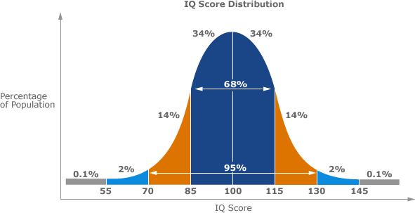
IQ: Measurement of Intelligence based on standardised tests
IQ tests have a mean of 100, SD of 15

Slide 10
Psychopathy
Someone who doesn’t have empathy (understanding) of the emotions and needs of others
Psychopaths lack remorse for their actions
There isn’t a formal clinical term ‘psychopathy’ – it comes under Antisocial Personality Disorder

Slide 11
Psychopath
Lack empathy and remorse
Manipulative and deceitful
Sociopath
Low/some empathy and remorse
Superficial charm
Possibly genetic
Impulsive and emotionally volatile (anger)
Possibly environmental
Struggle with stable relationships
Notes:
Sociopath or psychopath

Slide 12
Maternal Deprivation Hypothesis Impacts of deprivation
Intellectual
Delayed development
Abnormally low IQ
Emotional
Affectionless Psychopathy
Inability to experience guilt, or strong emotions towards others.
Potential criminality
lack of empathy for victims or guilt for own actions
Prevents fulfilling relationships

Slide 13
James Bond – orphaned at 11 Is he an affectionless psychopath?

Slide 14
Video Link (A01) Maternal Deprivation
Notes:
Use Worksheet with video

Slide 15
Evaluation: Maternal Deprivation Hypothesis
Strengths | Weaknesses
Counterpoint – Levy’s evidence that maternal deprivation can have LT effects | Flawed evidence
 | Confusion between deprivation and privation
 | Is the period Critical or Sensitive? Czech Twins – emotionally abused from 18 months to 7 years, BUT had recovered by teens (Koluchova, 1976)
Conflicting evidence Lewis (1954) – failed replication Gao et al. (2010) – link between adult psychopathy and poor maternal care

