Slide 1
Three bits of biopsychology
Essential stuff for understanding OCD (and any other disorder!)

Slide 2
Three bits of Biopsychology
Genes
Brain structure
Neurons, neurotransmitters, neurotransmission

Slide 3
Genes
A unit of heredity
You inherit genes from your biological parents
Humans have about 20-25 0000 genes
COMT → linked to schizophrenia, anxiety and OCD
MAOA (Warrior gene) → aggression, antisocial behaviour

Slide 4
Genes - review
A unit of h…….
You ……….. genes from ……
Humans have about ……. genes
……….. → linked to schizophrenia, anxiety and ……
MAOA (……… gene) → ………….., antisocial behaviour

Slide 5
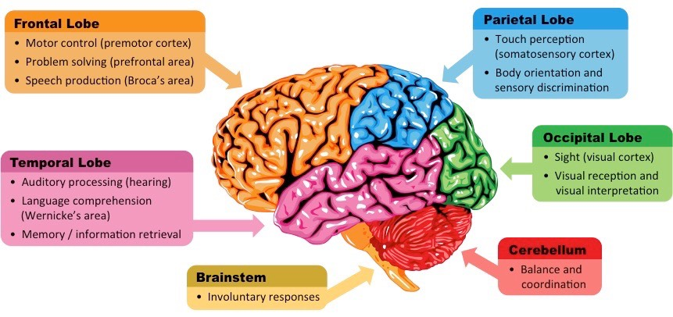
The Brain – Main Lobes

Slide 6
The Brain – Main Lobes

Slide 7
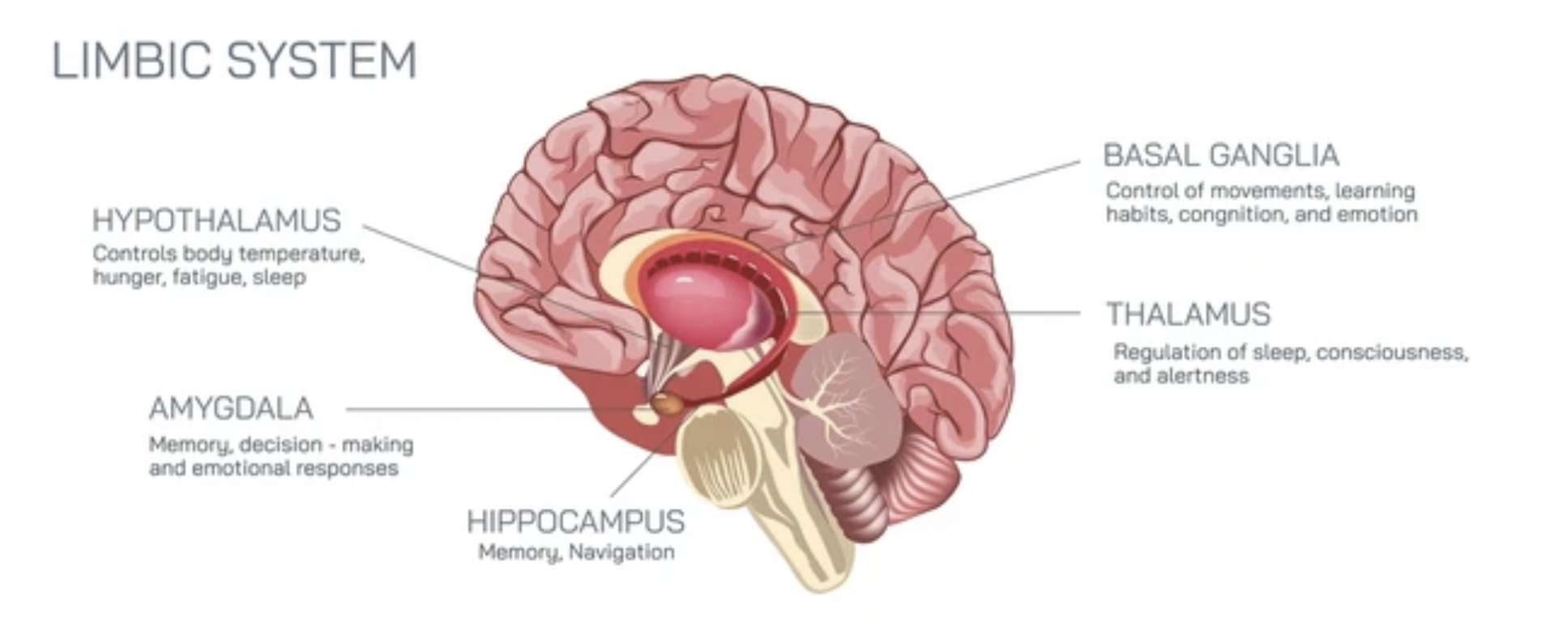
The Limbic System

Slide 8
The Limbic System

Slide 9
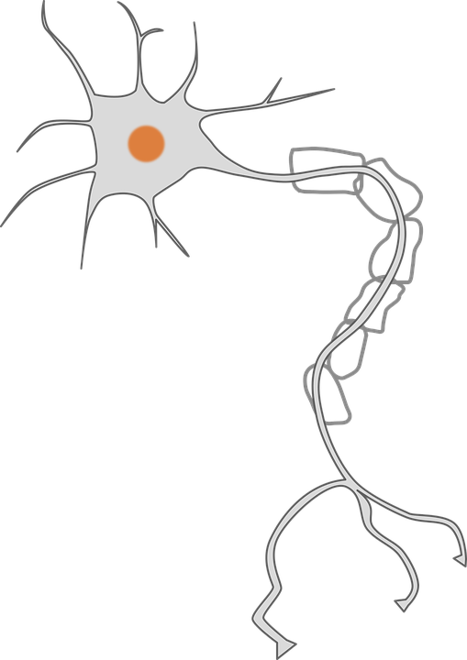
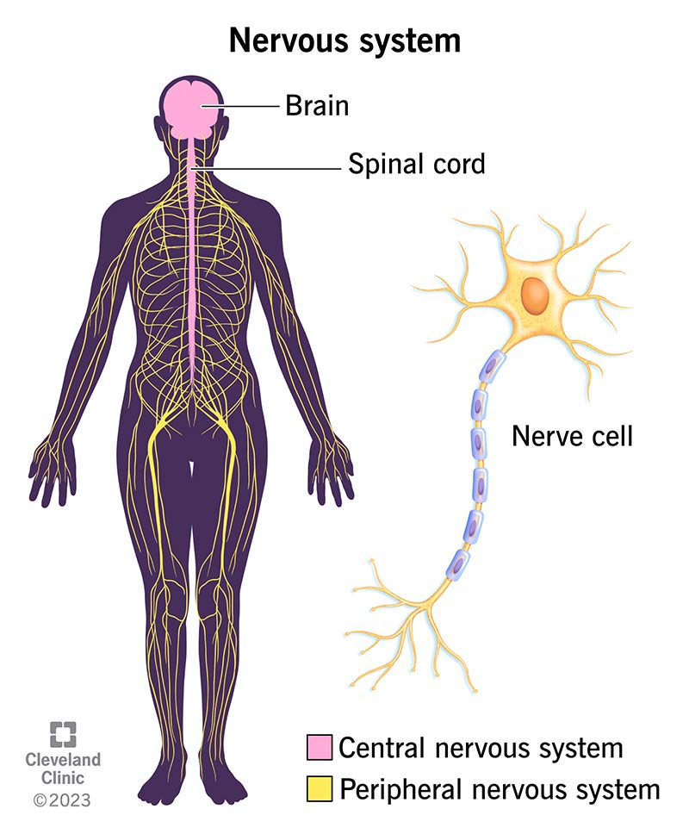
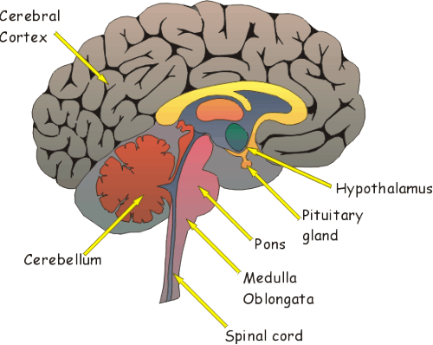
Neurons, Brain, Central Nervous System
Brain cell - Neuron
Brain
CNS

Slide 10
Brain questions
How many neurons are in your brain?
100 000 000 000 +/- a couple of billion
What percentage of your brain do you use?
Pretty much all of it – otherwise what is it there for?
A 2013 survey found that 65% of Americans thought we only used 10% of our brains (a common myth)

Slide 11
The CNS and Synaptic Transmission
The central nervous system is made up of the b________ and the s_______ c_______.
N___________ in our body send information via the spinal cord to the brain.
The brain then p_______________ this information and sends a m____________ to the body through the spinal cord.
rain
pinal
ord
eurons
rocesses
essage

Slide 12
The CNS and Synaptic Transmission
unctions
Different areas of the brain are responsible for different f____________, e.g., the h______c_________ is important for memory.
Neurons in the brain pass messages along through electrical impulses and the release of n______t__________________.
When neurotransmitters are released they cross the synaptic gap (a physical gap between two neurons) to be picked up by r____________ sites.
ippo
ampus
euro
ransmitters
eceptor

Slide 14
The Neuron - synapse
Synapse (axon terminal) – sends electrical impulses to neighbouring neurons

Slide 15
The Neuron – Myelin sheath
Myelin sheath – works like insulation to speed up the electrical impulse

Slide 16
The Neuron – Axon
Axon – transfers electrical impulses from the cell body to the synapse

Slide 17
The Neuron – Soma
Soma - cell body

Slide 18
The Neuron – Soma
Nucleus – contains cell DNA

Slide 19
The Neuron – Dendrite
Dendrite – receives electrical impulses from neighbouring neurons

Slide 20
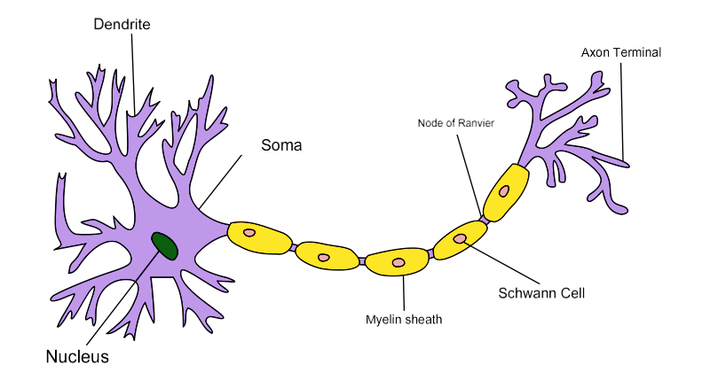
The synaptic gap
Synaptic Gap

Slide 21
Complete these definitions
Synapse
Synaptic gap
Dendrite
Axon
Nodes of Ranvier
Myelin sheath

Slide 22
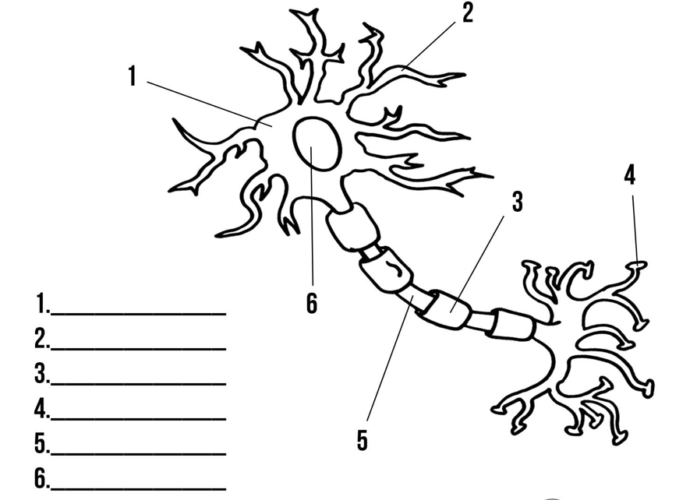
Complete the labels on your whiteboards

Slide 23
Complete the labels on your whiteboards

Slide 24
Basics of neural communication
Two neurons do not make direct contact. Where they meet, there is a very small gap called a s___________.
The signal needs to cross this gap to continue on its journey to, or from, the C ___ ___.
This is done by means of chemicals which d_________ across the gap between the two neurons.
ynaptic gap
N S
iffuse

Slide 25
Steps in neural transmission
An electrical impulse travels along an axon.
This triggers the nerve-ending of a neuron to release chemical messengers called neurotransmitters. These are held in synaptic vesicles.
These chemicals diffuse across the synapse (the gap) and bind with particular receptor molecules on the dendrite of the next neuron.

Slide 26
Steps in neural transmission
The receptor molecules on the second neuron bind only to specific chemicals released from the first neuron. This stimulates the second neuron to send an electrical impulse.
Any neurotransmitter not used by the receptors is absorbed by the sending neuron to be used again. This is called reuptake.

Slide 27
Notes:
Synaptic transmission video

