Slide 1
Biological Treatment for OCD

Slide 2
Drug therapies for OCD
Serotonin is a mood regulator (low levels → OCD and depression)
Drug therapies → increasing serotonin levels and /or reducing anxiety

Slide 4
Reuptake
Notes:
2:04 - reuptake

Slide 5
Main drug treatments for OCD
Increasing serotonin levels
Blocking reuptake
Reducing anxiety levels
Slowing down brain activity / neurons firing
SSRI
Tricyclics: older, ++ side effects
SNRI
Benzodiazepines**
Notes:
In Topic Companion VLE/SatchelOne

Slide 6
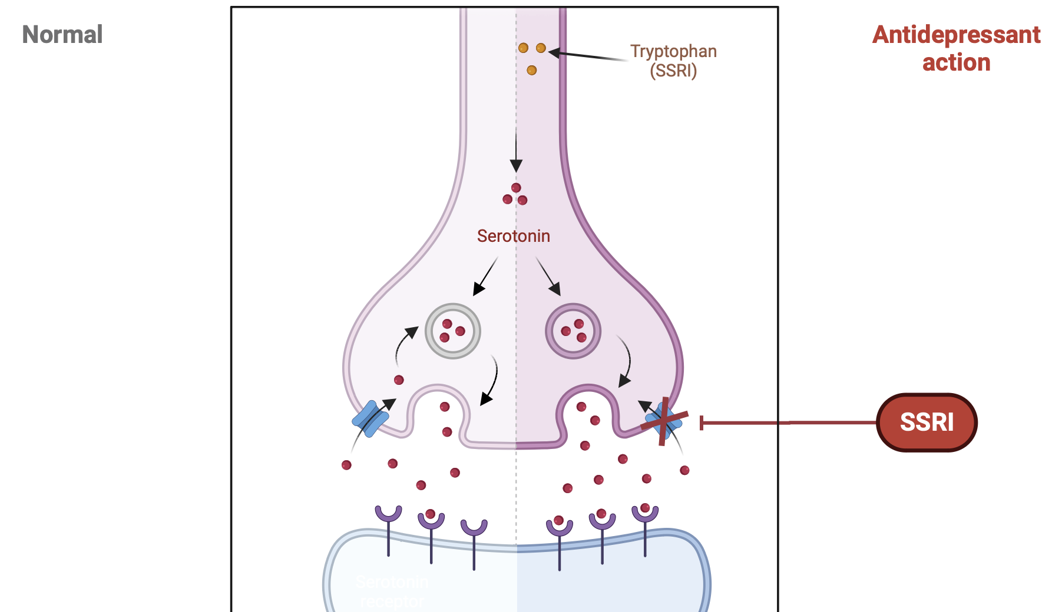
SSRI (Selective Serotonin Reuptake Inhibitor)
Unused serotonin pulled back into the neuron by reuptake
SSRI blocks reuptake - so more serotonin is available in synaptic gap
Serotonin reuptake transporter
Serotonin Receptor

Slide 7
SNRIs and Tricyclics
Noradrenaline is also a mood regulator.
SNRIs block Noradrenaline and serotonin reuptake.
SNRIs work better for some people than SSRIs.
TCAs block Norepinephrine and Serotonin reuptake.
TCAs → more severe side effects than SSRIs or SNRIs → used when patients don’t respond to these or have severe depression, OCD or bipolar disorder

Slide 8
Benzodiazepines (BZ)
BZs are anti-anxiety drugs (e.g., Diazepam).
They enhance the action of GABA, a calming neurotransmitter.
GABA slows down brain activity by telling neurons to stop firing.
About 40% of brain neurons respond to GABA – widespread impact

Slide 9
BZ action

Slide 10
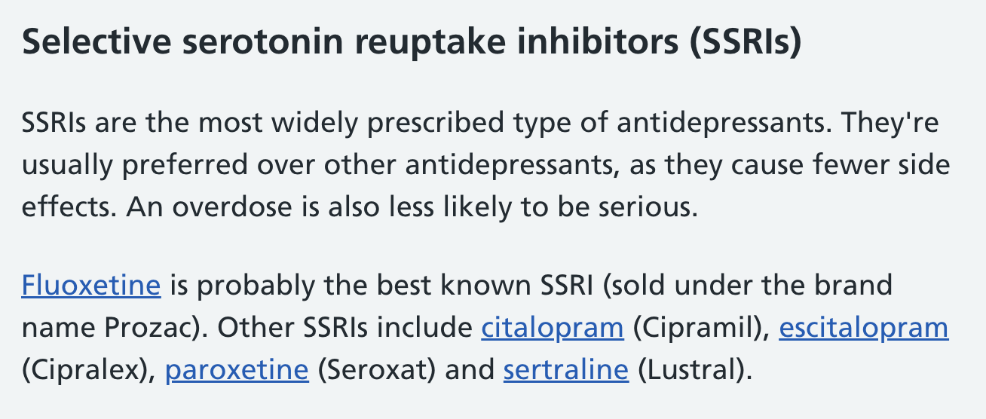
NHS Direct on SSRIs

Slide 11
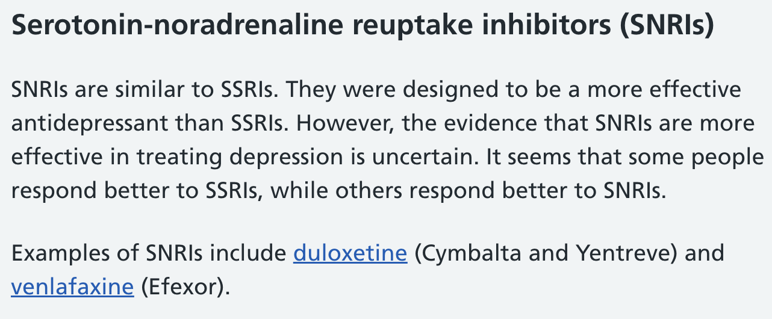
NHS Direct on SNRIs

Slide 12
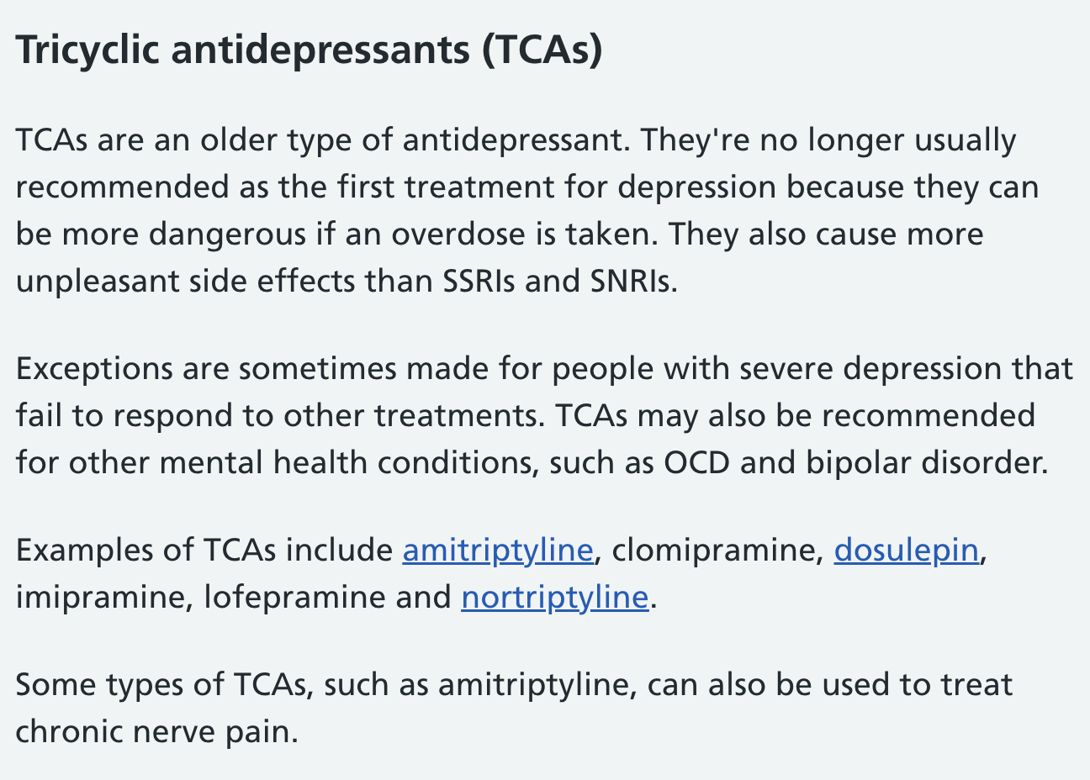
NHS Direct on Tricyclics

Slide 13
SSRI = selective serotonin re-uptake inhibitor

Slide 16
Evaluating drug therapies for OCD
Are they effective? What’s the evidence?
How do they compare to psychological treatments (e.g., CBT)?
What are the side effects?
Do drugs treat the symptoms and not the cause of disorders?

