Slide 1
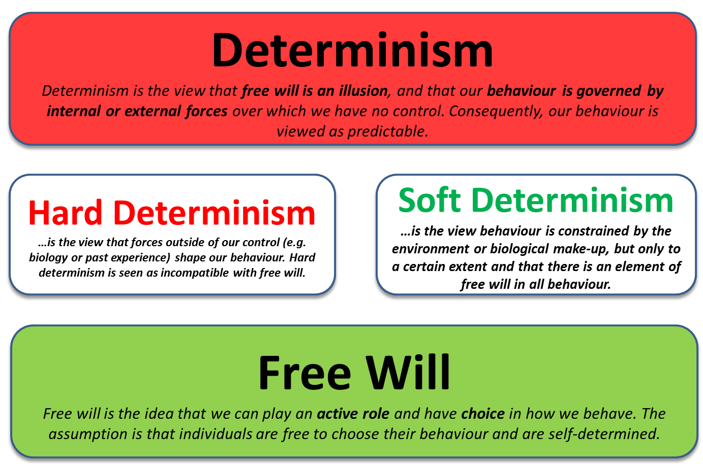
Issues & Debates
Free Will vs. Determinism

Slide 2

Session Overview
Definitions
Types of Questions
Essay Writing
Determinism
Multiple Choice
Application
Essays
Discuss the free will vs. determinism debate
Hard/Soft
Biological
Environmental
Psychic
Free Will
Short-Answer

Slide 3


Do you agree or disagree?
I have free will and can decide when I get out of bed.
20 Seconds
My behaviour is determined by my circadian rhythm (biological factor) and expectations of my boss Jim (environmental factor).

Slide 4

Do you agree or disagree?
I have free will and can choose not to visit my boring grandparents.
20 Seconds
My behaviour is determined by feelings of guilt (environmental factor) and therefore I visit my grandparents to remove these feelings (negative reinforcement).

Slide 5

Do you agree or disagree?
I have free will and can choose not to visit my boring grandparents.

Slide 6

Free Will is an Illusion
The idea that free will is an illusion is an ongoing philosophical debates.
An American Author and Neuroscientist Sam Harris, argued that free will is an illusion: our actions are the product of brain states, which are themselves the result of prior causes which in turn are generated by a universe over which we have no control.
Therefore, you are in this webinar not through choice, but through a combination of biological and environmental factors, in other words your behaviour is determined.

Slide 7

Definitions
Determinism: hard determinism and soft determinism; biological, environmental and psychic determinism.

Slide 8

Determinism
Determinism is the view that free will is an illusion, and that our behaviour is governed by internal or external forces over which we have no control. Consequently, our behaviour is viewed as predictable.
Hard Determinism
…is the view that forces outside of our control (e.g. biology or past experience) shape our behaviour. Hard determinism is seen as incompatible with free will.
Soft Determinism
…is the view behaviour is constrained by the environment or biological make-up, but only to a certain extent and that there is an element of free will in all behaviour.
Notes:
Hard determinism would suggest that the lady in this picture has no control over which item of food she will eat, through a combination of biological factors (preference for sweet foods as sweet is associated with energy) and environmental factors (the artificial taste is pleasing – positive reinforcement), she has no choice. Soft determinism suggests that the her behaviour is constrained and while she might be more inclined to eat the cupcake, she has the ability to exercise her own free will and resist the temptation.

Slide 9
Biological Determinism
Biological determinism refers to the idea that all human behaviour is innate and determined by genes.
Environmental Determinism
Environmental determinism is the view that behaviour is caused by forces outside the individual. Therefore, behaviour is caused by previous experience learned through classical and operant conditioning.
Psychic Determinism
Psychic determinism claims that human behaviour is the result of childhood experiences and innate drives (ID, Ego and Superego), as in Freud’s model of psychological development.
Year 1 – Psychopathology: The biological approach suggests that OCD is partly genetic. Nestadt et al. (2000) found that people with first-degree relatives who suffer from OCD are five times more likely to suffer from OCD at some point in their lives.
Year 1 – Psychopathology: The behaviourist approach suggests that phobias are acquired through classical conditioning and maintained through operant conditioning and therefore, to some extent, environmentally determined.
Year 2 – Gender/Forensic: The psychodynamic approach suggests that gender behaviours are acquired during the phallic stage of development, through the resolution of the Oedipus Complex or Electra complex, where children identify with the same sex parent.

Slide 10
Biological Determinism
Biological determinism refers to the idea that all human behaviour is innate and determined by genes.
Environmental Determinism
Environmental determinism is the view that behaviour is caused by forces outside the individual. Therefore, behaviour is caused by previous experience learned through classical and operant conditioning.
Psychic Determinism
Psychic determinism claims that human behaviour is the result of childhood experiences and innate drives (ID, Ego and Superego), as in Freud’s model of psychological development.
Year 1 – Psychopathology: The biological approach suggests that OCD is partly genetic. Nestadt et al. (2000) found that people with first-degree relatives who suffer from OCD are five times more likely to suffer from OCD at some point in their lives.
Year 1 – Psychopathology: The behaviourist approach suggests that phobias are acquired through classical conditioning and maintained through operant conditioning and therefore, to some extent, environmentally determined.
Year 2 – Gender/Forensic: The psychodynamic approach suggests that gender behaviours are acquired during the phallic stage of development, through the resolution of the Oedipus Complex or Electra complex, where children identify with the same sex parent.

Slide 11
Determinism
Determinism is the view that free will is an illusion, and that our behaviour is governed by internal or external forces over which we have no control. Consequently, our behaviour is viewed as predictable.
Hard Determinism
…is the view that forces outside of our control (e.g. biology or past experience) shape our behaviour. Hard determinism is seen as incompatible with free will.
Soft Determinism
…is the view behaviour is constrained by the environment or biological make-up, but only to a certain extent and that there is an element of free will in all behaviour.
Free Will
Free will is the idea that we can play an active role and have choice in how we behave. The assumption is that individuals are free to choose their behaviour and are self-determined.
Notes:
Treatment
Representation = how you portray someone through academic research
At this point I’m going to stop

Slide 12
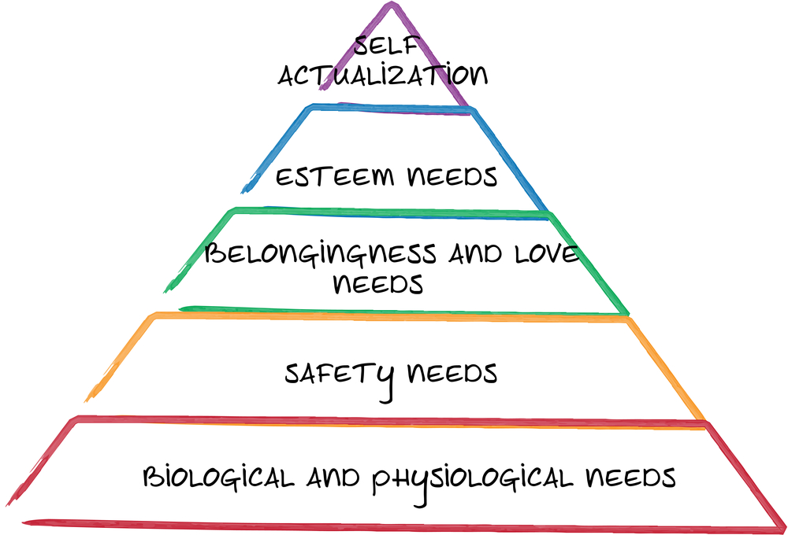
Free Will
Free will is the idea that we can play an active role and have choice in how we behave. The assumption is that individuals are free to choose their behaviour and are self-determined.
Year 2 – Approaches in Psychology: Humanist psychologists argue against the determinism view, claiming that humans have self-determination and free will and that behaviour is not the result of any single cause.
Notes:
Treatment
Representation = how you portray someone through academic research
At this point I’m going to stop

Slide 13

Types of Questions
Multiple Choice, Short Answer, Application Essay

Slide 14
Multiple Choice Questions
Short Answer
Which two of the following statements describes a free will point of view? [2 marks]
Explain what is meant by hard determinism and soft determinism. [4 marks]
Applied
“Research suggests that depression runs in the family. However, many depressed people also have other issues, including social problems, or problems with drink or drugs. Despite these challenges, many depressed people overcome their depression and find ways to resolve their issues.” With reference to the extract above, explain what is meant by ‘determinism’. Refer to at least two types of determinism in your answer. [6 marks]
Essay
Discuss the free will and determinism debate in psychology [16 marks]
A People are not responsible for their own actions
B People behave in a random fashion
C Behaviour always has a cause
D People exercise full choice over how they behave
E People have no choice about how to act

Slide 15
Multiple Choice Questions
Short Answer
Which two of the following statements describes a free will point of view? [2 marks]
Explain what is meant by hard determinism and soft determinism. [4 marks]
Applied
“Research suggests that depression runs in the family. However, many depressed people also have other issues, including social problems, or problems with drink or drugs. Despite these challenges, many depressed people overcome their depression and find ways to resolve their issues.” With reference to the extract above, explain what is meant by ‘determinism’. Refer to at least two types of determinism in your answer. [6 marks]
Essay
Discuss the free will and determinism debate in psychology [16 marks]
A People are not responsible for their own actions
B People behave in a random fashion
C Behaviour always has a cause
D People exercise full choice over how they behave
E People have no choice about how to act

Slide 16
Multiple Choice Questions
Multiple Choice Questions
Which two of the following statements describes a free will point of view? [2 marks]
  A People are not responsible for their own actions
  B People behave in a random fashion
  C Behaviour always has a cause
  D People exercise full choice over how they behave
  E People have no choice about how to act
MCQs typically require knowledge of definitions.
So what are the correct answers?
B & D
20 Seconds

Slide 17
Short Answer
  Explain what is meant by hard determinism and soft determinism. [4 marks]
Applied
  “Research suggests that depression runs in the family. However, many depressed people also have other issues, including social problems, or problems with drink or drugs. Despite these challenges, many depressed people overcome their depression and find ways to resolve their issues.” With reference to the extract above, explain what is meant by ‘determinism’. Refer to at least two types of determinism in your answer. [6 marks]
Essay
  Discuss the free will and determinism debate in psychology [16 marks]

Slide 18
Applied
  “Research suggests that depression runs in the family. However, many depressed people also have other issues, including social problems, or problems with drink or drugs. Despite these challenges, many depressed people overcome their depression and find ways to resolve their issues.” With reference to the extract above, explain what is meant by ‘determinism’. Refer to at least two types of determinism in your answer. [6 marks]
Determinism is the view that free will is an illusion, and that our behaviour is governed by internal or external forces over which we have no control. There are different types of determinism including biological, environmental and psychic determinism.
Biological determinism is the idea that behaviour is controlled by aspects of biology. The extract states that ‘depression runs in the family’ which implies that depression may be biologically determined and the result of genetics.
However, the extract also suggests that many people who suffer from depression also have ‘other issues, including social problems’ which suggests that behaviour might be determined by external influences such as their parents or society, which implies that environmental determinism may also play a role.

Slide 19

Essay Writing
Discuss the free will and determinism debate in psychology.
[16 marks]

Slide 20
Essay
  Discuss the free will and determinism debate in psychology [16 marks]
Discuss = outline & evaluate
Approximately 20-25 minutes
~500 Words
~175 Words AO1 (6 marks)
~325 Words AO3 (10 marks)

Slide 21

Essay
  Discuss the free will and determinism debate in psychology [16 marks]
AO1: Determinism
Soft/Hard
Biological
Environmental
Psychic
AO1: Free Will
Free Will – Humanist Example
WITH EXAMPLES
Notes:
. i.e. the decision to move the finger was a pre-determined action of the brain.

Slide 22
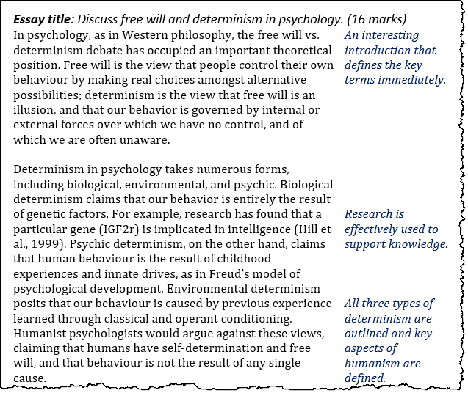

Slide 23
Essay
  Discuss the free will and determinism debate in psychology [16 marks]
AO1: Determinism
Soft/Hard
Biological
Environmental
Psychic
AO1: Free Will
Free Will – Humanist Example
WITH EXAMPLES
AO3: Humanist Argument/Evidence Against Determinism
Twin Studies: MZ studies typically find an 80% similarity in intelligence scores and a 40% similarity in the likelihood of depression.
AO3: Determinism Provides an ‘Excuse’
Stephen Mobley argued that he was ‘born to kill’ after killing a pizza shop manager, because his family had a disposition towards violence. This argument was rejected in court.
AO3: Free Will is an Illusion
Skinner argues that free will is an illusion. Libet et al. (1983) found that the motor regions of the brain become active before a person registers conscious awareness of a decision.
Notes:
. i.e. the decision to move the finger was a pre-determined action of the brain.

Slide 24
Essay
  Discuss the free will and determinism debate in psychology [16 marks]
AO1: Determinism
Soft/Hard
Biological
Environmental
Psychic
AO1: Free Will
Free Will – Humanist Example
WITH EXAMPLES
AO3: Humanist Argument/Evidence Against Determinism
Twin Studies: MZ studies typically find an 80% similarity in intelligence scores and a 40% similarity in the likelihood of depression.
AO3: Determinism Provides an ‘Excuse’
Stephen Mobley argued that he was ‘born to kill’ after killing a pizza shop manager, because his family had a disposition towards violence. This argument was rejected in court.
AO3: Free Will is an Illusion
Skinner argues that free will is an illusion. Libet et al. (1983) found that the motor regions of the brain become active before a person registers conscious awareness of a decision.
Notes:
. i.e. the decision to move the finger was a pre-determined action of the brain.

Slide 25

Essay Writing
Point
Evidence or Example
Explain
Humanist psychologists would argue against the idea of determinism, claiming that humans have self-determination and free will.
Furthermore, there is evidence to support this claim. Identical twin studies typically find an 80% similarity in intelligence scores and a 40% similarity in the likelihood of depression.
However, as identical twins share 100% of their genes, these results suggest that 20% is caused by other (environmental) factors. This demonstrates that biological determinism is unable to explain any particular behaviour, in this case, depression and intelligence.

Slide 26

Essay Writing
Point
Evidence / Example
Explain 1
Explain 2
Humanist psychologists would argue against the idea of determinism, claiming that humans have self-determination and free will.
Furthermore, there is evidence to support this claim. Identical twin studies typically find an 80% similarity in intelligence scores and a 40% similarity in the likelihood of depression. However, as identical twins share 100% of their genes, these results suggest that 20% is caused by other (environmental) factors.
However, as identical twins share 100% of their genes, these results suggest that 20% is caused by other (environmental) factors. This demonstrates that biological determinism is unable to explain any particular behaviour, in this case, depression and intelligence.
The same evidence indicates that no behaviour is completely environmentally determined. If identical twins only show an 80% likeness in terms of intelligence, it is therefore assumed that only 20% is caused by the environment, highlighting a limitation with biological and environmental determinism

Slide 27
Essay
  Discuss the free will and determinism debate in psychology [16 marks]
AO1: Determinism
Soft/Hard
Biological
Environmental
Psychic
AO1: Free Will
Free Will – Humanist Example
WITH EXAMPLES
AO3: Humanist Argument/Evidence Against Determinism
Twin Studies: MZ studies typically find an 80% similarity in intelligence scores and a 40% similarity in the likelihood of depression.
AO3: Determinism Provides an ‘Excuse’
Stephen Mobley argued that he was ‘born to kill’ after killing a pizza shop manager, because his family had a disposition towards violence. This argument was rejected in court.
AO3: Free Will is an Illusion
Skinner argues that free will is an illusion. Libet et al. (1983) found that the motor regions of the brain become active before a person registers conscious awareness of a decision.
Notes:
. i.e. the decision to move the finger was a pre-determined action of the brain.

Slide 28
Essay Writing
Point
Evidence or Example
Explain
Many psychologists, theorists and legal experts do not favour a deterministic point of view. If behaviour is determined by outside forces, that provides a potential excuse for criminal acts.
For example, in 1981 Stephen Mobley argued that he was ‘born to kill’ after killing a pizza shop manager, because his family had a disposition towards violence and aggressive behaviour. This argument was rejected by an American court.
Therefore, a hard determinist position may be undesirable as it provides an ‘excuse’, allowing people to mitigate their own liability and could lead to vexing legal issues regarding the nature of responsibility and intent (mens rea).

Slide 29
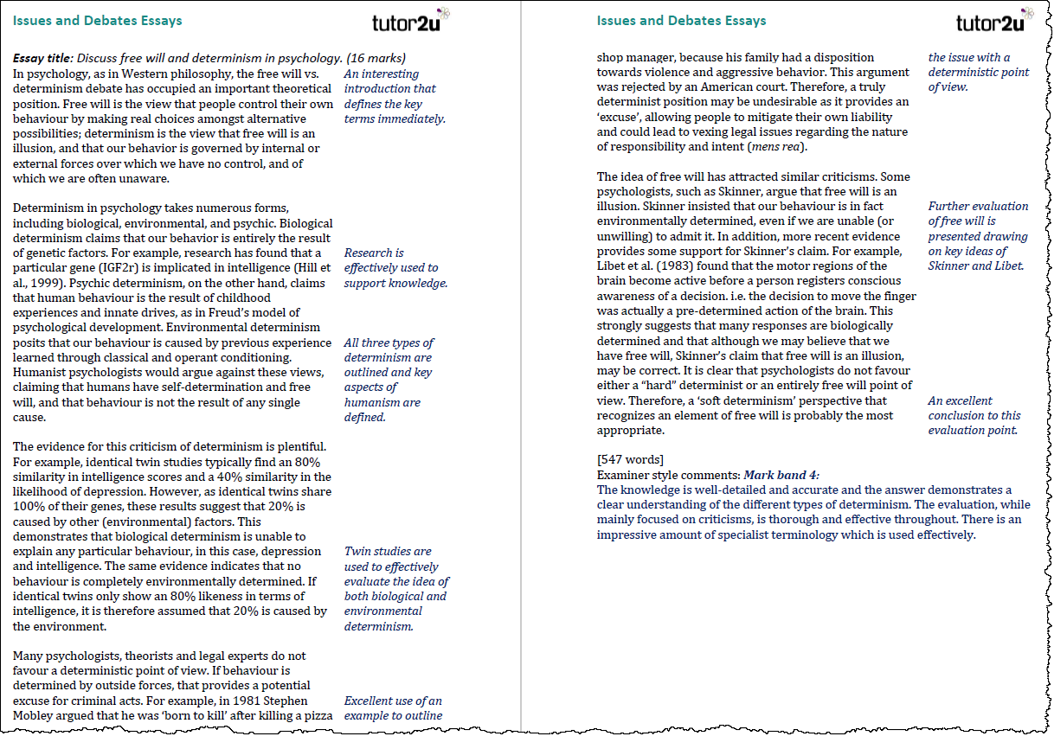

Slide 30

A Level Psychology Support from tutor2u
tutor2u is the leading provider of support for A Level Psychology Teachers and Students. Join our resource-sharing communities on Facebook and make full use of our resources on the free tutor2u Psychology Channel.
Facebook Groups:
AQA Psychology Teachers
Edexcel Psychology Teachers
OCR Psychology Teachers
A Level Psychology Students
Visit the tutor2u A Level Psychology Channel

