Slide 1
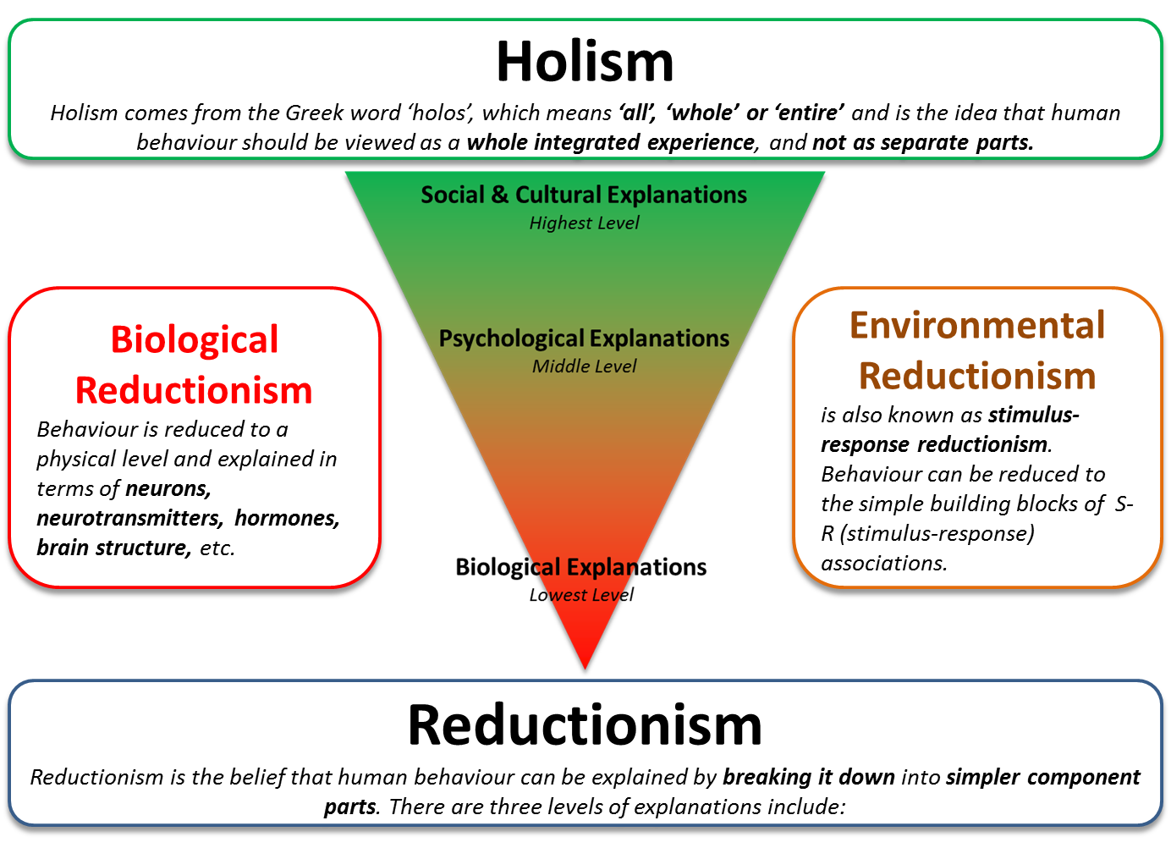
Issues & Debates
Holism & Reductionism

Slide 2

Holism and Reductionism Webinar
Definitions
Types of Questions
Essay Writing
Reductionism, including :
Essay
Discuss holism and reductionism in psychology. (16 marks)
Short-Answer
Biological
Environmental
Levels of Explanation
Holism
‘Application’ Essay

Slide 3

What do you see?
Describe what you see in relation to the following image.
20 Seconds

Slide 4
What do you see?
Describe what you see in relation to the following image.
Did you write ‘cube’?
Is so, you’re wrong. There is no cube.

Slide 5
What do you see?
Describe what you see in relation to the following image.
20 Seconds

Slide 6
What do you see?
Describe what you see in relation to the following image.
Did you write ‘lots of cones’?
Is so, then you’re trying to be smart!

Slide 7
The Loch Ness Monster?
The letter ‘S’
A bold white triangle
The sun
A cube
Another sun

Slide 8
Holism and Reductionism
The perception of these images can be explained by Gestalt Psychology.
Gestalt Psychology adopts a holistic approach to perception: when we perceive something in the real world, we do so as a whole rather than as a collection of bits and pieces.
Notes:
Gestalt Psychology was a movement in psychology founded in Germany in 1912, seeking to explain perception in terms of gestalts (form/shape) rather than by analysing their constituents.

Slide 9
Holism and Reductionism
If you examine the image on the right, what you will instantly perceive is the outline of a cube.
However, there is in fact no cube in the image and your mind has created a cube due to the position and configuration of the black shapes.

Slide 10

Definitions
Reductionism (Biological and Environmental), Levels of Explanation and Holism

Slide 11
Social & Cultural Explanations
(The influence of social groups on behaviour)
Highest Level
Psychological Explanations
(Cognitive,
Behavioural/Environmental)
Middle Level
Biological Explanations
(Neurochemical, Genetic,
Brain Structure, etc.)
Lowest Level
Reductionism
Reductionism is the belief that human behaviour can be explained by breaking it down into simpler component parts.
Notes:
The reductionist approach suggests that there are different levels of explanation, or levels in which we can break down behaviour.

Slide 12
Year 1 Topic Memory: Memory could be explained at a social and cultural level, as research suggests that cultural expectations affect what we remember and how we recall information. (Bartlett, 1932 – Schema Theory).
Social & Cultural Explanations
(The influence of social groups on behaviour)
However, memory can also be considered at a psychological level. For example, cognitive psychologists examine particular aspects of memory. For example, Miller (1956) examined the capacity of STM and Peterson and Peterson (1959) examined the duration of STM.
Psychological Explanations
(Cognitive,
Behavioural/Environmental)
Biological Explanations
(Neurochemical, Genetic,
Brain Structure, etc.)
Finally, memory can also be considered in terms of biological components. For example, Maguire et al. (2000) found an association between the size of the hippocampus and memory for spatial navigation.
Reductionism
Reductionism is the belief that human behaviour can be explained by breaking it down into simpler component parts.
Notes:
The reductionist approach suggests that there are different levels of explanation, or levels in which we can break down behaviour.

Slide 13
Biological
Reductionism
refers to the way that biological psychologists try to reduce behaviour to a physical level and explain it in terms of neurons, neurotransmitters, hormones, brain structure, etc.
Environmental Reductionism
is also known as stimulus-response reductionism. Behaviourists assume that all behaviour can be reduced to the simple building blocks of S-R (stimulus-response) associations and that complex behaviours are a series of S-R chains.
Reductionism
Reductionism is the belief that human behaviour can be explained by breaking it down into simpler component parts.

Slide 14


Year 1 Psychopathology: The biological approach claims that OCD is caused by higher levels of dopamine and lower levels of serotonin.
Year 1 Psychopathology: The behaviourist approach claims that phobias are initiated through classical conditioning and maintained through operant conditioning.
Biological
Reductionism
refers to the way that biological psychologists try to reduce behaviour to a physical level and explain it in terms of neurons, neurotransmitters, hormones, brain structure, etc.
Environmental Reductionism
is also known as stimulus-response reductionism. Behaviourists assume that all behaviour can be reduced to the simple building blocks of S-R (stimulus-response) associations and that complex behaviours are a series of S-R chains.

Slide 15
Holism
Holism comes from the Greek word ‘holos’, which means ‘all’, ‘whole’ or ‘entire’ and is the idea that human behaviour should be viewed as a whole integrated experience, and not as separate parts.
Biological
Reductionism
refers to the way that biological psychologists try to reduce behaviour to a physical level and explain it in terms of neurons, neurotransmitters, hormones, brain structure, etc.
Environmental Reductionism
is also known as stimulus-response reductionism. Behaviourists assume that all behaviour can be reduced to the simple building blocks of S-R (stimulus-response) associations and that complex behaviours are a series of S-R chains.
Reductionism
Reductionism is the belief that human behaviour can be explained by breaking it down into simpler component parts.

Slide 16
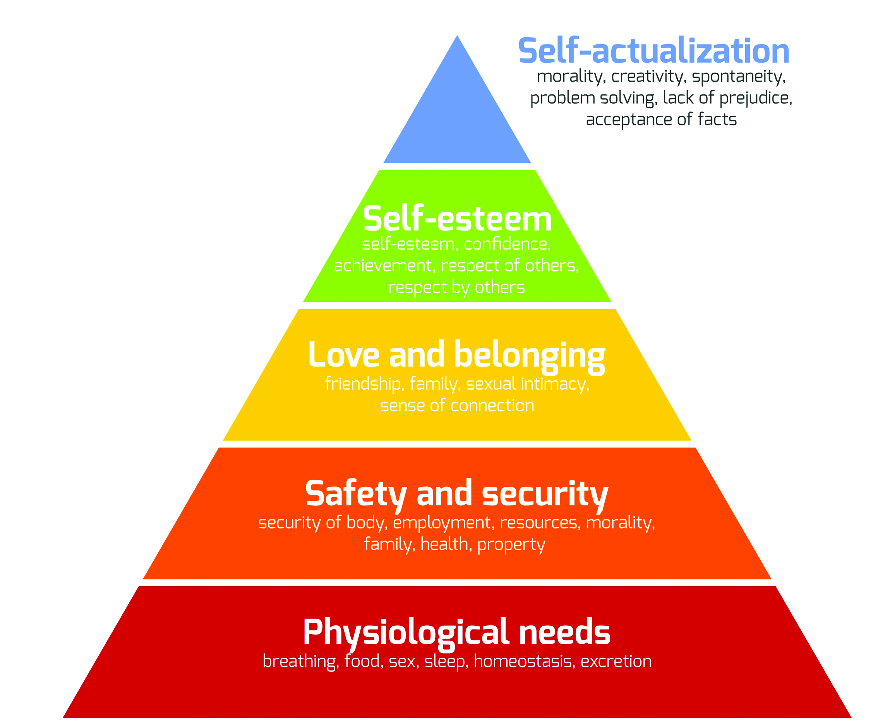
Holism
Holism comes from the Greek word ‘holos’, which means ‘all’, ‘whole’ or ‘entire’ and is the idea that human behaviour should be viewed as a whole integrated experience, and not as separate parts.
Gestalt Psychology
Gestalt psychology adopts a holistic approach to perception: when we perceive something in the real world, we do so as a whole rather than as a collection of bits and pieces.
Humanistic Psychology
Humanistic psychology argues that humans react to stimuli as an organised whole, rather than a set of stimulus-response links. As an approach, it uses qualitative methods to investigate all aspects of the individual, as well as the interactions between people.

Slide 17
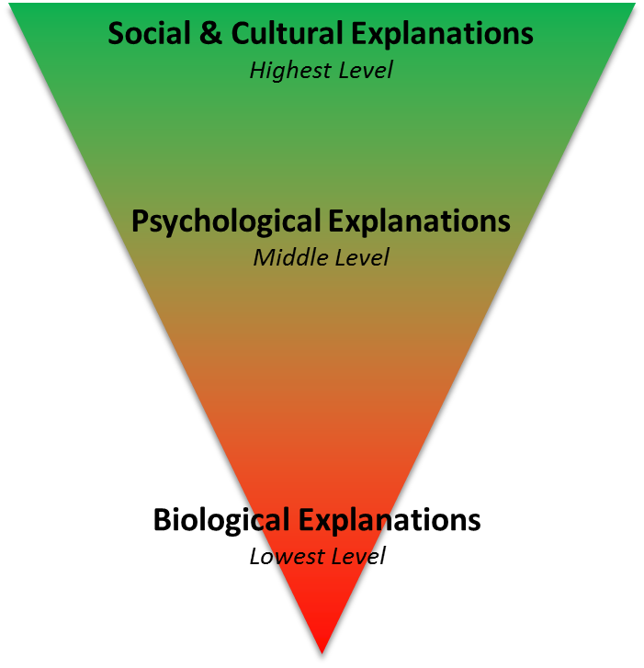
Holism
Holism comes from the Greek word ‘holos’, which means ‘all’, ‘whole’ or ‘entire’ and is the idea that human behaviour should be viewed as a whole integrated experience, and not as separate parts.
Biological
Reductionism
Behaviour is reduced to a physical level and explained in terms of neurons, neurotransmitters, hormones, brain structure, etc.
Environmental Reductionism
is also known as stimulus-response reductionism.
Behaviour can be reduced to the simple building blocks of S-R (stimulus-response) associations.
Reductionism
Reductionism is the belief that human behaviour can be explained by breaking it down into simpler component parts. There are three levels of explanations include:
Notes:
The reductionist approach suggests that there are different levels of explanation.

Slide 18

Types of Questions
Short Answer, Essay, ‘Application Essay’

Slide 19
Short Answer
Explain what psychologists mean by ‘levels of explanation’ in relation to reductionism. [3 marks]
Short Answer
Give an example of biological reductionism from an area of psychology you have studied. [3 marks]
Essay
Discuss holism and reductionism in psychology. [16 marks]
‘The best way to understand and explain behaviour is to reduce it to the simplest component parts.’ In the context of the holism-reductionism debate, discuss this view. Refer to at least one topic in your answer. (Total 16 marks)
Essay

Slide 20
Short Answer
Explain what psychologists mean by ‘levels of explanation’ in relation to reductionism. [3 marks]
Short Answer
Give an example of biological reductionism from an area of psychology you have studied. [3 marks]
Essay
Discuss holism and reductionism in psychology. [16 marks]
‘The best way to understand and explain behaviour is to reduce it to the simplest component parts.’ In the context of the holism-reductionism debate, discuss this view. Refer to at least one topic in your answer. (Total 16 marks)
Essay

Slide 21
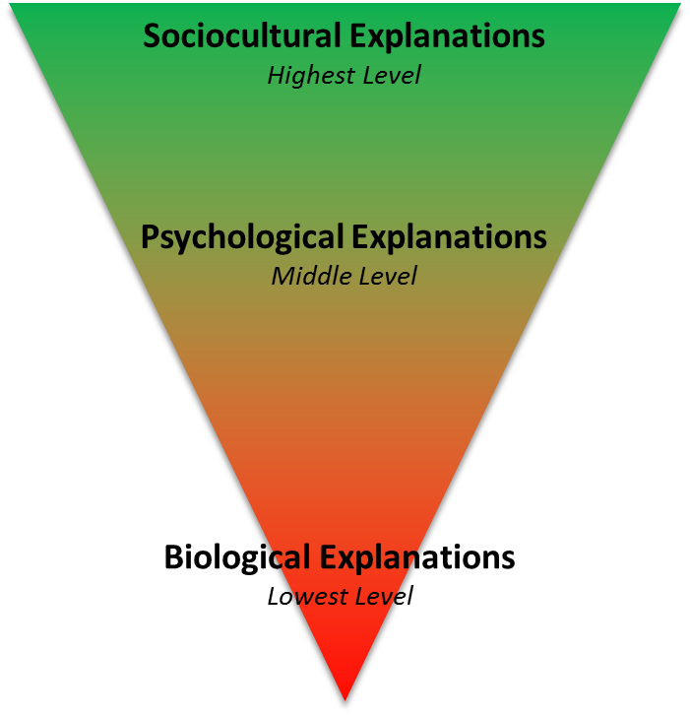
Short Answer
  Explain what psychologists mean by ‘levels of explanation’ in relation to reductionism. [3 marks]
Reductionism
Reductionism is the belief that human behaviour can be explained by breaking it down into simpler component parts. There are three levels of explanations include:
The reductionism approach argues is that human behaviour can be explained by breaking it down into simpler component parts.
There are three different levels of explanation within reductionism: 1) higher levels take into account social and cultural factors; 2) middle levels which reduce behaviour to more simple psychological explanations; 3) lower levels which reduces behaviour to individual biological factors (e.g. neurochemistry, genes, brain structure, etc.)

Slide 22
Short Answer
  Give an example of biological reductionism from an area of psychology you have studied. [3 marks]
One example of biological reductionism comes from the Year 1 Psychopathology topic.
The biological approach argues that obsessive compulsive disorder is caused by increased levels of dopamine and lower levels of serotonin and therefore reduces the cause of OCD down to an imbalance of neurotransmitters.
Biological
Reductionism
refers to the way that biological psychologists try to reduce behaviour to a physical level and explain it in terms of neurons, neurotransmitters, hormones, brain structure, etc.
Year 1 Psychopathology: The biological approach claims that OCD is caused by higher levels of dopamine and lower levels of serotonin.

Slide 23

Essay Writing
Discuss holism and reductionism in psychology. [16 marks]

Slide 24
Essay
  Discuss holism and reductionism in psychology. [16 marks]
Discuss = outline & evaluate
Approximately 20-25 minutes
~500 Words
~175 Words AO1 (6 marks)
~325 Words AO3 (10 marks)

Slide 25
Holism and Reductionism
[Introduction] AO1: The Holism and Reductionism Debate
AO1: Reductionism
Define Biological Reductionism
  Example - OCD
Define Environmental Reductionism
  Example - Phobias
AO1: Holism
Define Holism
  Example – Gestalt Psychology
NATURE
NURTURE

Slide 26
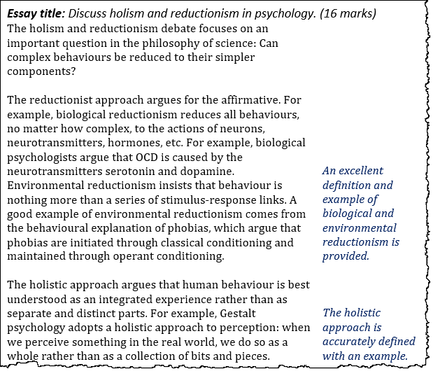

Slide 27
[Introduction] AO1: The Holism and Reductionism Debate
AO1: Reductionism
Define Biological Reductionism
  Example - OCD
Define Environmental Reductionism
  Example - Phobias
AO1: Holism
Define Holism
  Example – Gestalt Psychology
NATURE
NURTURE
AO3: Psychology as a Science
Experimental Reductionism
Causal Relationships
AO3: Real World Application
Biological Treatments
SSRIs for OCD
Soomro et al. (2008)
AO3: Reductionism is Limited
Ignores the complexity of behaviour
ADHD

Slide 28
[Introduction] AO1: The Holism and Reductionism Debate
AO1: Reductionism
Define Biological Reductionism
  Example - OCD
Define Environmental Reductionism
  Example - Phobias
AO1: Holism
Define Holism
  Example – Gestalt Psychology
NATURE
NURTURE
AO3: Psychology as a Science
Experimental Reductionism
Causal Relationships
AO3: Real World Application
Biological Treatments
SSRIs for OCD
Soomro et al. (2008)
AO3: Reductionism is Limited
Ignores the complexity of behaviour
ADHD

Slide 29

Essay Writing
Point
Evidence or Example
Explain
Scientists (including psychologists) are drawn to reductionist explanations.
For example, most experimental psychology is based on the assumption that human behaviour can be studied effectively in relatively simple experiments, where complex behaviour is reduced to isolated variables (known as experimental reductionism).
This allows researchers to study the different factors that influence human behaviour in a controlled manner while establishing causal relationships. Consequently, both biological and environmental reductionism are viewed as scientific approaches, whereas holism is not.

Slide 30
[Introduction] AO1: The Holism and Reductionism Debate
AO1: Reductionism
Define Biological Reductionism
  Example - OCD
Define Environmental Reductionism
  Example - Phobias
AO1: Holism
Define Holism
  Example – Gestalt Psychology
NATURE
NURTURE
AO3: Psychology as a Science
Experimental Reductionism
Causal Relationships
AO3: Real World Application
Biological Treatments
SSRIs for OCD
Soomro et al. (2008)
AO3: Reductionism is Limited
Ignores the complexity of behaviour
ADHD

Slide 31
Essay Writing
Point
Evidence or Example
Explain
Criticism of reductionism takes many forms. Some psychologists argue that biological reductionism can lead to errors of understanding because it ignores the complexity of human behaviour.
For example, to treat conditions like ADHD with drugs in the belief that the condition consists of nothing more than neurochemical imbalances is to mistake the symptoms of the phenomenon for its true cause. Ritalin may reduce these symptoms, but the conditions which gave rise to the ADHD have not been addressed.
Furthermore, since success rates of drug therapies are highly variable, the purely biological understanding seems inadequate and therefore explanations which consider multiple factors are more suitable.

Slide 32
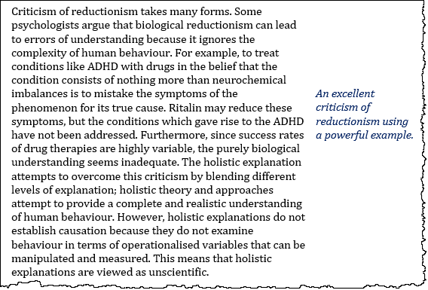

Slide 33
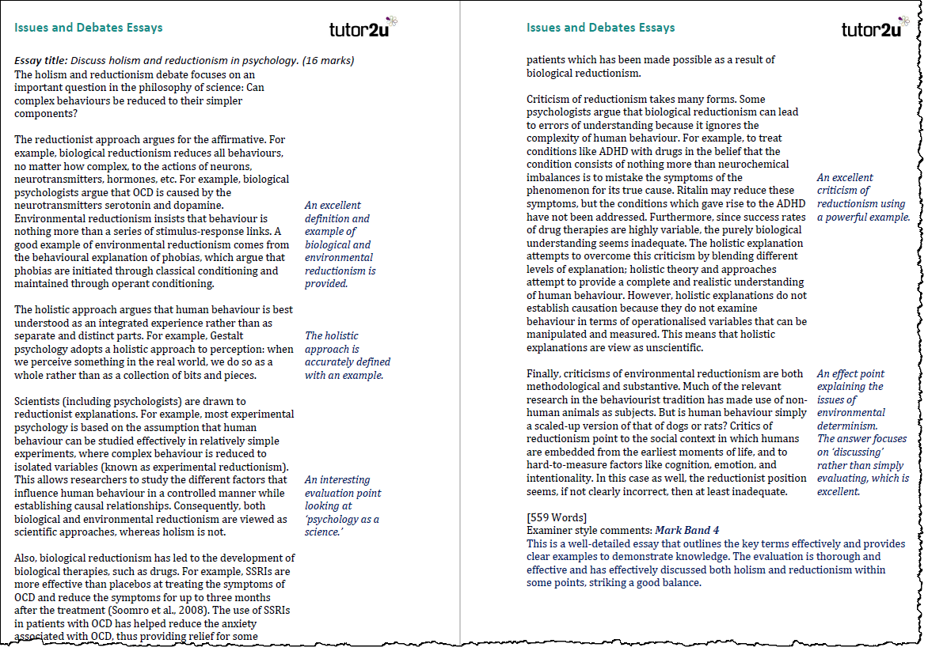
160
399
AO1
AO3

Slide 34

A Level Psychology Support from tutor2u
tutor2u is the leading provider of support for A Level Psychology Teachers and Students. Join our resource-sharing communities on Facebook and make full use of our resources on the free tutor2u Psychology Channel.
Facebook Groups:
AQA Psychology Teachers
Edexcel Psychology Teachers
OCR Psychology Teachers
A Level Psychology Students
Visit the tutor2u A Level Psychology Channel

