Slide 1
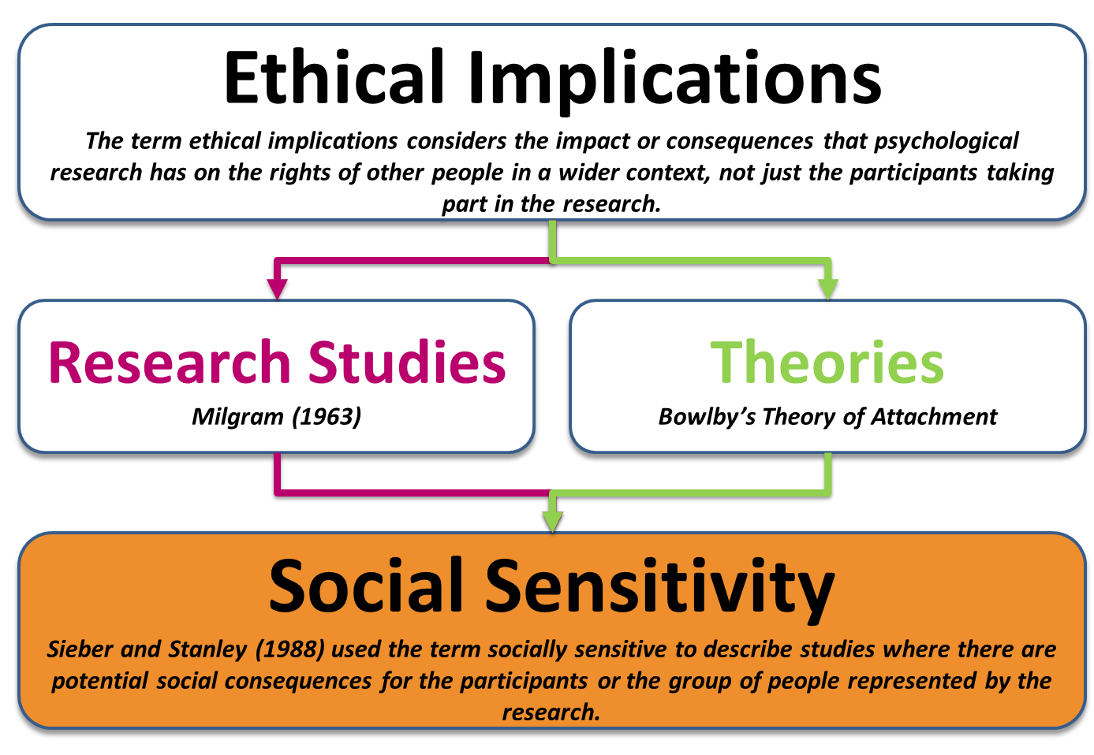
Issues & Debates
Social Sensitivity

Slide 2
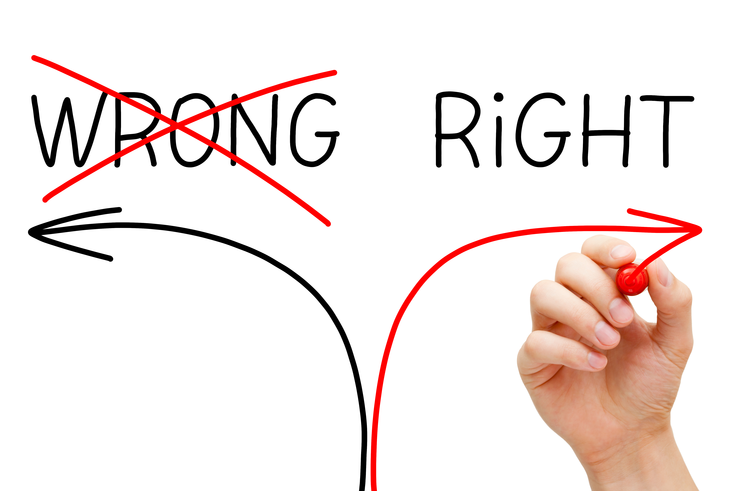
Social Sensitivity
Definitions & Examples
Types of Questions
Essay Writing
Ethical Implications
Application
Discuss the ethical implications of research studies and/or theory, including reference to social sensitivity. [16 marks]
Short-Answer
Essay
Social Sensitivity

Slide 3

Was it right for Milgram (1963) to conduct his research?
Yes/No. Justify Your Answer.

Slide 4

Was it right for Bowlby to publish his theory of attachment?
Yes/No. Justify Your Answer.

Slide 5

Definitions
Ethical Implications & Social Sensitivity

Slide 6

Ethical Guidelines
A set of principles set out by the BPS to help psychologists behave honestly and with integrity.
Ethical Issues
Issues that arise when there is conflict between the rights of the participant and the aims of the researcher(s).
Ethical Implications

Slide 7
Specification: Ethical implications of research studies and theory, including reference to social sensitivity.
Ethical Implications
Ethical implications considers the impact or consequences that psychological research has on the rights of other people in a wider context, not just the participants taking part in the research.
Research Studies
Milgram (1963)
Theories
Bowlby’s Theory of Attachment

Slide 8
Research Studies
Milgram (1963)
Did the ends justify the means?
The participants were deceived, they were unable to provide fully informed consent. The experiment was distressing.
However, they were debriefed and took part in a follow-up interview. Participants said that they suffered no long-term effects.
Therefore, it could be argued that the importance of the findings did justify the way the research was conducted, as the research is useful to society in determining the factors that affect obedience to authority.

Slide 9
Theories
Bowlby’s Theory of Attachment
Bowlby’s Theory of Attachment suggests that children form one special attachment bond, usually with their mother, which must take place within a critical period.
Bowlby also suggested that this attachment bond affects their future relationships through an internal working model.
While Bowlby’s theory has contributed to the development of childcare practices, it has also encouraged the view that a women’s place is at home with her children, which could make some mothers feel guilty for wanting to return to work, following childbirth.

Slide 10
Ethical Implications
The term ethical implications considers the impact or consequences that psychological research has on the rights of other people in a wider context, not just the participants taking part in the research.
Research Studies
Milgram (1963)
Theories
Bowlby’s Theory of Attachment
Social Sensitivity
Sieber and Stanley (1988) used the term socially sensitive to describe studies where there are potential social consequences for the participants or the group of people represented by the research.

Slide 11
Research Studies
Milgram (1963)
Did the ends justify the means?
The participants were deceived, they were unable to provide fully informed consent. The experiment was distressing.
However, they were debriefed and took part in a follow-up interview. Participants said that they suffered no long-term effects.
It could be argued that Milgram’s research is socially sensitive as the results could be used to ensure that people obey orders, including those they don’t wish to follow.
Therefore, it could be argued that the importance of the findings did justify the way the research was conducted, as the research is useful to society in determining the factors that affect obedience to authority.

Slide 12
Theories
Bowlby’s Theory of Attachment
Bowlby’s Theory of Attachment suggests that children form one special attachment bond, usually with their mother, which must take place within a critical period.
Bowlby also suggested that this attachment bond affects their future relationships through an internal working model.
Likewise, it could be argued that Bowlby’s Theory of Attachment is socially sensitive as it could be used to coerce mothers to stay at home and look after their children.
While Bowlby’s theory has contributed to the development of childcare practices, it has also encouraged the view that a women’s place is at home with her children, which could make some mothers feel guilty for wanting to return to work, following childbirth.

Slide 13
Research Studies
Milgram (1963)
Theories
Bowlby’s Theory of Attachment
Social Sensitivity
Sieber and Stanley (1988) used the term socially sensitive to describe studies where there are potential social consequences for the participants or the group of people represented by the research.

Slide 14
The Research Question
The researcher must consider their research question carefully. Asking questions like ‘Are there racial differences in IQ?’ or ‘Is intelligence inherited?’ may be damaging to members of a particular group.
The Methodology Used
The researcher needs to consider the treatment of the participant's and their right to confidentiality and anonymity. For example, if someone admits to committing a crime, should the researcher maintain confidentiality?
The Institutional Context
The researcher should be mindful of how the data is going to be used and consider who is funding the research. If the research is funded by a private institution or organisation, why are they funding the research and how do they intend to use the findings?
Interpretation and Application of Findings
Finally, the researcher needs to consider how their findings might be interpreted and applied in the real-world. Could their data or results be used to inform policy?

Slide 15
The Research Question
The researcher must consider their research question carefully. Asking questions like ‘Are there racial differences in IQ?’ or ‘Is intelligence inherited?’ may be damaging to members of a particular group.
The Methodology Used
The researcher needs to consider the treatment of the participant's and their right to confidentiality and anonymity. For example, if someone admits to committing a crime, should the researcher maintain confidentiality?
The Institutional Context
The researcher should be mindful of how the data is going to be used and consider who is funding the research. If the research is funded by a private institution or organisation, why are they funding the research and how do they intend to use the findings?
Interpretation and Application of Findings
Finally, the researcher needs to consider how their findings might be interpreted and applied in the real-world. Could their data or results be used to inform policy?

Slide 16

Social Sensitivity
Cyril Burt used studies of identical twins to support his view that intelligence is largely genetic.
His views greatly influenced the Hadow Report (1926) which led to the creation of the 11+ which was used from 1944-1976.
This meant that generations of children were affected by the 11+ exam.
However, it later transpired that his data was falsified.

Slide 17
The Research Question
Burt should have considered his research question carefully. For example, examining whether intelligence is genetic could have serious implications and lead to further research where psychologists try to discover ‘intelligent genes’.
The Methodology Used
Burt used twin studies as the basis of his investigation; however, it later transpired that his data was fabricated. Some psychologists even believe that he made up the names of his two researcher assistants who collected the data.
The Institutional Context
While Burt was working for the University of Liverpool at the time, he also worked for London County Council and other institutions and therefore he should have been mindful about the intended use of his research, following publication.
Interpretation and Application of Findings
Finally, and most significantly, Burt should have considered the severe implications of his findings which were used to inform policy. His views greatly influenced the Hadow Report (1926) which led to the creation of the 11+ which was used from 1944-1976.

Slide 18
The Research Question
Burt should have considered his research question carefully. For example, examining whether intelligence is genetic could have serious implications and lead to further research where psychologists try to discover ‘intelligent genes’.
The Methodology Used
Burt used twin studies as the basis of his investigation; however, it later transpired that his data was fabricated. Some psychologists even believe that he made up the names of his two researcher assistants who collected the data.
The Institutional Context
While Burt was working for the University of Liverpool at the time, he also worked for London County Council and other institutions and therefore he should have been mindful about the intended use of his research, following publication.
Interpretation and Application of Findings
Finally, and most significantly, Burt should have considered the severe implications of his findings which were used to inform policy. His views greatly influenced the Hadow Report (1926) which led to the creation of the 11+ which was used from 1944-1976.

Slide 19
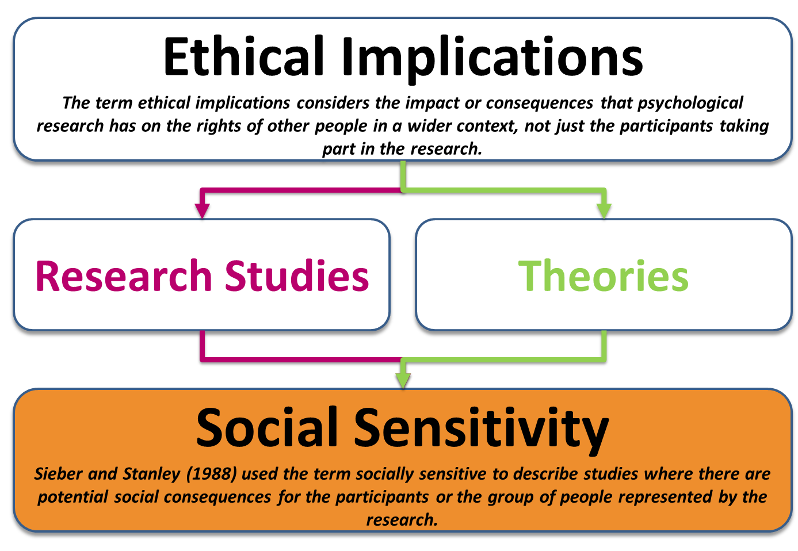
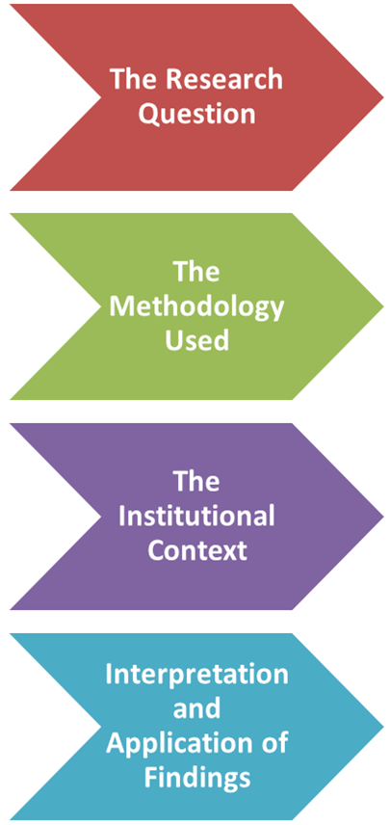

Slide 20

Types of Questions
Short-Answer, Application, Essay

Slide 21
Short-Answer Question
Explain what is meant by socially sensitive research. [3 marks]
Application
Briefly explain how the researchers could have dealt with the issue of social sensitivity in this study. [4 marks]
Essay
Discuss the ethical implications of research studies and/or theory, including reference to social sensitivity. [16 marks]

Slide 22
Short-Answer Question
Explain what is meant by socially sensitive research. [3 marks]
Application
Briefly explain how the researchers could have dealt with the issue of social sensitivity in this study. [4 marks]
Essay
Discuss the ethical implications of research studies and/or theory, including reference to social sensitivity. [16 marks]

Slide 23
Short-Answer Question
  Explain what is meant by socially sensitive research. [3 marks]
The term socially sensitive research is used to describe studies where there are potential social consequences for the participants or the group of people represented by the research.
For example, Milgram’s study could be considered as socially sensitive because the results could be used to ensure that people obey orders, including those they don’t wish to follow.

Slide 24

Short-Answer Question
  Explain what is meant by socially sensitive research. [3 marks]
Specification: Ethical implications of research studies and theory, including reference to social sensitivity.
Give an example of research that is socially sensitive.
Give an example of a theory that is socially sensitive.

Slide 25
Application
  Briefly explain how the researchers could have dealt with the issue of social sensitivity in this study. [4 marks]
In a study of antisocial activity and social background, researchers interviewed 100 children aged 14 years. They then classified each child according to their level of antisocial activity. They concluded that 26 were ‘very antisocial’, 40 were ‘mildly antisocial’ and 34 were ‘not antisocial’. The researchers found that the majority of the ‘very antisocial’ children attended Crayford secondary school, whereas most of the other two groups of children attended another local school.
The researchers need to be aware of the methodology they use including the treatment of the participants and their right to confidentiality and anonymity. In order to deal with this issue of social sensitivity the research needs to ensure that they do not publish the names of any students or the school, which they have not done in this extract as they have named ‘Crayford Secondary School’’.

Slide 26
Application
  Briefly explain how the researchers could have dealt with the issue of social sensitivity in this study. [4 marks]
In a study of antisocial activity and social background, researchers interviewed 100 children aged 14 years. They then classified each child according to their level of antisocial activity. They concluded that 26 were ‘very antisocial’, 40 were ‘mildly antisocial’ and 34 were ‘not antisocial’. The researchers found that the majority of the ‘very antisocial’ children attended Crayford secondary school, whereas most of the other two groups of children attended another local school.
Furthermore, the researchers need to consider the application of the findings which could have negative implications for the students, the school and the wider community. For example, the findings could lead to a self-fulfilling prophecy where the student think that their school is ‘anti-social’ and as result become more antisocial.

Slide 27
Application
  Briefly explain how the researchers could have dealt with the issue of social sensitivity in this study. [4 marks]
In a study of antisocial activity and social background, researchers interviewed 100 children aged 14 years. They then classified each child according to their level of antisocial activity. They concluded that 26 were ‘very antisocial’, 40 were ‘mildly antisocial’ and 34 were ‘not antisocial’. The researchers found that the majority of the ‘very antisocial’ children attended Crayford secondary school, whereas most of the other two groups of children attended another local school.
The researchers need to be aware of the methodology they use including the treatment of the participants and their right to confidentiality and anonymity. In order to deal with this issue of social sensitivity the research needs to ensure that they do not publish the names of any students or the school, which they have not done in this extract as they have named ‘Crayford Secondary School’’ Furthermore, the researchers need to consider the application of the findings which could have negative implications for the students, the school and the wider community. For example, the findings could lead to a self-fulfilling prophecy where the student think that their school is ‘anti-social’ and as result become more antisocial.

Slide 28

Essay Writing
Discuss the ethical implications of research studies and theory, including reference to social sensitivity. [16 marks]

Slide 29

Social Sensitivity
AO1: Ethical Implications & Social Sensitivity
Define Ethical Implications
Outline Sieber and Stanley’s four considerations for socially sensitive research
NATURE
NURTURE

Slide 30
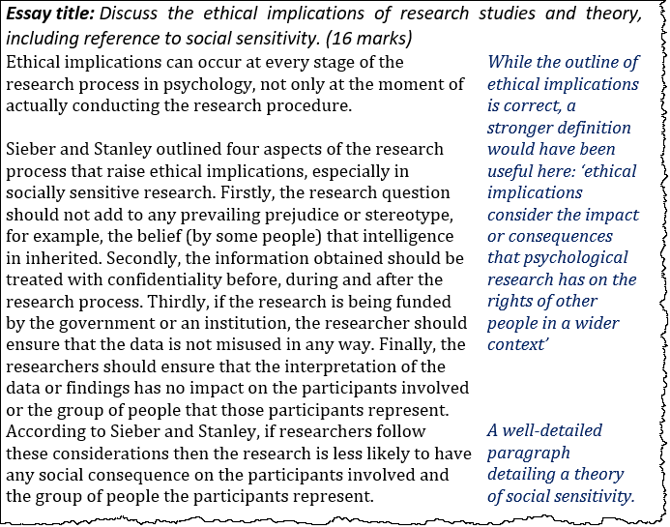

Slide 31
Social Sensitivity
AO1: Ethical Implications & Social Sensitivity
Define Ethical Implications
Outline Sieber and Stanley’s four considerations for socially sensitive research
NATURE
NURTURE
AO3: Issues of Discrimination
Racial Differences in IQ (Yerkes)
Eugenic Law
AO3: Real-World Application (EWT)
Flin et al.
Improved Accuracy in Child Eyewitnesses
AO3: Should we conduct socially sensitive research?
No – Due to issues highlighted above
Yes – Otherwise there would be no research

Slide 32
Social Sensitivity
AO1: Ethical Implications & Social Sensitivity
Define Ethical Implications
Outline Sieber and Stanley’s four considerations for socially sensitive research
NATURE
NURTURE
AO3: Issues of Discrimination
Racial Differences in IQ (Yerkes)
Eugenic Law
AO3: Real-World Application (EWT)
Flin et al.
Improved Accuracy in Child Eyewitnesses
AO3: Should we conduct socially sensitive research?
No – Due to issues highlighted above
Yes – Otherwise there would be no research

Slide 33

Essay Writing
Point
Evidence or Example
Explain
Socially sensitive research can lead to issues of discrimination and therefore some psychologists would argue against conducting this form of research.
For example, between 1907 and 1963, over 64,000 individuals were forcibly sterilised under eugenic legislation in the United States, and in 1972, the United States Senate Committee revealed that at least 2,000 involuntary sterilisations had been performed on poor black women without their consent or knowledge.
This could be ‘justified’ by (flawed) research findings (e.g. Robert Yerkes) which argued that black Americans had lower IQ scores in comparison to white Americans, highlighting a serious issue with socially sensitive research.

Slide 34
Social Sensitivity
AO1: Ethical Implications & Social Sensitivity
Define Ethical Implications
Outline Sieber and Stanley’s four considerations for socially sensitive research
NATURE
NURTURE
AO3: Issues of Discrimination
Racial Differences in IQ (Yerkes)
Eugenic Law
AO3: Real-World Application (EWT)
Flin et al.
Improved Accuracy in Child Eyewitnesses
AO3: Should we conduct socially sensitive research?
No – Due to issues highlighted above
Yes – Otherwise there would be no research

Slide 35
Essay Writing
Point
Evidence or Example
Explain
It is important to recognise that not all socially sensitive research is controversial and some is desirable and beneficial to society.
For example, research examining eye-witness testimony, especially the use of child witnesses (e.g. Flin et al.) has found that young children can be reliable witnesses if they are questioned in a timely and appropriate manner.
In this area, socially sensitive research has resulted in a good working relationship between psychologists and the legal profession to help improve the accuracy and validity of children eye-witnesses.

Slide 36
Social Sensitivity
AO1: Ethical Implications & Social Sensitivity
Define Ethical Implications
Outline Sieber and Stanley’s four considerations for socially sensitive research
NATURE
NURTURE
AO3: Issues of Discrimination
Racial Differences in IQ (Yerkes)
Eugenic Law
AO3: Real-World Application (EWT)
Flin et al.
Improved Accuracy in Child Eyewitnesses
AO3: Should we conduct socially sensitive research?
No – Due to issues highlighted above
Yes – Otherwise there would be no research

Slide 37
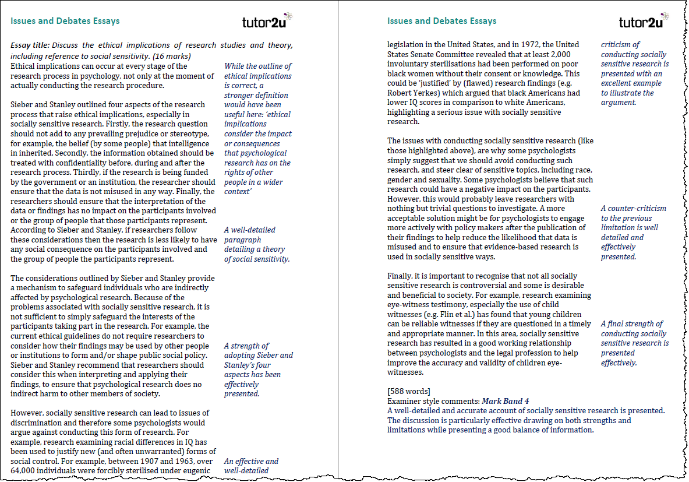

Slide 38

A Level Psychology Support from tutor2u
tutor2u is the leading provider of support for A Level Psychology Teachers and Students. Join our resource-sharing communities on Facebook and make full use of our resources on the free tutor2u Psychology Channel.
Facebook Groups:
AQA Psychology Teachers
Edexcel Psychology Teachers
OCR Psychology Teachers
A Level Psychology Students
Visit the tutor2u A Level Psychology Channel

