Slide 1
L/O TBAT outline and evaluate Milgram's research into obedience

Slide 2
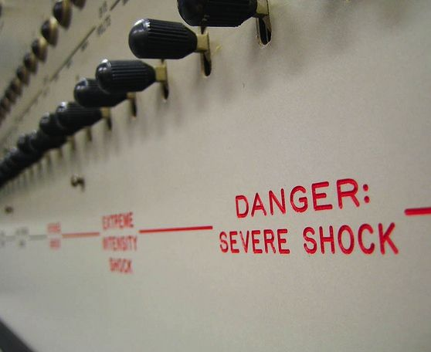
The Shock Machine
Starts at 45 V
Goes up in 15 V jumps
Ends at 450 V
How far would you go?

Slide 3
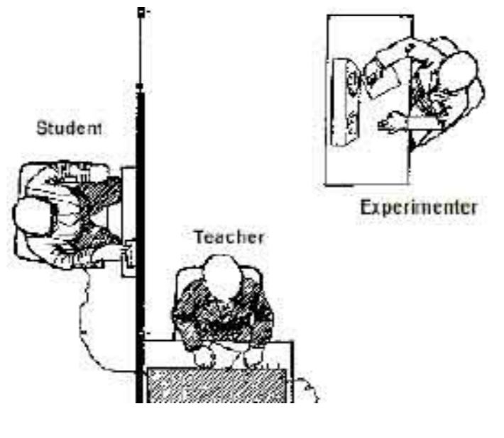
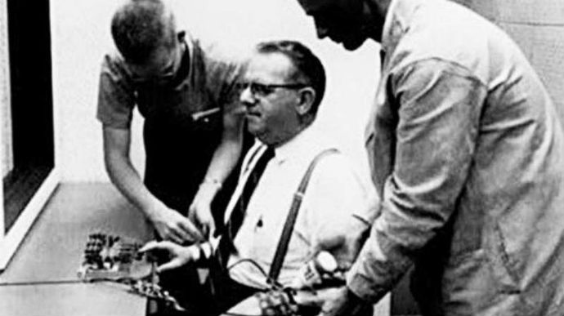
Describe what you see!

Slide 4
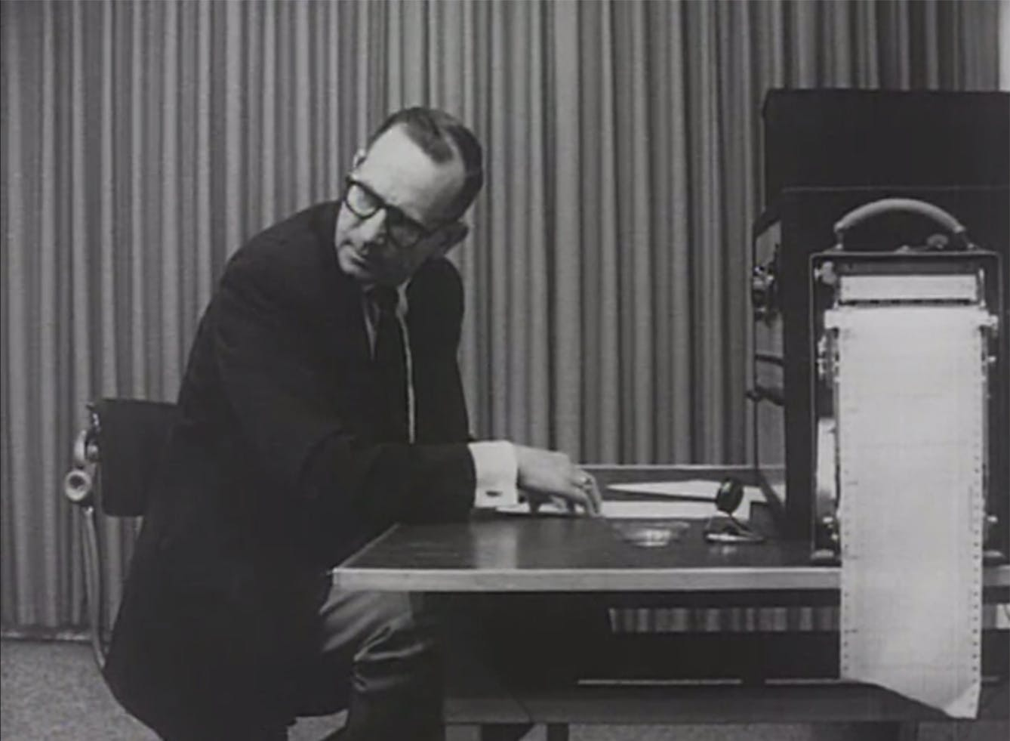
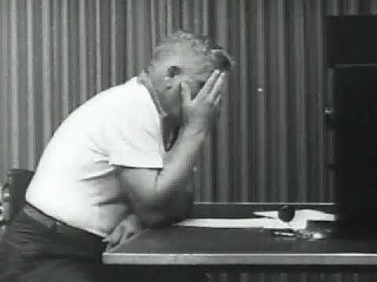
What are these participants doing? Why?

Slide 5
Milgram (1963) – Baseline study
This is variation ’5’
Milgram refined his procedure over variations 1-4
Milgram used the results of this ‘baseline’ study to compare what happened when he made changes (variations)

Slide 6


Slide 7
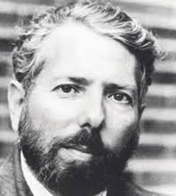
Stanley Milgram
Born on August 15, 1933, in New York City to Jewish immigrant parents, Milgram earned a BA in political science from Queens College and later a PhD in social psychology from Harvard University in 1960
He is best known for his controversial obedience experiments conducted at Yale in the early 1960s, which demonstrated how ordinary people could commit harmful acts under the influence of authority
Milgram also developed the "Small World Experiment," which led to the concept of "six degrees of separation"
Milgram’s work profoundly influenced social psychology and ethics in research.
He died on December 20, 1984, at the age of 51 in New York

Slide 8
Stanley Milgram
BBC Documentary

Slide 9
Think / pair / share
Why do you think participants obeyed in this study?
The original study was conducted in the 1960s, would the study work today? Why/why not?
Why might many people still think this study was unethical and should not have been done?

Slide 10
Key term - obedience
A form of social influence in which an individual follows a direct order
The person giving the order is usually an authority figure who has the power to punish disobedient behaviour.

Slide 11
Experimenter
This is a movie about Milgram's work and life
It covers more than just the shock generator experiments
As we watch the procedure I'll stop the film, then let you write down key elements of the procedure onto a whiteboard
Notes:
Use either Amazon (Watch Experimenter | Prime Video (amazon.co.uk))
Or DVD version – first 9/10 minutes up to the lift scene with his future wife!

Slide 12
Evaluating Milgram's research into obedience

Slide 13
Supporting evidence: The Game of Death
Ppts thought they were contestants in a new game show
Paid to give electric shocks when ordered to other (fake) pts
This was done in front of a studio audience
Write down what % you think when to the max voltage
Answer: 80% went to 460 V

Slide 14
Limitation: did participants think it was real?
If they didn’t → low internal validity
Milgram: 75% ppts said they thought shocks were real
BUT
Orne and Holland (1968) argued that they were ’play-acting’
AND
Gina Perry (2013) listened to the recordings again: 50% thought shocks were real, 66% of these went to 450 V

Slide 15
Sheridan and King (1972)
Would pts give FATAL electric shocks to an innocent puppy?
Write down your predictions for males and females
Males: 54%
Females: 100%

Slide 16
Notes/reading: Obedience – Milgram (1963)
A01 (description)
A03 (evaluation)
Procedure: who, what, how
Findings
Conclusions
Research support
Low internal validity vs puppies!
Alternative explanation
  Not ‘blind’ obedience
  Ppts ‘identified’ with research aims – and were trying to be part of the study

Slide 17
Milgram Knowledge Quiz
How many participants took part in the original research?
How many of these participants were male?
What percentage administered a 450 Volt shock?
How many administered a 300V shock?
Which decade did the experiment take place in?
Why was the study considered reliable?
Why was the study criticised for validity?
What was Milgram’s first name?
Where did Milgram’s parents come from?

Slide 18
Milgram Knowledge Quiz
How many participants took part in the research? 40
How many of these participants were male (%)? 100%
What percentage administered a 450 Volt shock? 65%
How many administered a 300V shock? 82.5%
Which decade did the experiment take place in? 1960s
Why was the study considered reliable? Standardised procedure and can be repeated e.g., in other cultures
Why was the study criticised for validity? Participants may not have really acted the same way in a more realistic situation
What was Milgram's first name? Stanley
Where did Milgram's parents come from? Eastern Europe

Slide 19
Milgram’s Variations

Slide 20
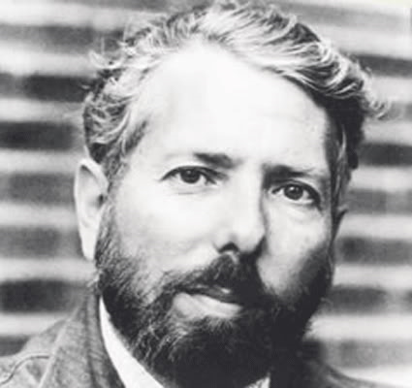
Milgram did a series of variations from the "baseline" study
Baseline: 65% of participants continued to give shocks up to 450 volts

Slide 21

Run down office block (Exp. 10)
The study was moved from Yale Uni to a rundown office in a nearby town.

Slide 22
LOWER OBEDIENCE
47.5%

Slide 23
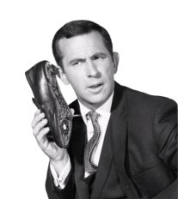
Telephonic Instruction (Exp. 7)
After giving initial instructions, experimenter left the room and gave any further instructions by phone

Slide 24
LOWER OBEDIENCE
22.5%

Slide 25
Getting someone else to do it!
There are two teachers – in fact one of them is a confederate/stooge (like the learner)
The participant (teacher) says whether the learner got the answer right or wrong
If the answer is wrong, the participant teacher tells the fake teacher to throw the switch
I.e., the participant gets someone else to actually give the shock

Slide 26
HIGHER OBEDIENCE
92.5%

