Slide 1
Resisting social influence

Slide 2
Think / Pair / Share
How might your personality determine whether you obey or disobey (dissent) an order or instruction?
How might your culture (e.g., parents, religion, country, etc.) determine your obedience / dissent?
How might your gender determine your obedience / dissent?
Think of situations you have been in when someone has told you to do something. What elements of that situation (the location, the way the other person was dressed, who that other person was) made you obey?

Slide 3
Think / Pair / Share
What are the 4 most important factors you think are involved in whether someone obeys?
What are the 4 most important factors you think are involved in whether someone disobeys?

Slide 4
Key Ideas
Resistance through social support (conformity and obedience)
Resistance through locus of control

Slide 5
Social support
Conformity – how does Asch's research show that social support can lead to a resistance to conformity?
Obedience – how does Milgram's research show that social support can lead to a resistance to obedience?
Notes:
Conformity – Asch's Research
Solomon Asch (1951) conducted a series of experiments where participants were asked to match the length of lines. In the critical trials, confederates (actors) unanimously gave incorrect answers.
Key finding on social support: When one confederate gave the correct answer (i.e., broke the unanimity of the group), the rate of conformity dropped significantly.
Interpretation: The presence of an ally gave the participant confidence to resist the pressure to conform, showing that social support reduces conformity.
Why it matters: It highlights that group unanimity is a powerful force, but even a single dissenting voice can empower others to stand by their own perceptions.
Obedience – Milgram's Research
Stanley Milgram (1963) studied obedience by having participants administer what they believed were electric shocks to a learner under the instruction of an authority figure.
Key finding on social support: In a variation of the study, when two confederates refused to continue administering shocks, the obedience rate among real participants dropped dramatically.
Interpretation: Seeing others disobey the authority figure provided a form of social validation and moral support, making it easier for participants to resist.
Why it matters: It shows that obedience to authority is not inevitable, and that peer resistance can encourage ethical decision-making.

Slide 6
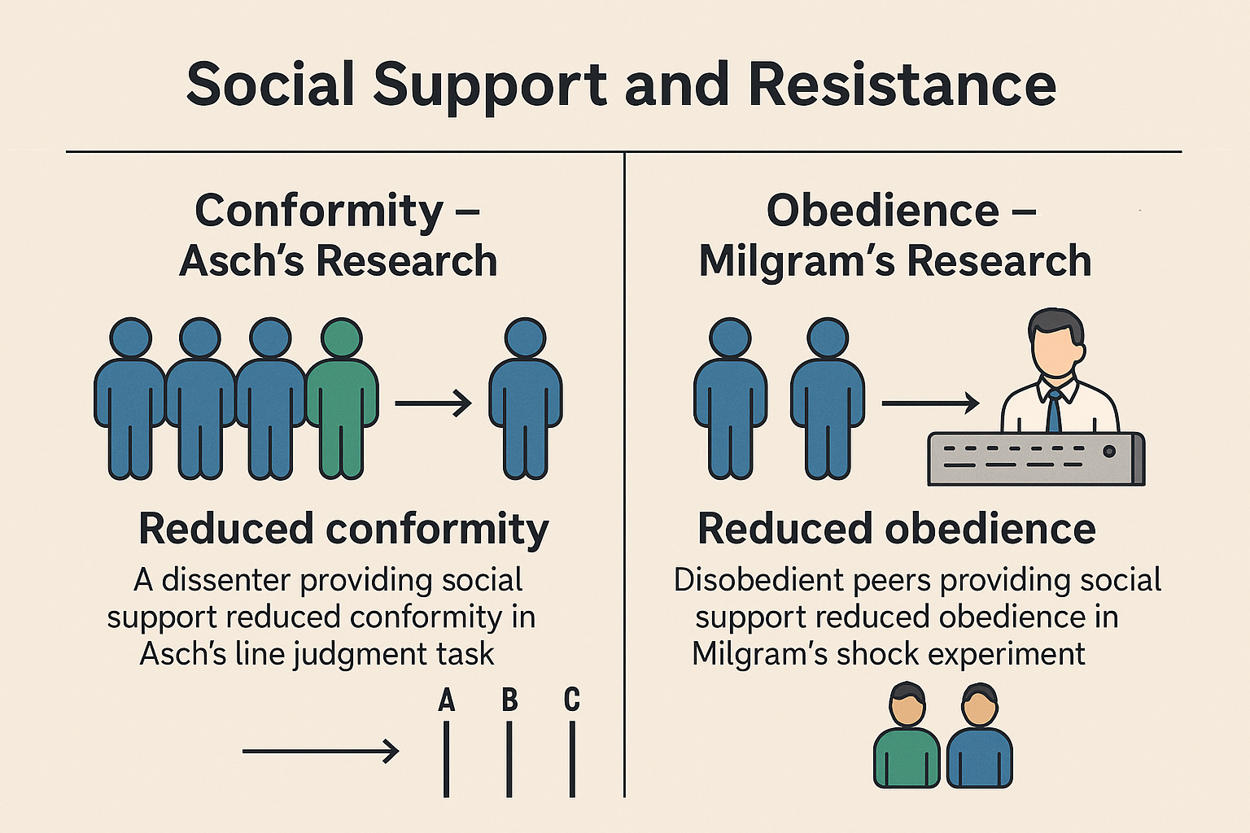
Drop of 75% in conformity level
Drop from 65% to 10% obedience level

Slide 7
Social support
Read through the Social support A01 and A03 – make notes as below:
A01
  How does social support explain resistance to conformity and obedience?
A03
  What research support is there (beyond Asch and Milgram) for the role of social support?
  How did the Allen and Levine (1971) study show that social support both helped and didn't help resistance in an Asch type task?
Notes:
What did the Albrecht et al. (2006) study find and what does this mean for the real world?
What did the Gamson et ai. (1982) study find and what does this mean for resistance to obedience?

Slide 8
Locus of control
Rotter (1966): where do you put responsibility – on yourself, or on others?
Internal LoC: on yourself - less obedient
External LoC: on others - more obedient
Notes:
Do LoC line dance – ask what they think the different sides of the line mean (see the teacher handout) - link takes you to the music!
https://www.youtube.com/watch?v=x_4lxcle7OE&list=PL8zP47fAkmHg7lwWs5-KpUh6pEwBI2yHO

Slide 9
Locus of Control (Rotter, 1966)
Read through the Locus of Control A01 + A03. Make notes as follows
A01: define locus of control (int/ext). Explain impact on behaviour + beliefs
A01: how does LOC explain resistance to social pressure (personal responsibility, confidence, intelligence, achievement orientation)?
A03:
  what research support is there (Murphy and vaccine resistance)?
  What does the contradictory research suggest (Twenge)?
  Why might the role of LOC be limited?

