Slide 1
Transition Challenge 2026: CLOSE UP
This is a practical and written project. The challenge is broken down into tasks.
You have been asked to produce an outcome based on the theme of ‘CLOSE UP’, researching the work of others and producing your own personal response (final artwork) to the theme.
You can present your work in a sketchbook or on paper of any size.
Please email if you have any questions: bowens@wallingfordschool.com

Slide 2
Transition Challenge 2026: CLOSE UP
OVERVIEW:
Task One: Ten good quality photographs that respond to the theme of ‘close up’.
Task Two: At least ten observational drawings (scale and media of your choice) based on close ups.
Task Three: A final piece of work that relates clearly to the theme and research undertaken.
Task Four (Optional): An evaluation of all of your work so far for this project.
Task Five (Optional): A written comparison between two images related to close ups: ‘Reflecting Drops’ by Peter Keetman and ‘Motocrosser’ by Richard Patterson.
(DETAILS ON FOLLOWING SLIDES)

Slide 3
Transition Challenge 2026: CLOSE UP
DEADLINES:
Friday 7th August: Please email me photos of your photographs and observational drawings.
(Tasks 1 and 2)
Friday 4th September: Please also send me a photo of your final piece of work.
Optional: Please send me your evaluation and your comparison between ‘Reflecting Drops’ by Peter Keetman and ‘Motocrosser’
(Task 3 + (Optional: 4 and 5))

Slide 4
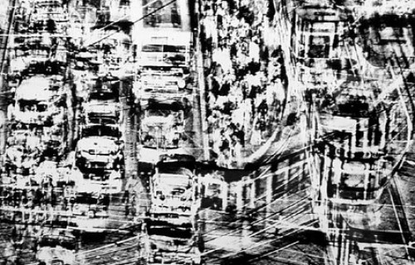
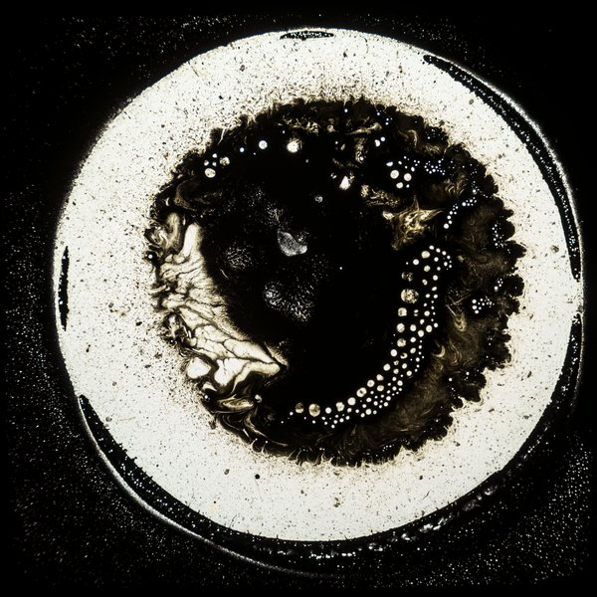
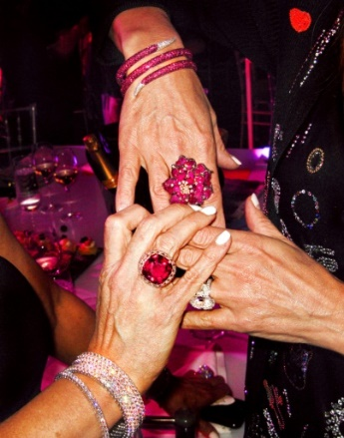
Transition Challenge 2026: CLOSE UP
Task One:
You have been asked to explore and investigate the theme ‘CLOSE UP’ to produce creative outcomes. The theme should be seen as a starting point and you should explore appropriate primary and secondary source material.
Artists who have explored Close up:
Chuck Close
Jessica Craig-Martin
Lucien Freud
Peter Keetman
Georgia O’Keeffe
Richard Patterson
Irving Penn
Jenny Saville
Close up definitions:
Very near.
An intimate and detailed description or study.
A photograph or film image taken at close range
You should produce at least ten different, good quality photographs that respond to the theme

Slide 5
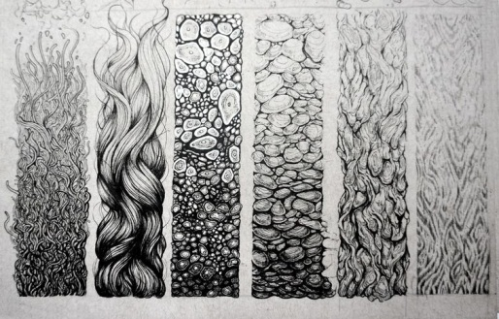
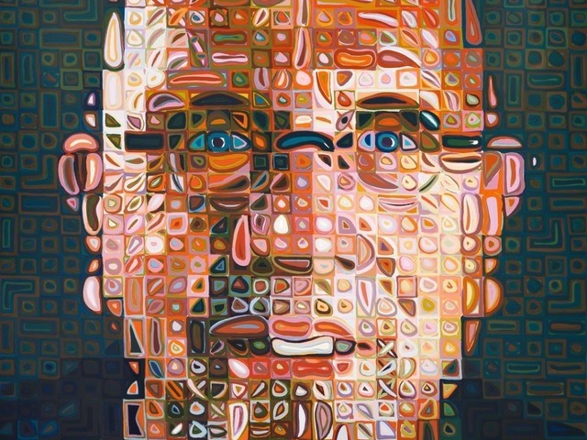
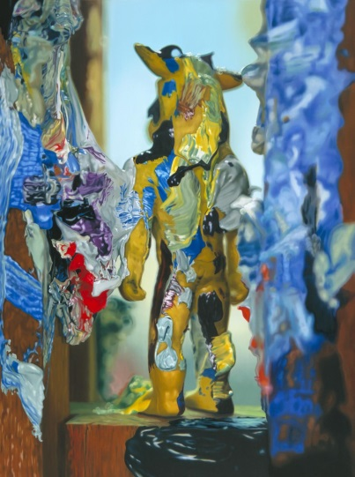
Transition Challenge 2026: CLOSE UP
Task Two:
You have been asked to explore and investigate the theme ‘CLOSE UP’ to produce creative outcomes. The theme should be seen as a starting point and you should explore appropriate primary and secondary source material.
Close up definitions:
Very near.
An intimate and detailed description or study.
A photograph or film image taken at close range
At least ten observational studies based on close-ups.
You can use either pen or pencil for these drawings.

Slide 6
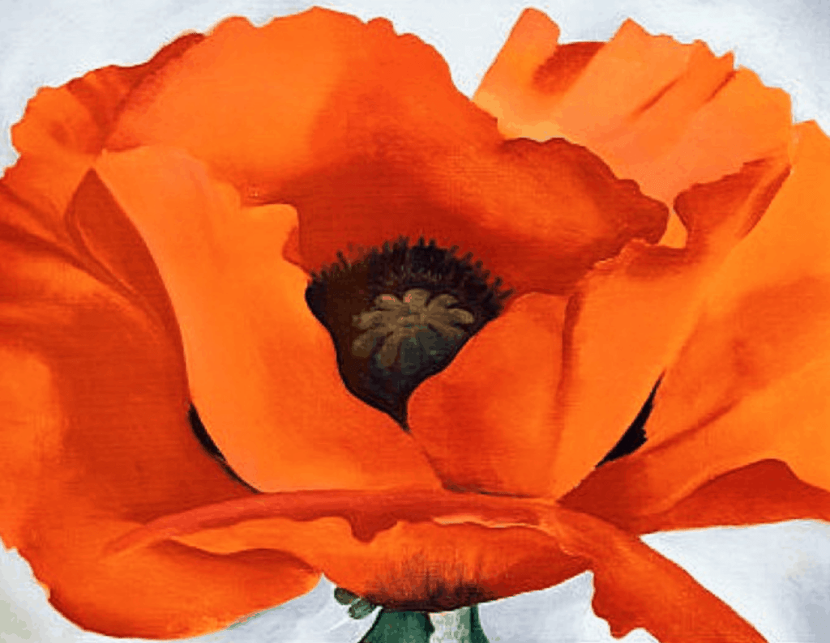
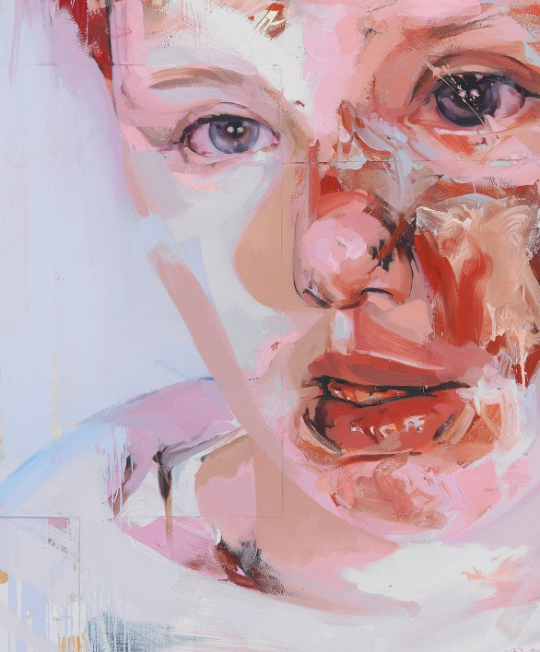
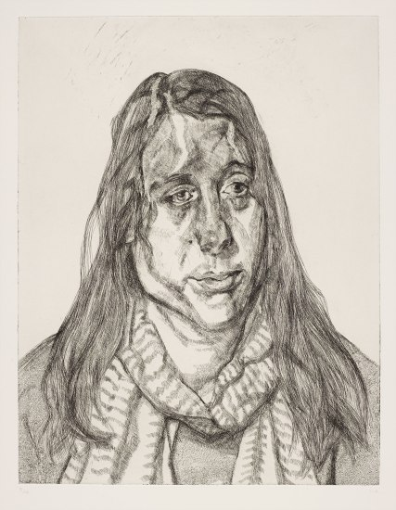
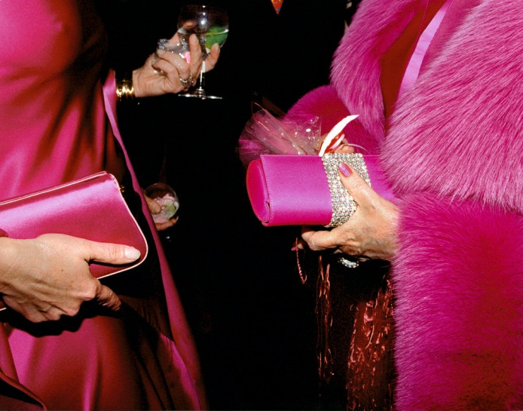
Transition Challenge 2026: CLOSE UP
Task Three:
You have been asked to explore and investigate the theme ‘CLOSE UP’ to produce creative outcomes. The theme should be seen as a starting point and you should explore appropriate primary and secondary source material.
Close up definitions:
Very near.
An intimate and detailed description or study.
A photograph or film image taken at close range
A final piece of work that relates clearly to the theme and research undertaken. This can be in any media.

Slide 7
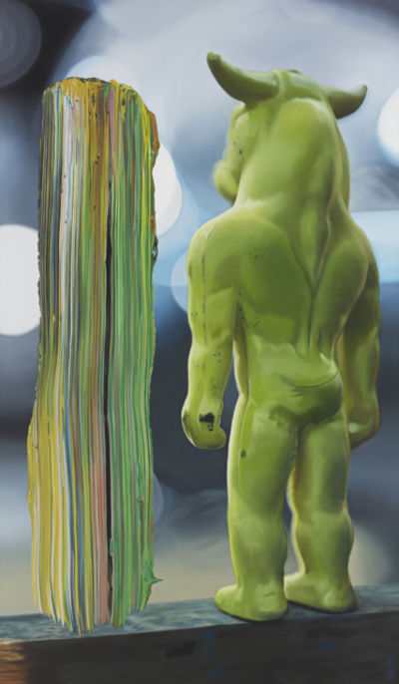
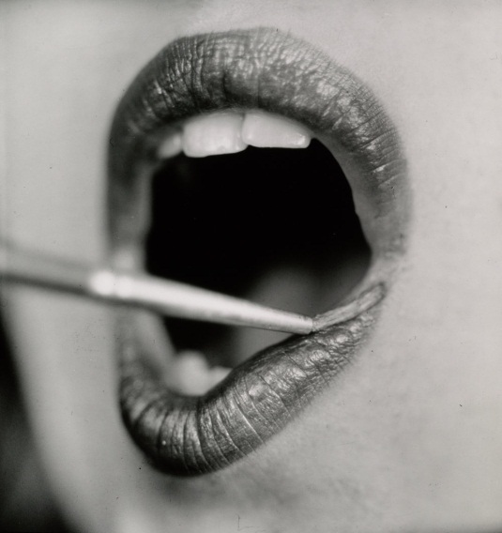
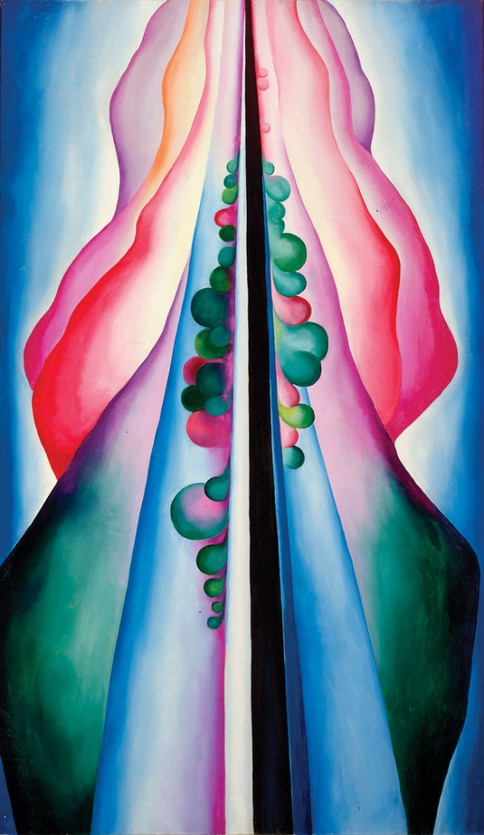
Transition Challenge 2026: CLOSE UP
Task Four (Optional):
You have been asked to explore and investigate the theme ‘CLOSE UP’ to produce creative outcomes. The theme should be seen as a starting point and you should explore appropriate primary and secondary source material.
A written evaluation of the project.
What went well? What could have gone better? What would you do differently next time?
(approx. 150 words)

Slide 8
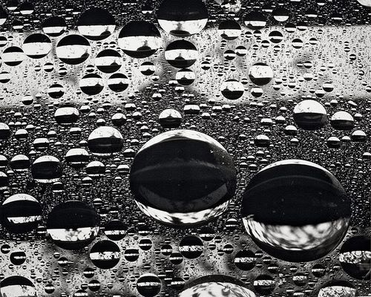
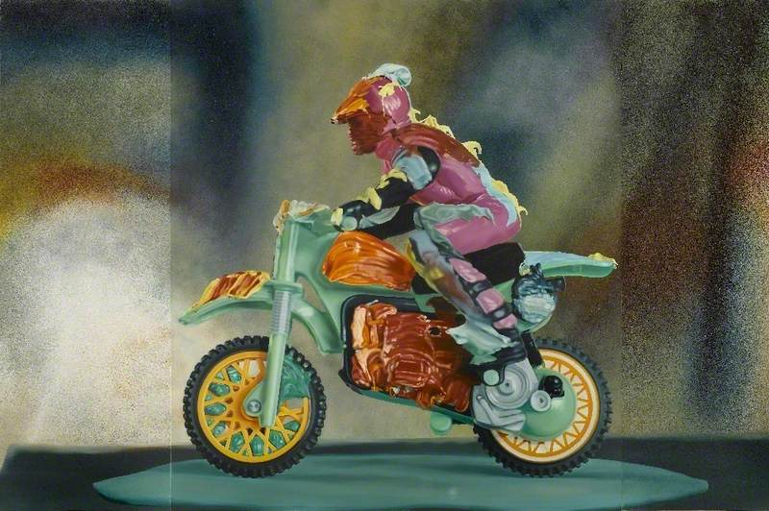
Transition Challenge 2026: CLOSE UP
Task Five (Optional):
Make a written comparison between two images related to close ups: ‘Reflecting Drops’ by Peter Keetman and ‘Motocrosser’ by Richard Patterson. Describe and analyse the work of both artists and make comparisons between them.
Refer to the formal elements in your writing: Line, shape, space, contrast, pattern, colour, tone, depth etc.
Don’t forget to express your opinions on the work you investigate.
Approx. 500 words.
‘Motocrosser’
by Richard Patterson.
‘Reflecting Drops’
by Peter Keetman

Slide 9
Transition Challenge 2026: OPTIONAL EXTRAS
Other things that you could be doing include:
- Making observational drawings of anything! Any drawing that you do is helpful. You could include drawings of: biscuits, tomato sauce bottles, a self-portrait, a pile of books, empty packets of crisps, a pile of clothes on a chair, an open door, a crushed up envelope, a houseplant, toothbrush and toothpaste combination, bath taps, a lamp, a packet of playing cards, some saucepans, a toaster, a TV remote, an Xbox controller, football boots, a musical instrument, a pair of socks, a carrier bag, some books on a shelf, a view from a window, a glass of something fizzy, a phone, a pile of knives and forks, shoes, gloves and scarves, a bin, crumpled up sheet of paper, a pile of magazines, fishing equipment, a box of cereal, a pencil case, a candle, a hairbrush, a towel on a radiator, an apple with a bite taken out of it, a vacuum cleaner, magnets on a fridge ... ANYTHING!
(You can present your work in a sketchbook or on paper of any size.)
- Follow the Art Department on Instagram (walli.artdept) for ideas about artists, challenges, techniques, exhibitions and much more.
- Visit the Tate website on www.tate.org.uk and get to know a wide range of different artists and art styles.
Please email if you have any questions: bowens@wallingfordschool.com

Slide 10
Any questions?
If you have any further questions
please contact Mr Bowen on:
bowens@wallingfordschool.com

