Slide 1

A Level Biology
AQA Biology
Books you will be provided with: AQA Biology 2nd Edition by Glenn and Susan Toole
Resources you may choose to buy/look at (although these are entirely optional): None, really. It’s worth keeping an eye on the news for advances in medicine and biological research. There are other good revision guides available – CGP do one but there are others too.
Work to be completed by 14th July 2026: 1. Complete the introduction to AS Biology booklet including the graph. 2. Read an article in the news about advances in biology: https://www.bbc.co.uk/news/science_and_environment is a good place to start.
Work to be completed by 4th September 2026: Complete the A3 organelles table if you haven’t done so already. Use the information on the table to produce a revision card for each organelle. On each card you should include the 2D diagram, a description of the structure and the function. Complete the organelle questions sheet. Try to answer all questions. You might need to look some of them up. Produce a table summarising for each of the microscopes that you looked at during taster day the advantages and the disadvantages.
What to bring with you to the first lesson in September: A lever arch folder All summer work.
Any questions? Please email whitek@wallingfordschool.com before July 16th

Slide 2
Introduction to AS Biology
Name _______________ Form _____
Work to be completed by 14th July 2026
Aims of this booklet:
To introduce some of the key skills that you will need to succeed in AS Biology.
To recall some key information from GCSE Biology.
To help you to start to think about the command words used in different questions.
This booklet must be handed in during your first year 12 Biology lesson. No excuses. Don’t come to the lesson without it.

Slide 3
Section 1: Converting between units
Work to be completed by 14th July 2026
In AS Biology you will need to be able to convert measurements into different units. Biologists don’t measure in millimetres and not centimetres.
1mm = 1000µm = 1000,000nm
nm = nanometres
µm = micrometres
1. Convert the following measurements into µm
5mm
71mm
150nm
1250nm
0.3mm
2. Convert the following measurements into mm
a) 12µm
b) 150µm
c) 0.3µm
d) 112nm
e) 5nm
3. Convert the following measurements into nm
15mm
0.1mm
0.02mm
130µm
2500µm
0.6µm
4. Put the following into size order, from smallest to largest.
0.1mm 15mm 1200µm 30µm 150nm 7nm 1200nm

Slide 4
Section 2: rearranging equations
Work to be completed by 14th July 2026
image size = actual size x magnification
Rearrange the equation to show how you would calculate:
a) magnification =
b) actual size =
2. Complete the following calculations:
An image of a water flea was 15mm long. The image had been magnified 3.8 X from the actual size of the flea. How big is the real flea?
The actual size of a bacterium is 40µm. A picture of a the bacterium includes an image that has been magnified 2500X. How big is the picture of the bacterium?
An image of a buttercup is 55mm wide. The actual flower is 23mm wide. By how much has the flower been magnified to make the image?

Slide 5
Section 3: Practising the use of command words
Work to be completed by 14th July 2026
Describe the structure of a red blood cell.
Explain why a plant grows towards the light.
State the job of the heart.
Justify the use of animals in the testing of new medicines.
Evaluate both sides of the argument for the use of stem cells in medicine.

Slide 6
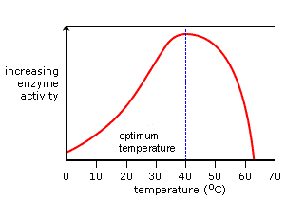
Section 3: Practising the use of command words
Work to be completed by 14th July 2026
Describe the shape of the graph.
Explain the shape of the graph.
State what enzymes are made of.
Explain why the body needs a different enzyme to digest a meal of chicken and potatoes.

Slide 7
Section 4: looking at practical Biology
Work to be completed by 14th July 2026
Ms White spent her summer investigating the effect of temperature on enzyme activity. She collected the volume of oxygen made during an enzyme-controlled reaction. The greater the volume of oxygen, the more the enzyme was functioning.
She collected the following data:
Temperature (°C) | Volume of oxygen (cm³) | Volume of oxygen (cm³) | Volume of oxygen (cm³) | Mean vol. of oxygen (cm³)
5 | 12 | 9 | 10
15 | 16 | 21 | 17
25 | 25 | 26 | 23
35 | 38 | 36 | 36
45 | 18 | 9 | 15
Identify any outliers in Ms White’s data.
Calculate the mean volume of oxygen (cm³) for each temperature.
Use the graph paper to plot a full page graph with range bars.

Slide 8
Section 5: Important facts from GCSE
Work to be completed by 14th July 2026
Write down the equations for respiration and photosynthesis.
Draw and label an animal and a plant cell.
Explain the link between chromosomes, DNA, genes and proteins.
Describe how a cell divides by mitosis.
Describe how particles move by diffusion.
Describe how water moves by osmosis.
Describe how particles move by active transport.

Slide 9
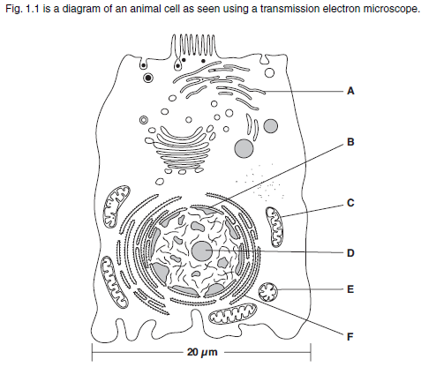
Organelle questions
Work to be completed by 4th September 2026
Which of the following best describes the function of the rough endoplasmic reticulum? (1 mark)
  It has ribosomes bound to the surface and is responsible for the synthesis and transport of proteins.
  It is responsible for lipid and carbohydrate synthesis and storage.
  It has ribosomes bound to the surface and is responsible for lipid synthesis and storage.
  It is responsible for protein storage.
Your Answer ______
What is the function of the nucleolus? (2 marks)
_______________________________________________________________________________________________________________________________________________________________________________________________________________
What is the function of the centrioles? (2 marks)
_______________________________________________________________________________________________________________________________________________________________________________________________________________
Select the correct term for the
organelle labelled C?
  Smooth endoplasmic
  reticulum
  Vesicle
  Golgi Apparatus
  Mitochondria
Your Answer _______
Which of the following best describes the function of the mitochondria?
  The site of anaerobic respiration where ATP is produced.
  The site of aerobic respiration where ATP is used.
  The site of aerobic respiration where ATP is produced.
  The site of anaerobic respiration where ATP is used.
Your Answer _______

Slide 10
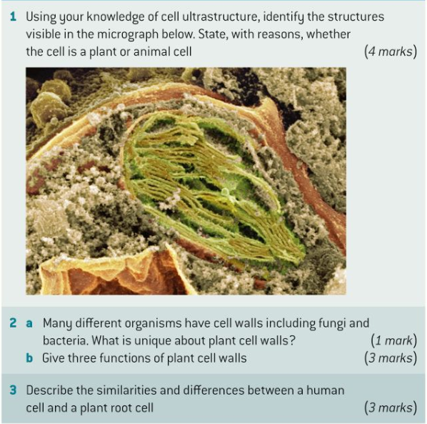

Work to be completed by 4th September 2026
_________________________________________________________________________________________________________________________________________________________________________________________________________________
__________________________________________________________________________________________________________________________________________________________________
____________________________________________________________________________________________________________________________________________________________________________________________________________________________________________________________________________________________________________________________________
__________________________________________________________________________________________________________________________________________________________________

Slide 11
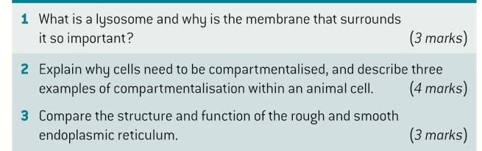
Work to be completed by 4th September 2026
________________________________________________________________________________________________________________________________________________________________________________________________________________________
________________________________________________________________________________________________________________________________________________________________________________________________________________________________________________________________________________________________________________________________________________________________________________________________________________________________________________
________________________________________________________________________________________________________________________________________________________________________________________________________________________

