Slide 1

Chemistry A Level Preparation
Name: ____________________________________
GCSE Target: ____________
GCSE Grade: ____________
Did you attend the Taster Day in June? ____________
In this pack are a few useful documents to let you know more about the A Level course you will start next term and some questions to keep your brain ticking over until September! If you have any problems please e-mail Miss Jones at jonesme@wallingfordschool.com
Many of the topics you will cover in Year 12 should feel familiar as they build on the ideas you have covered at GCSE. The work you will complete in preparation for the start of your A Level course is designed to consolidate your understanding of GCSE work. Use revision guides and online resources like BBC Bitesize to review the content and then complete the practise examples. It is important to note that we will cover all of these calculations again from September onwards.
Useful websites: Quantitative Chemistry - https://www.bbc.co.uk/bitesize/topics/z87mw6f, Bonding and structure - https://www.bbc.co.uk/bitesize/topics/zq6h2nb. I have also inserted links to useful websites throughout.
Task | Topic covered | Completed  | Percentage achieved
1 | Atoms and ions
2 | Equations and balancing
3 | Ionic bonding and ionic formulae
4 | Drawing molecules
5 | Bonding and structure
6 | Relative formulae mass and percentage by mass
7 | Moles and molar ratios
8 | Reacting masses
9 | Limiting reagents
10 | Concentration
11 | Calculations mixture
12 | Bond energy calculations

Slide 2

How to succeed in Chemistry…
When asked this question most students say “work hard”. As you have chosen to study Chemistry that is a given! Remember – you have now chosen to do Chemistry because you enjoy it , the minimum expectation is that you will complete all work set. Here are some other tips.
Stay organised – Organisation is a huge problem for some students and a reason why many struggle. The key tip is start off well and keep it up. Bring your folder to every lesson and keep your notes complete, well presented and in order. File dividers will be provided to help.
Read ahead – Get into the routine of reading ahead in the text book before a lesson and making notes on what you’ve read. This way you are coming to lessons with an idea of the content being studied and the context of when and why it is studied.
Play an active part in lessons – Learning is very much an active process. Take a leading role in group activities and practical experiments. Participating in discussions and asking lots of questions will also help. Simply turning up to lessons will not help you progress.
Be proactive – never be content if you do not fully understand something you have covered in lessons or in your homework. There are lots of things you can do - read your notes and text book again, ask other members of your class to explain it to you, ask the teacher to explain it again in a different way etc. You will be given a Chemistry textbook and a set of flashcards. The textbook you will receive is:
  A Level Chemistry for OCR A Student Book (OCR A Level Sciences) Paperback – 23 July 2015 by Rob Ritchie and Dave Gent (978-0198351979)
  Other useful resources you may want to get to supplement this may include:
  A-Level Chemistry: OCR A Year 1 & 2 Complete Revision & Practice - 23 Aug. 2018 by CGP Books (978-1789080384)
  A-Level Chemistry: OCR A Year 1 & 2 Exam Practice Workbook – 23 Aug. 2018 by CGP Books (978-1782949220)
Don’t leave gaps – Related to number 3, if you don’t get a question don’t leave it. You will still not understand it in the exam! Ask for help preferably before the work is due to be handed in.
Ask for help – The Chemistry department has an open door policy. You can come and get help any lunch time or after school. If you are stuck on a question at home also feel free to e-mail for help.
If you have no work to do ask for more or find some! There are always things you can do to help you progress in Chemistry. Look through your PLC (personalised learning checklist) and identify topics you found more difficult and look over these again. Read through the next few topics to prepare you for future lessons, get some more practice of common types of calculations, compile a glossary of key terms and their definitions. E-mail your teacher and ask for some extension work!
Read and listen around. Universities are looking for more than good grades. It is important that you show an interest in the subject and can talk intelligently about Chemistry above and beyond the topics you cover in lessons. Reading around the subjects in books and journals, listening to podcasts and watching relevant TV programmes can all help you to put the work you have covered in class into context.

Slide 3
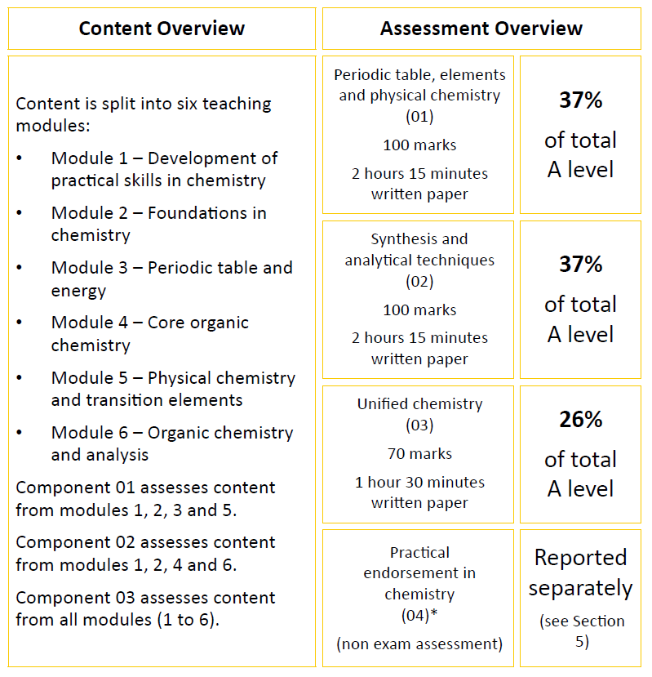
We study the OCR A specification. If you would like to read more about this course please look at the OCR website: http://www.ocr.org.uk/qualifications/as-a-level-gce-chemistry-a-h032-h432-from-2015/
In Year 12 we will cover Modules 2, 3 and 4. Module 1 relates to skills and these will be covered across the two years, as and when, we do practical work. In Year 13 we cover Modules 5 and 6. There is no longer any coursework but over the 2 years you will take part in a number of practical experiments and if these are completed satisfactorily you will also gain a pass in the practical assessment (this is separate to the A-level grade). At the end of Year 13 you will sit 3 exams as outlined above. Practical skills and knowledge will now be assessed in the 3 written exams.

Slide 4
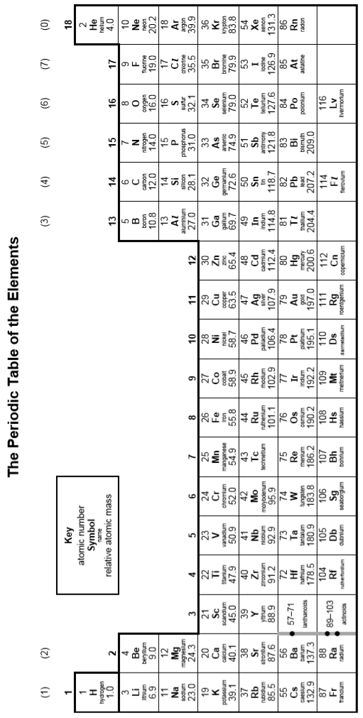
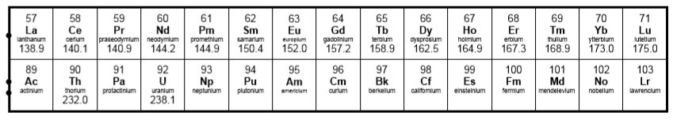

Slide 5
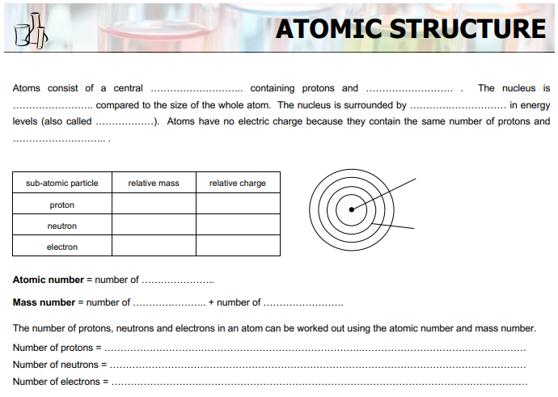
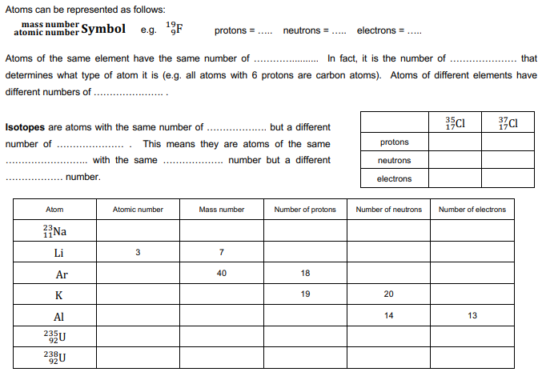
1
https://www.bbc.co.uk/bitesize/guides/z3sg2nb/revision/1

Slide 6
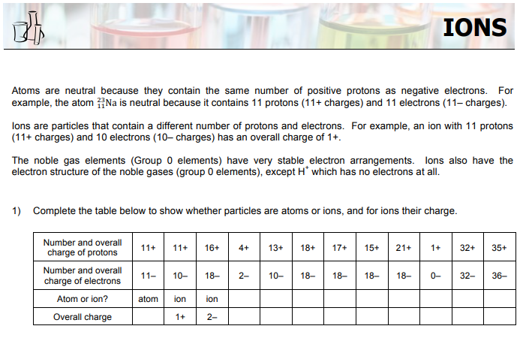
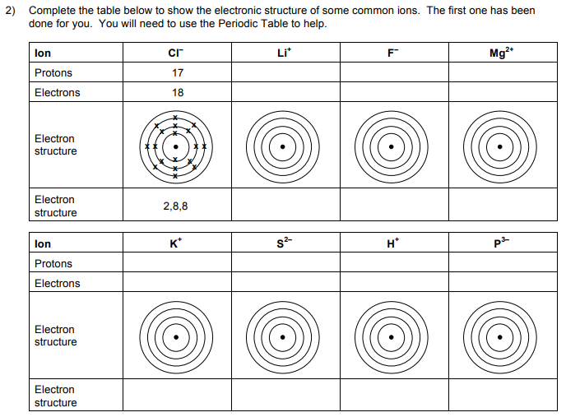
1
https://www.bbc.co.uk/bitesize/guides/zyydng8/revision/1

Slide 7
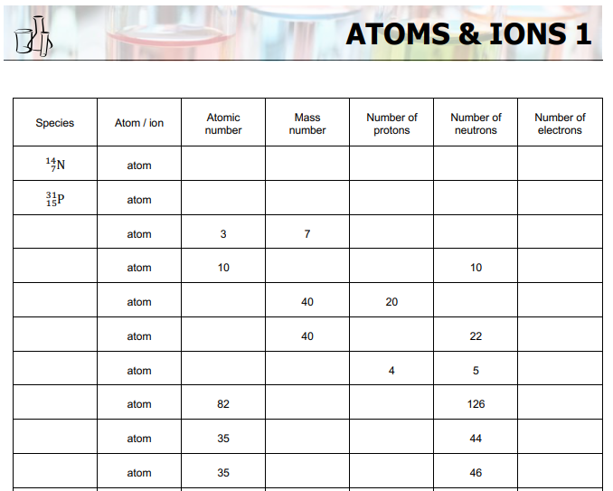
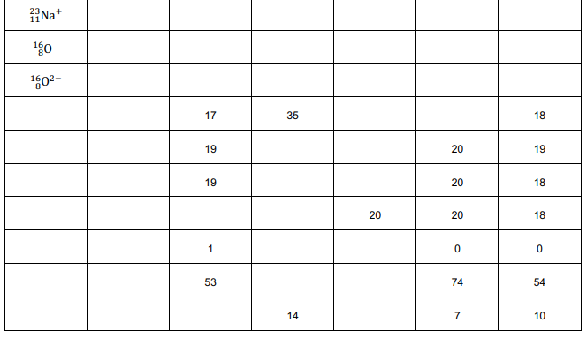
1

Slide 8
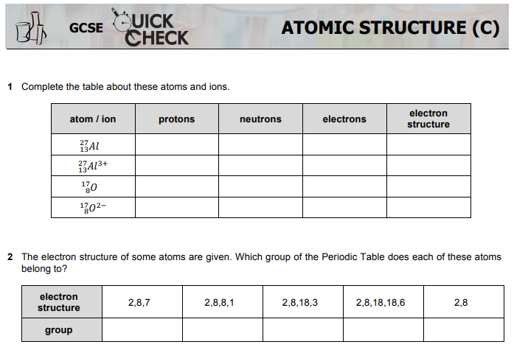
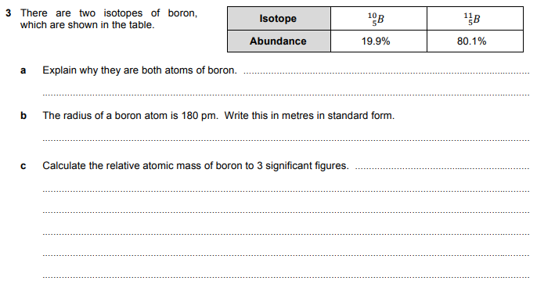
1

Slide 9
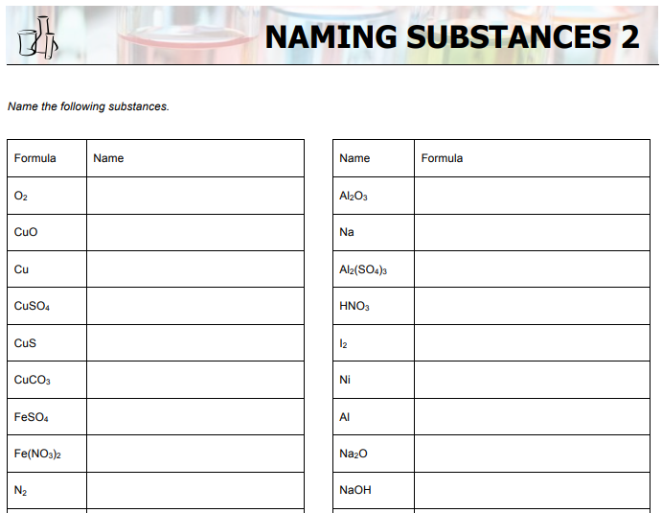
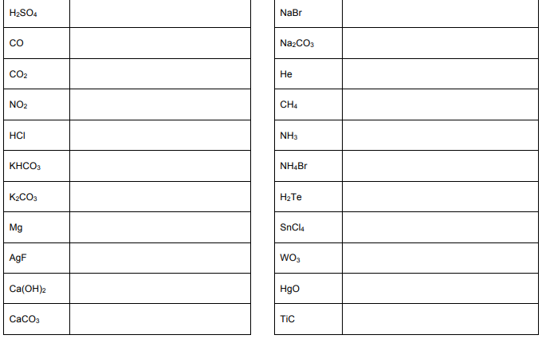
2
https://www.ducksters.com/science/chemistry/naming_chemical_compounds.php

Slide 10
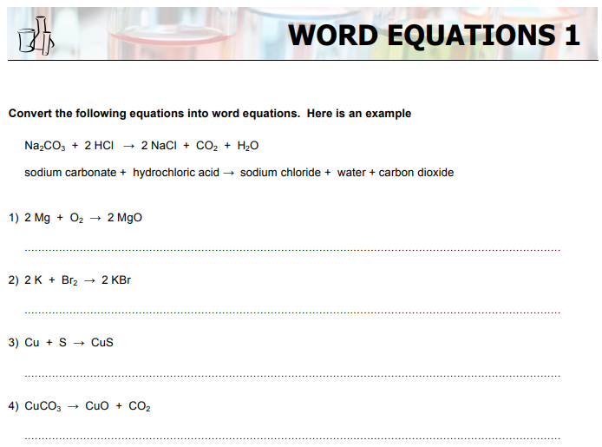
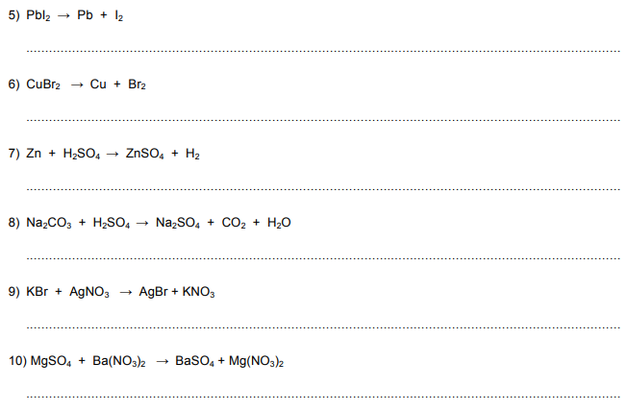
2

Slide 11
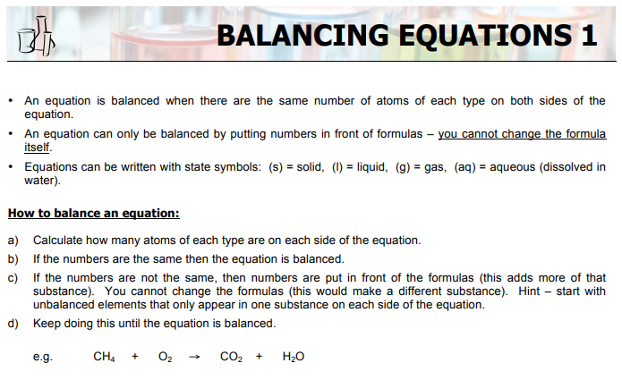
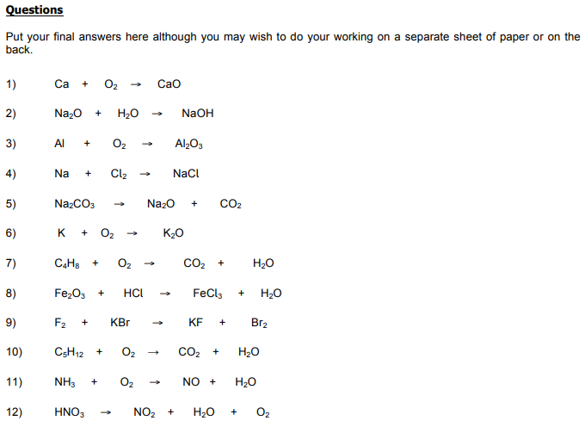
2
https://www.youtube.com/watch?v=vxCyzR6uETs

Slide 12
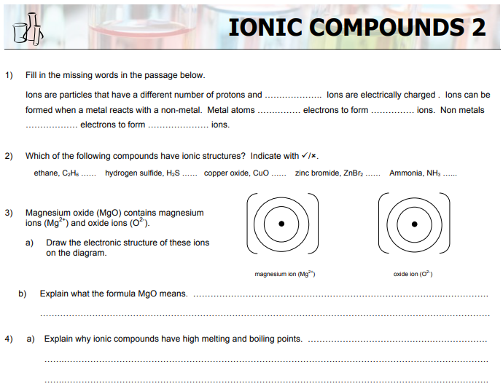
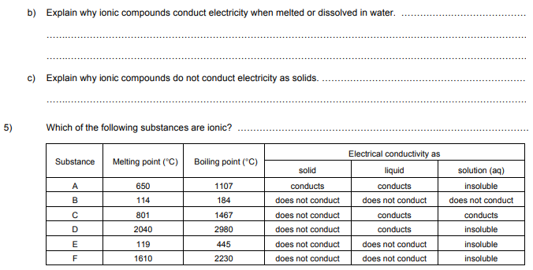
3
https://www.bbc.co.uk/bitesize/guides/zyydng8/revision/1

Slide 13
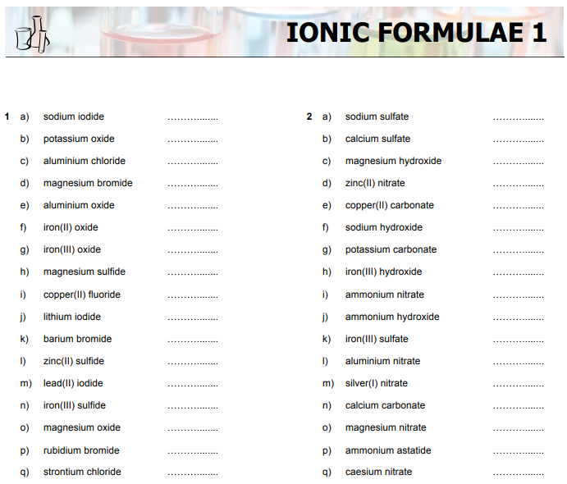
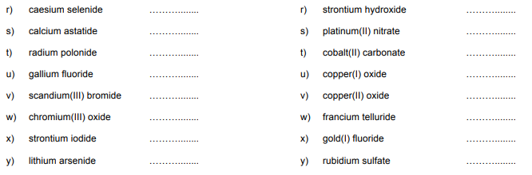
3
https://www.youtube.com/watch?v=tV8Cv2x0SD0

Slide 14
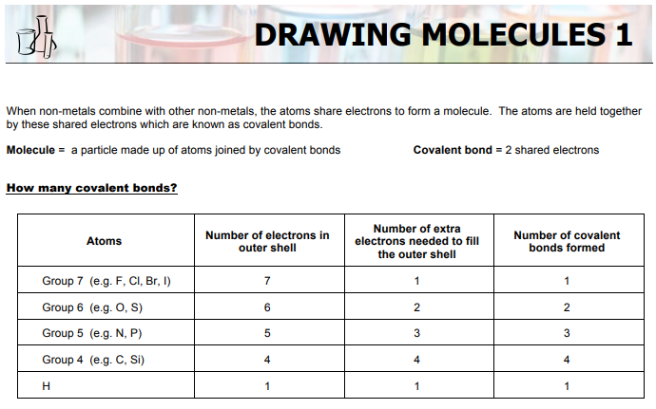
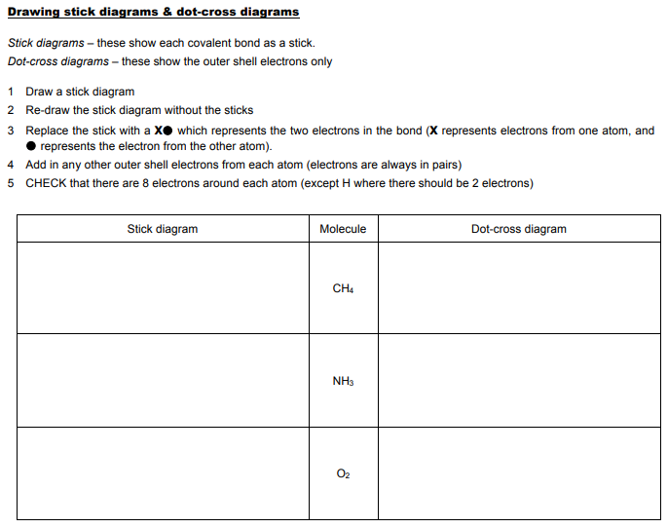
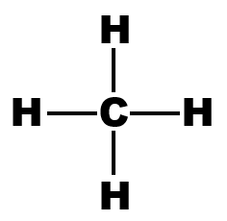

4
https://www.youtube.com/watch?v=lenvZEcMc60

Slide 15
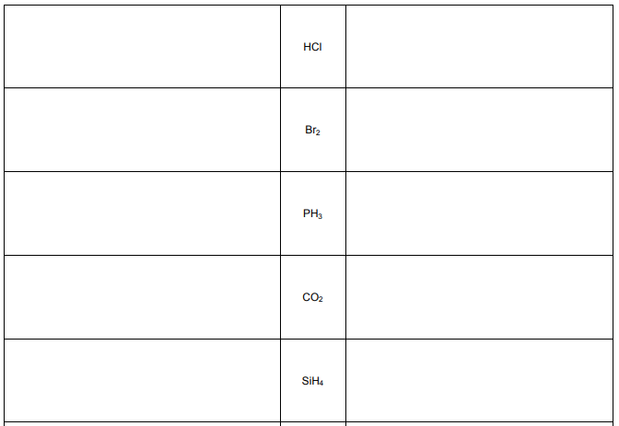
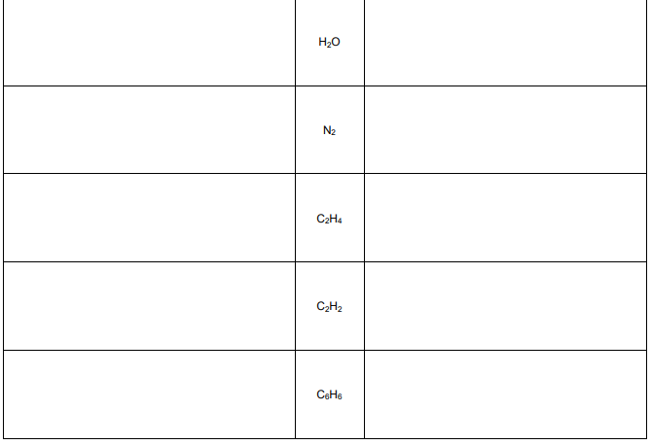

Slide 16
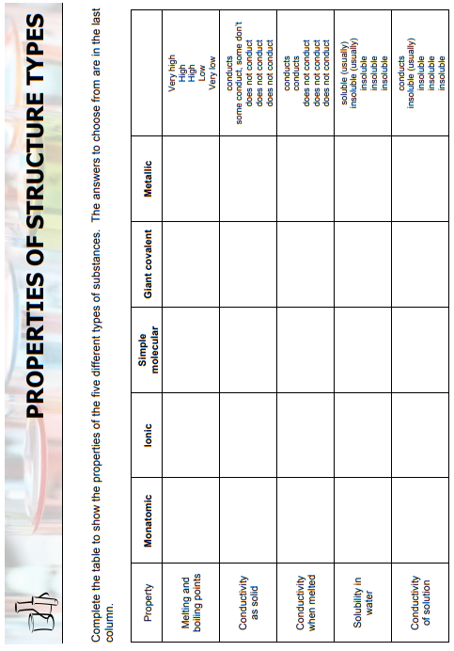
https://www.bbc.co.uk/bitesize/topics/zq6h2nb
5

Slide 17
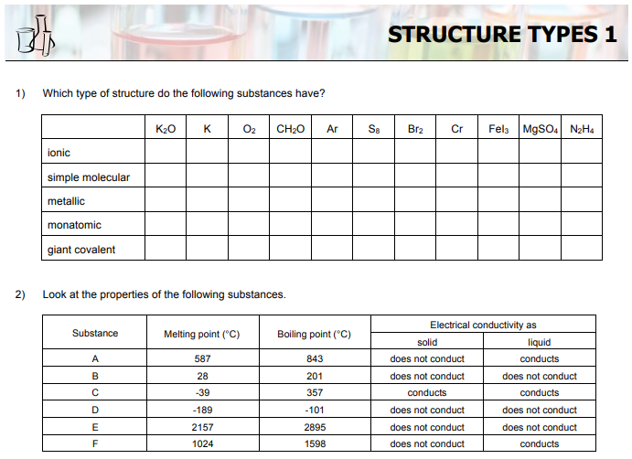
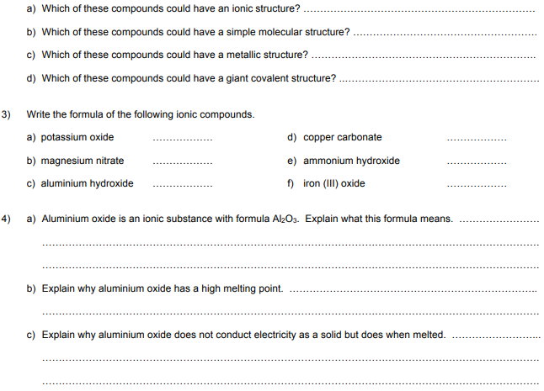
5
https://www.bbc.co.uk/bitesize/topics/zq6h2nb

Slide 18
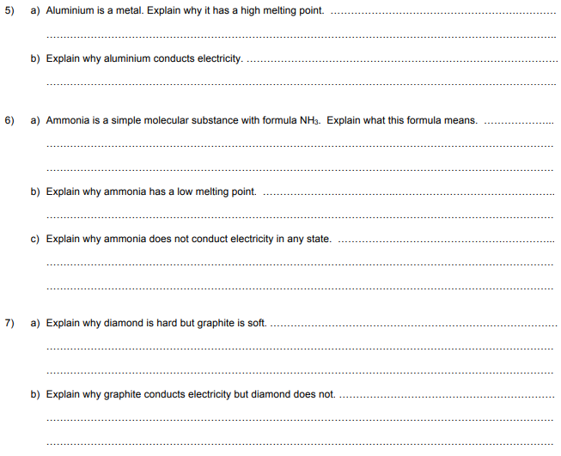

Slide 19
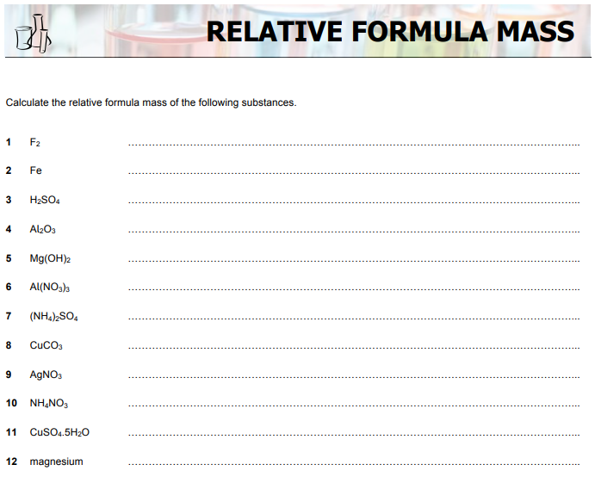
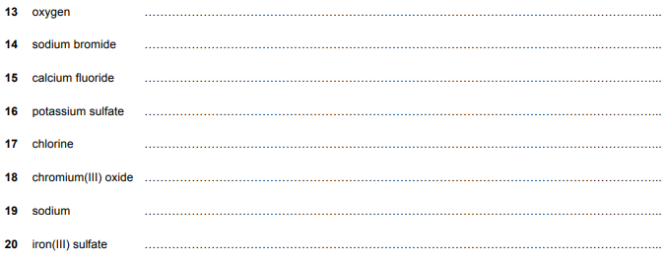
6
https://www.youtube.com/watch?v=q49NwIrjaFw

Slide 20
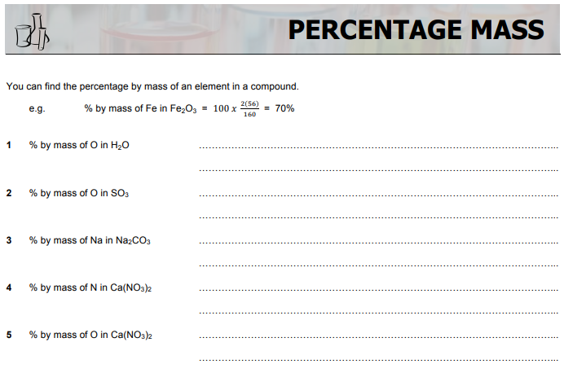
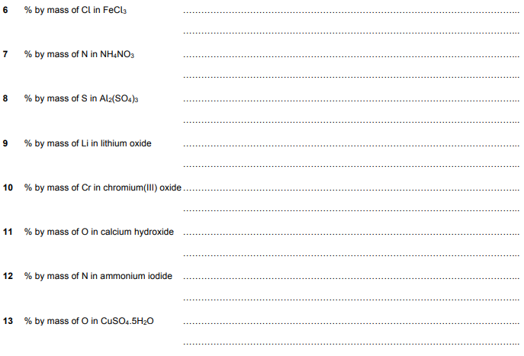
6

Slide 21
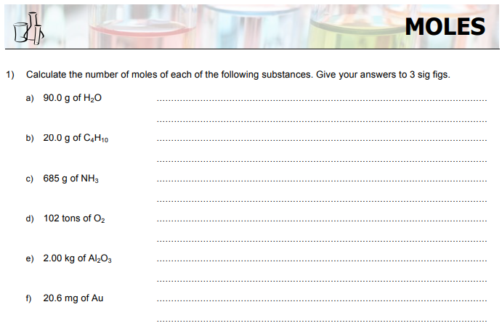
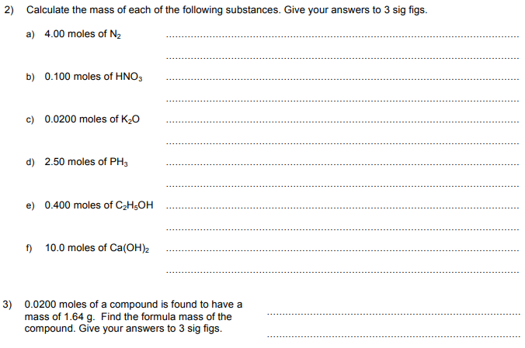
7
https://www.bbc.co.uk/bitesize/guides/z3kg2nb/revision/1

Slide 22
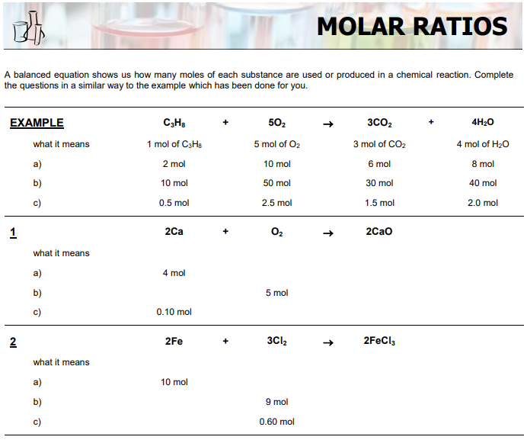
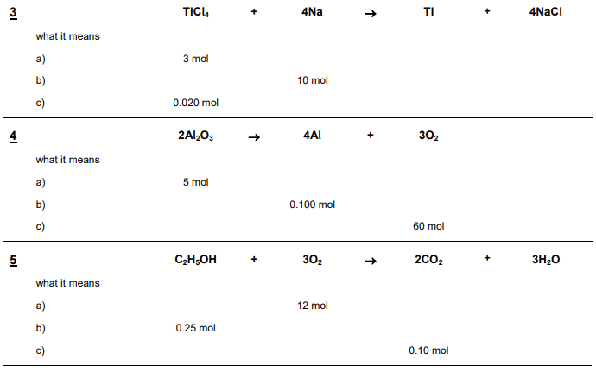
7
https://www.youtube.com/watch?v=3zmeVamEsWI

Slide 23
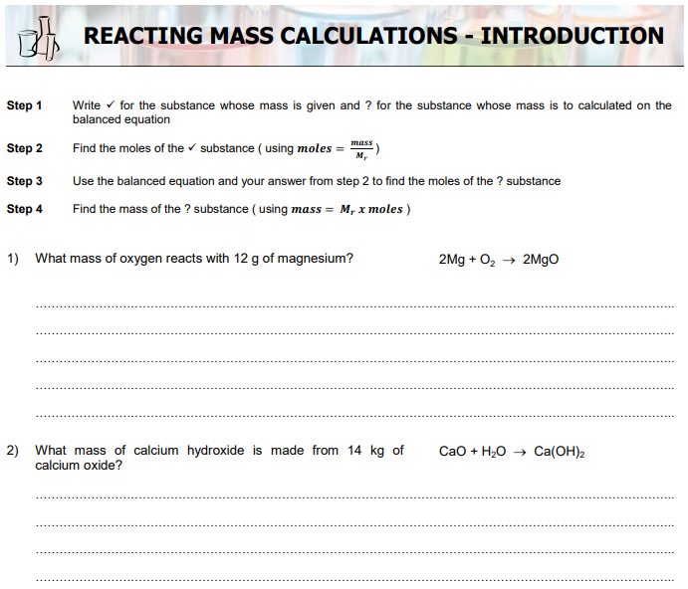
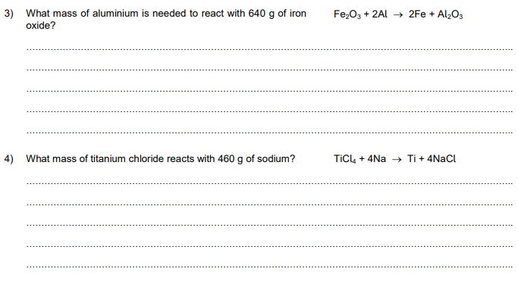
8
https://www.youtube.com/watch?v=TV6n5MFH6IU

Slide 24
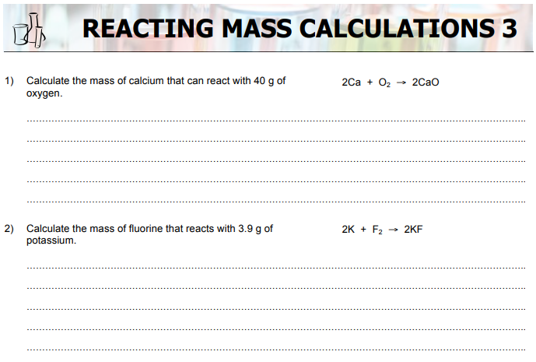
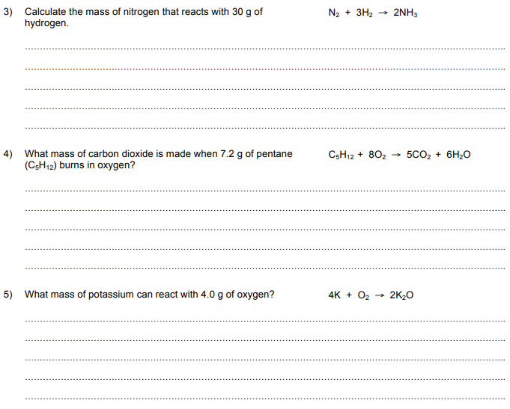
8

Slide 25
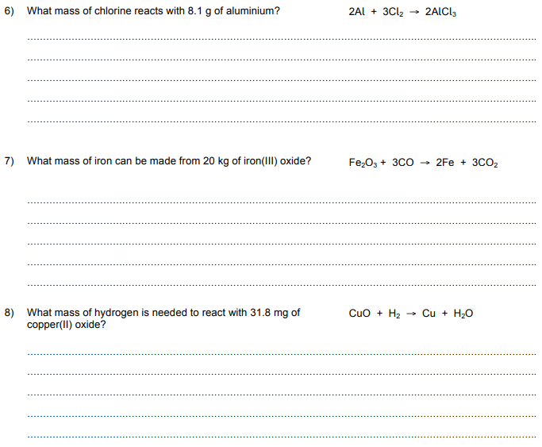
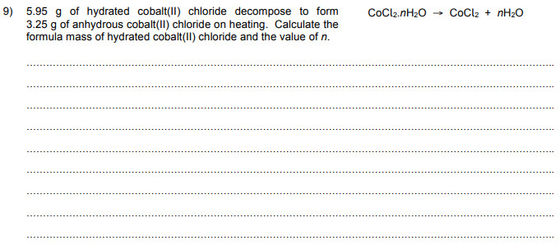

Slide 26
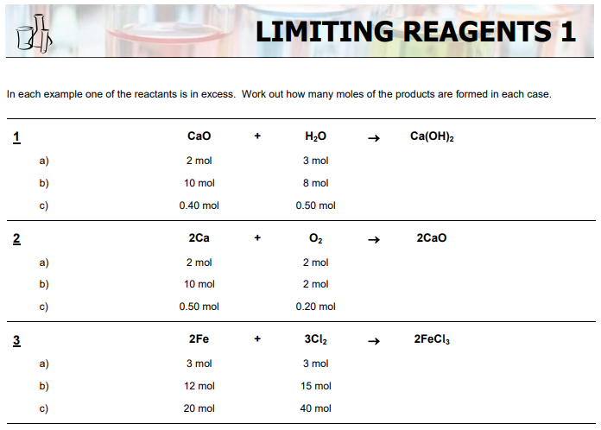
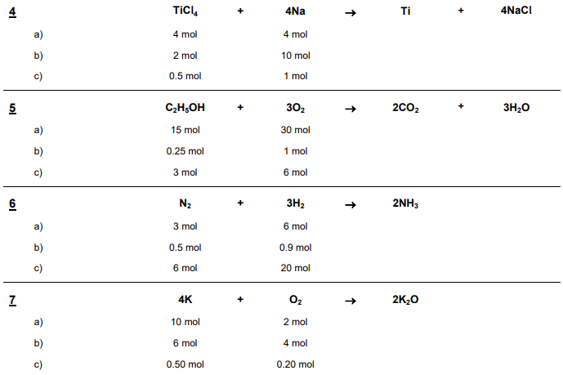
9
https://www.youtube.com/watch?v=MuzOmFhiE8o

Slide 27
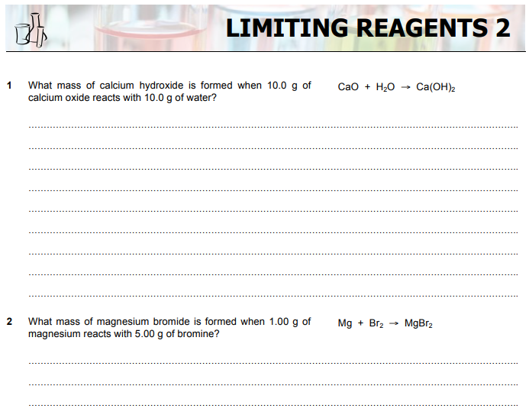
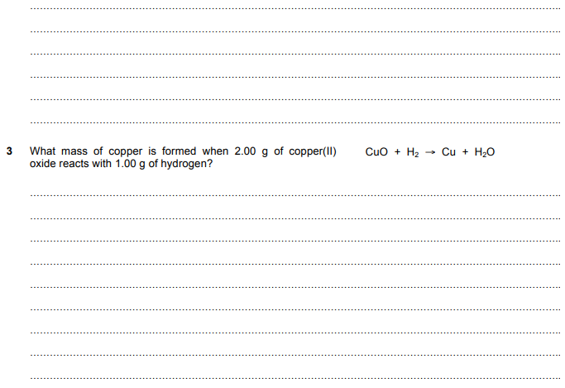
9

Slide 28
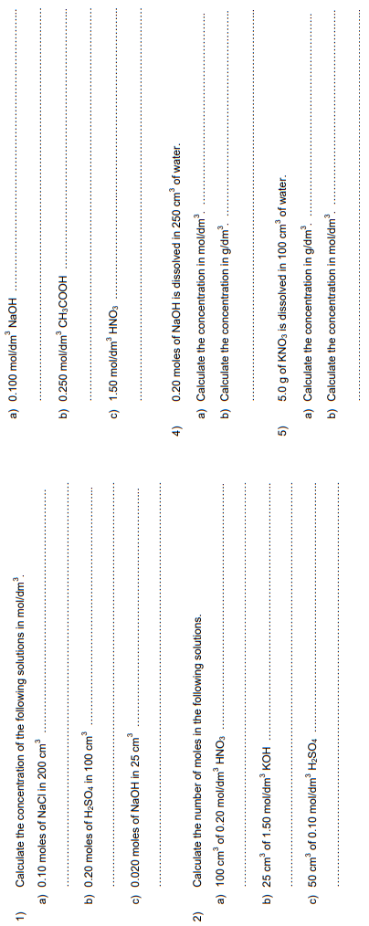
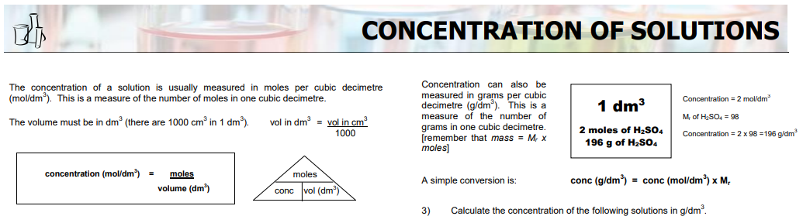
https://www.bbc.co.uk/bitesize/guides/z3kg2nb/revision/5
10

Slide 29


11

Slide 30



Slide 31


12
https://www.youtube.com/watch?v=it0HGXhxD-s

Slide 32



Slide 33



