Slide 1
Transition Challenge 2026:
DAVID HOCKNEY
This is a practical and written project. The challenge is broken down into tasks.
You have been asked to produce an outcome inspired by the work of DAVID HOCKNEY, researching his work and producing your own personal response (final practical outcome).
You can present your work in a sketchbook or on paper of any size.
Please email if you have any questions: dorninj@wallingfordschool.com

Slide 2
Transition Challenge 2026: DAVID HOCKNEY
OVERVIEW:
Task One: Artist Profile study of David Hockney and analysis of his work.
Task Two: A series of photos (at least 10) of a chosen subject.
Task Three: Observational drawings (scale and media of your choice).
Task Four: A final piece of work inspired by Hockney’s “Joiners” artform.
Task Five (Optional): An evaluation of all of your work so far for this project.
We advise that you read through all the slides before starting work so you have an overview of what is required.

Slide 3
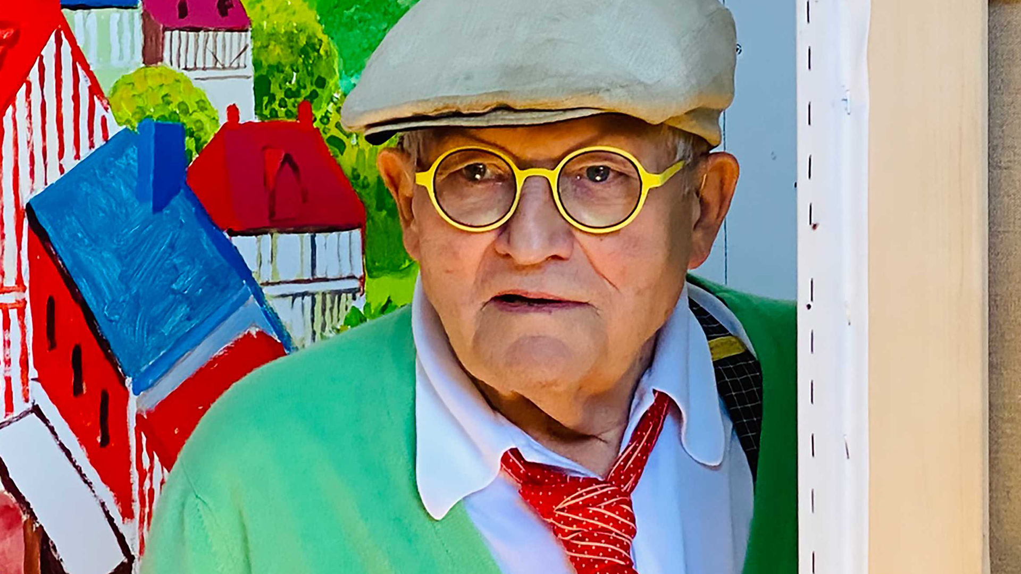
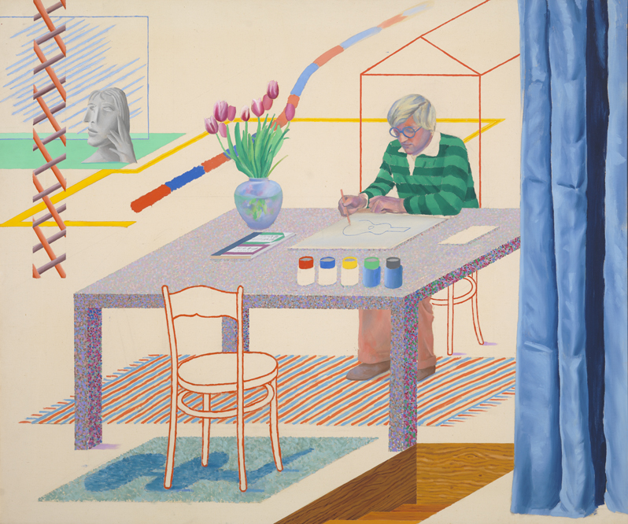
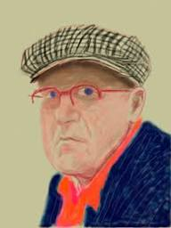
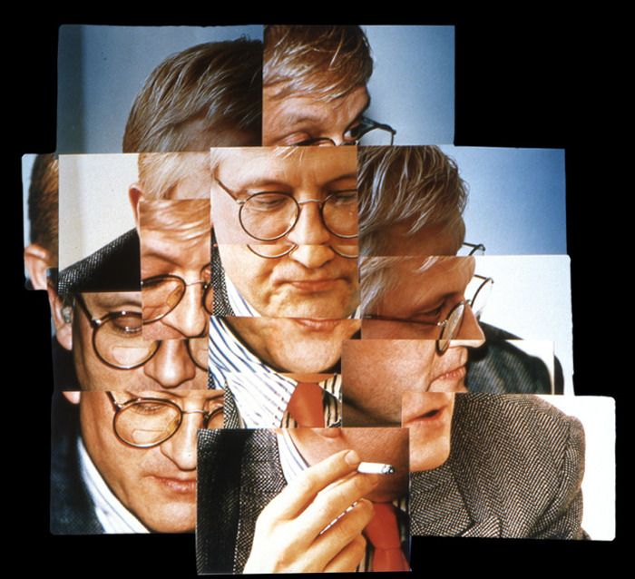
Task 1:
Artist Profile of David Hockney
The renowned British artist David Hockney, arguably one of the most influential of the modern era, died in June this year at the age of 88.
Below are some steps to help you write a profile of Hockney and analyse his work.
Start with an introduction – who is Hockney, what did he do? Focus on his work as an artist throughout his long career.
Select 3 or 4 different examples of his work and print them out. Hockney’s work changed over his long career and he use a wide range of media including photography and an iPad so try to reflect this in your choice.
Evaluate the examples:
What techniques/media etc. has he used?
what do you like about it?
what you would change/improve?
What aspects of the work could you explore or develop in your own work?
A couple of useful links:
Celebrated British artist David Hockney dies aged 88 - BBC News
www.hockney.com

Slide 4
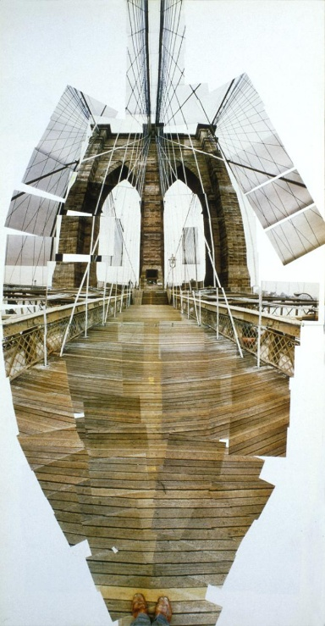
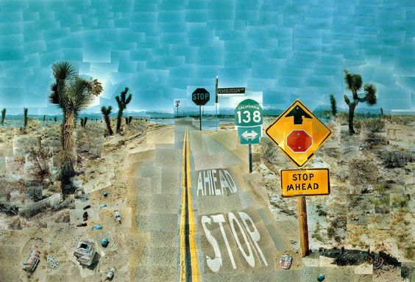
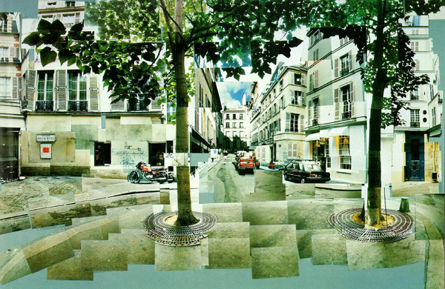
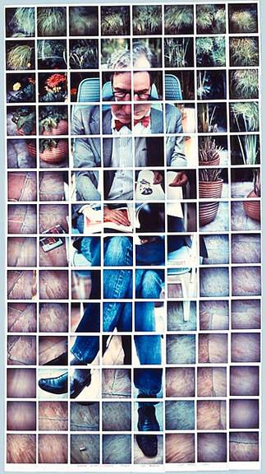
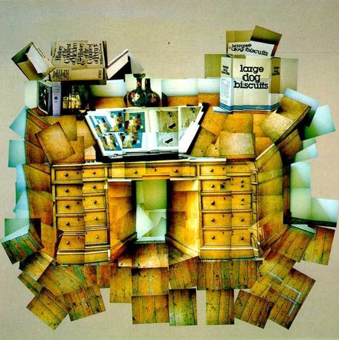
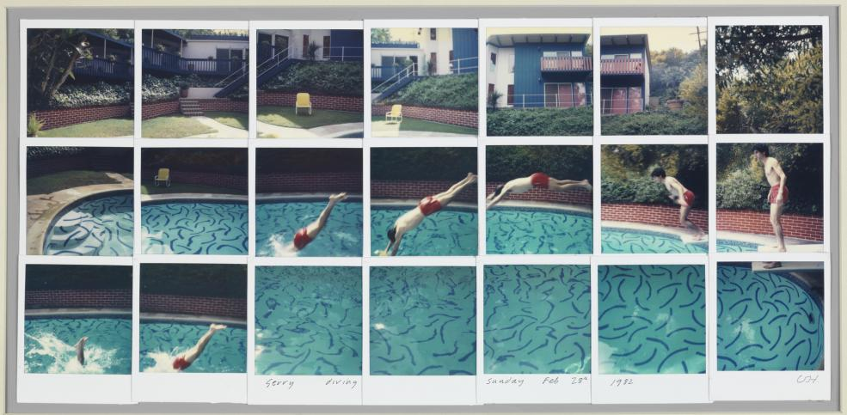
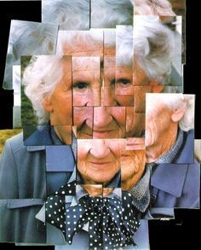
Task 2:
A series of photographs
Introduction:
David Hockney revolutionised visual art with his inventive technique of creating joiners.
This method, which involves piecing together a mosaic of photographs to form a single image, challenges traditional perspectives in both photography and painting.
By fragmenting and then reassembling the image, Hockney's joiners disrupt conventional viewpoints, inviting a deeper exploration into the idea of perception and representation.
Choose a subject to focus on – this might be a person, building or object.
Using David Hockney’s approach, take a series of photos of that one subject from different angles and distances.
You should take at least 10 photos but you may want to take more.

Slide 5
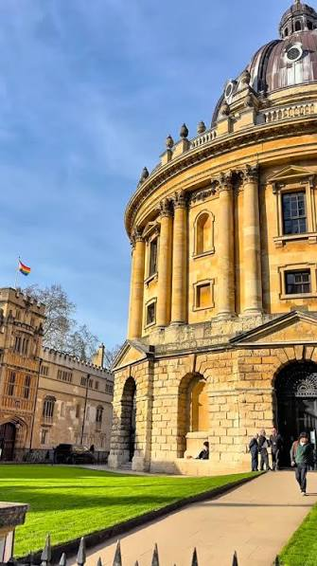
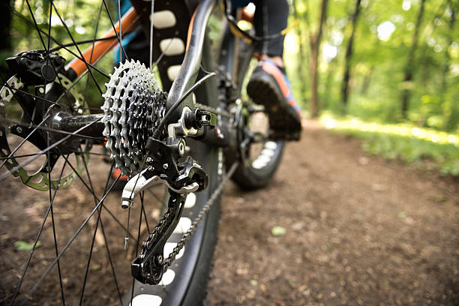
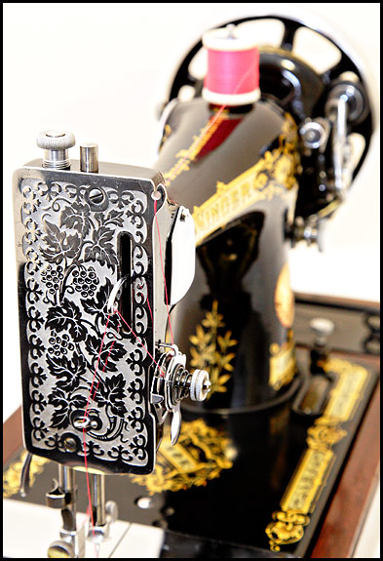
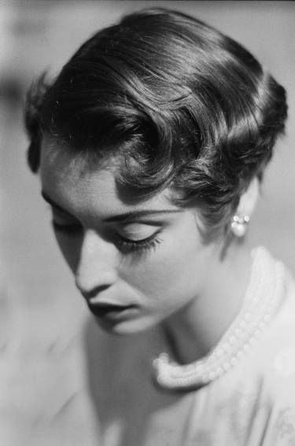
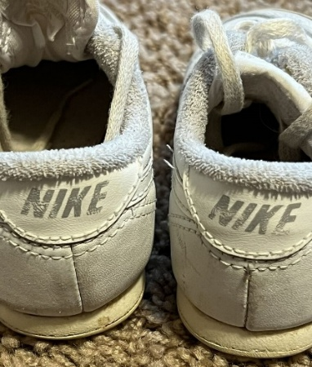
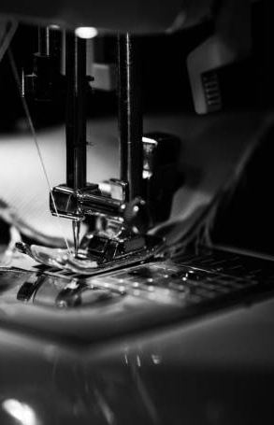
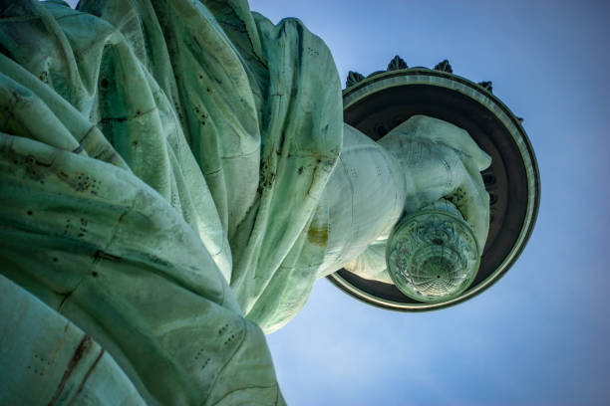
Task 2:
A series of photographs
Choose a subject to focus on – this might be a person, building or object.
Using David Hockney’s approach, take a series of photos of that one subject from different angles and distances.
You should take at least 10 photos but you may want to take more.
If possible, print out and present your photos. This only needs to be a contact sheet/thumbnails but you may want to make the more successful ones larger.

Slide 6
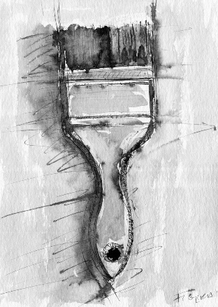
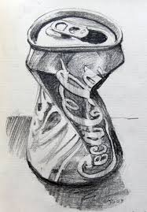
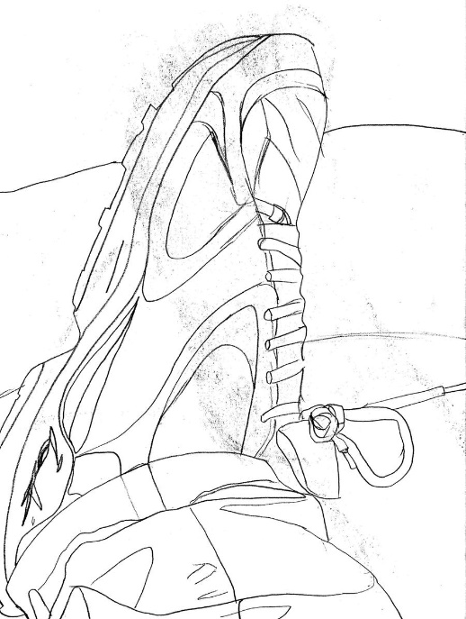
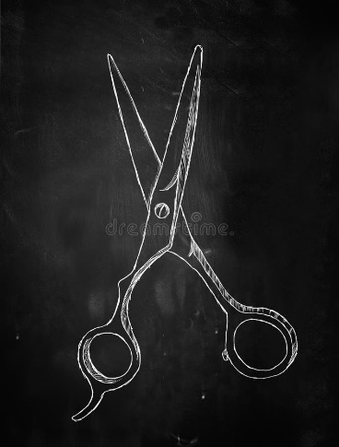
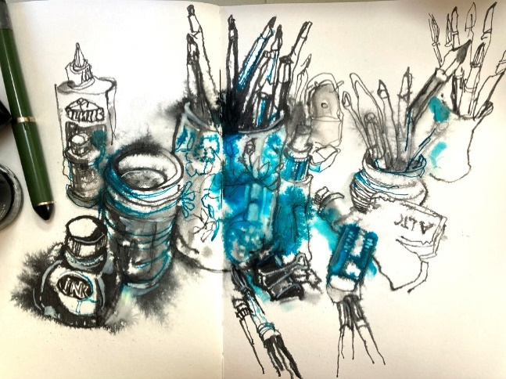
Task 3:
Observational drawings
Produce at least 3 drawings of your chosen subject.
Use the same subject as your photos for your drawings.
The size is up to you but should be no bigger than A4.
Again, consider different view points or perspectives e.g. close up, from above etc.
A view finder window might be useful to help you with composition.
If possible try to use a range of different media:
  Pencil
  Fine liner
  Pen/biro
  Coloured pencils
  Paint

Slide 7
Task 4:
A Final Outcome
The images above show the variety of approaches Hockney took for his joiner works.
Your task is to create your own ‘Joiner’ artwork, using the photos and drawings you have done as a starting point.
If you would like to try to do this digitally, there are a couple of links here to show you how:
https://digital-photography-school.com/how-to-make-a-cool-david-hockney-inspired-photomontage-in-photoshop/
You can use photos, drawings or a combination of both.
If you have the resources, you might like to try to include some textiles techniques in your final piece.
There are various ways you can approach this task. Some ideas are on the following slide.
https://www.practicalphotography.com/learning-zone/landscapes/articles/2016/6/27/piece-together-a-david-hockney-collage

Slide 8
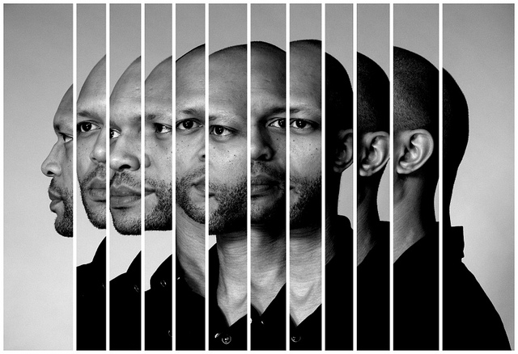
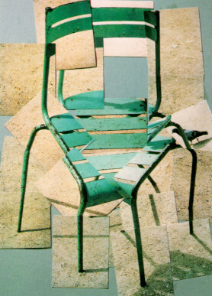
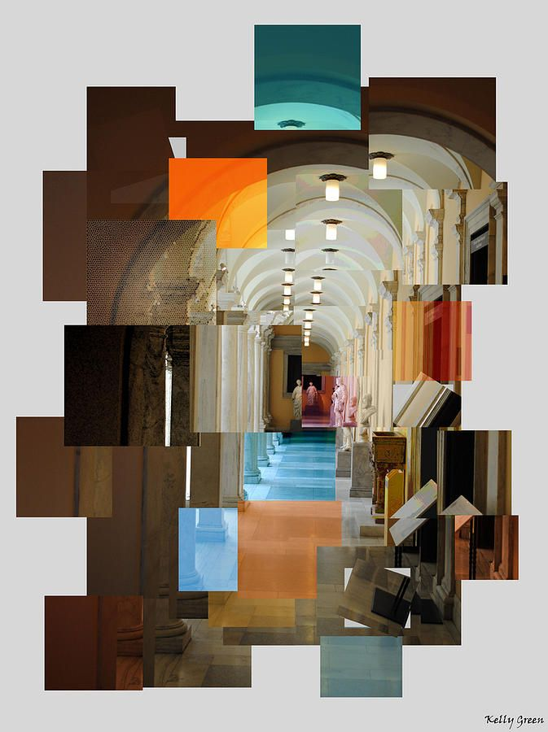
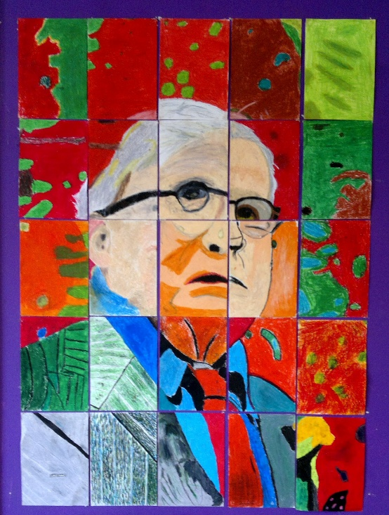
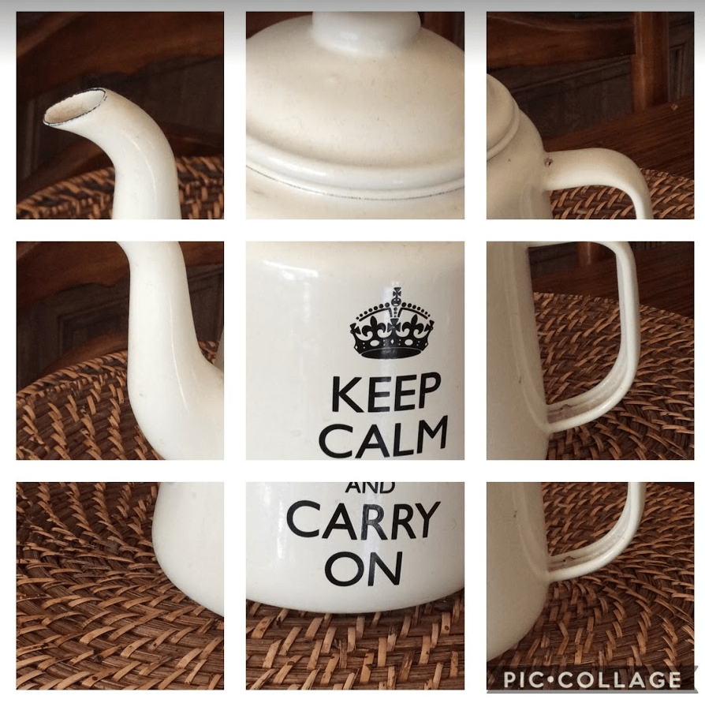
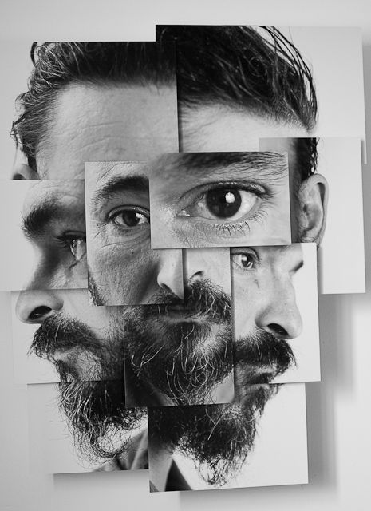

Slide 9
Transition Challenge 2026:
DAVID HOCKNEY
Hand in date:
Thursday 3rd September
Please bring your completed project to your first Textiles lesson in September.
Please email if you have any questions: dorninj@wallingfordschool.com

