Slide 1

The Boxer – Nikesh Shukla

Slide 2
Expectations
During our tutor reading sessions, we will be engaging with texts that explore a range of challenging themes. In The Boxer, these are: racism, far right extremism, family pressure, family death, friendships and prejudice.
These are themes that, if they have not already been part of your experience, you are likely to encounter in the news, social media, or everyday life.
Through our reading and discussion, we will explore key ideas linked to these topics. The purpose is not to cause offence or judge individuals, but to develop understanding, raise awareness, and provide a safe, respectful environment in which we can learn together.
In The Boxer, there is a racist slur used (P***) This is a racist word and not one we will repeat. This term is used in a derogatory way and used as a slur against people of colour. When we read the text, we will not say the word.

Slide 3
Expectations
We expect all students to approach these discussions with maturity, empathy, and sensitivity. Everyone has the right to feel safe and respected. Language or behaviour that causes harm to others is not acceptable, and will be addressed appropriately.
If you find any aspect of the material difficult or upsetting, you are encouraged to speak to your tutor, Mrs Wilson or another trusted member of staff. Support is always available.
By engaging thoughtfully with these themes, we aim to build your confidence in discussing important issues and to develop your understanding of the world around you.

Slide 4
Protected Characteristics
It is against the law to discriminate against someone because of a protected characteristic.
age
disability
gender reassignment
marriage and civil partnership
pregnancy and maternity
race
religion or belief
sex
sexual orientation
Throughout our tutor reading from Years 7 –10, will read texts that explore lots of these themes.
The reason for this is so that we can hear voices that represent different experiences than our own.

Slide 5
Introduction
The Boxer follows Sunny, a 17-year-old British Indian teenager who has recently moved from London to Bristol.
After being the victim of a racist attack, he joins a local boxing club to learn how to defend himself and rebuild his confidence. There he finds friendship, belonging and guidance from his coach, Shobu. Sunny develops a close friendship with Keir, another boxer.
However, Keir becomes increasingly influenced by far-right extremism through his family and community. As racial tensions in Bristol escalate, Sunny must navigate questions of identity, loyalty, courage and belonging. T
he novel is told over the ten rounds of Sunny's first amateur boxing match, with each round revealing key moments from the past that have led him to the fight. It explores racism, friendship, radicalisation and resilience in modern Britain.

Slide 6
Introduction
Watch the clips introduction, it does matter, and dealing with racists on the link here.
You could also watch this clip here. The clip explores discourse around racism, based on the book The Good Immigrant (NB: there is a swear word in this clip)

Slide 7

Young Carers
Young carers are under 18’s who have a caring role for someone at home. This looks different for everyone!
If you think you might be a young carer like Sunny in The Boxer, then talk to your tutor or come along to the young carers group on a Monday lunchtime in K11.

Slide 8
Immigrant (noun)
Im-ee-grant
Definition: A person who comes from a different country to live in a new one permanently.
Variation: immigration (noun)
Morphology: the prefix of 'im' means to go into; the root word migrate means to move from one place to another.
Page 84-86

Slide 9
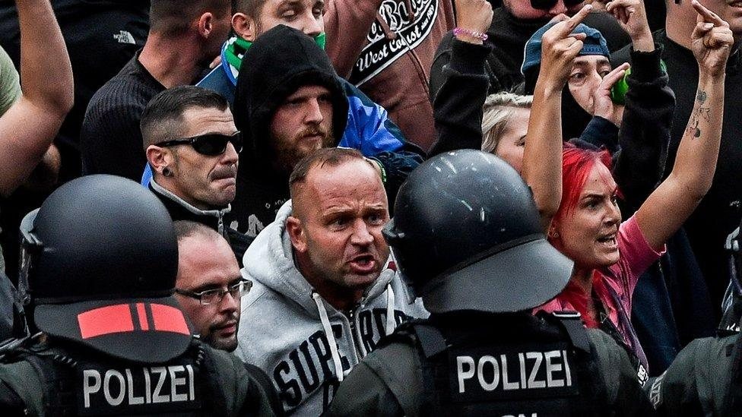
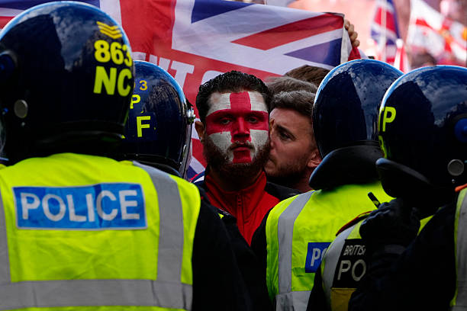
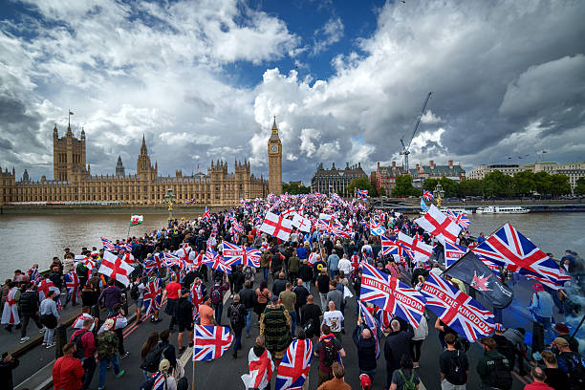
What is far-right extremism?
In The Boxer, far- right extremist views are portayed. You may have heard this term in the media but, for clarity, we will be using the definition below.
Far-right extremism is the belief that people from certain races, religions, or countries do not belong and should be treated differently. People with these extreme views often blame other groups for society's problem.
In recent years, we have seen a rise in far right extremist views in the UK. This may be due to political discourse and frustrations, economic worries, media and social media.
Extremism Clip

Slide 10
What is far-right extremism?
Right-wing protests are demonstrations organised by people or groups who often support stronger border controls, lower immigration levels, greater national identity and stricter law and order policies. Some protesters believe that immigration places pressure on housing, schools, healthcare and jobs.
However, these views are not shared by everyone. Critics argue that immigrants make important contributions to society by working, paying taxes and filling jobs in sectors such as healthcare and construction. They also point out that economic and social problems are often caused by many different factors, not immigration alone.

Slide 11
What is far-right extremism?
Not everyone who attends an anti-immigration protest is racist. Some are expressing concerns about government policies.
However, some protests have also attracted extremist groups and individuals who direct hostility towards immigrants, refugees or minority ethnic groups.
It is important to distinguish between debating immigration policy and showing prejudice towards people because of their background.
As we read The Boxer, we will encounter this views and we can decide whether the views are debate about immigration policy or extreme prejudice views.

Slide 12



Think, pair, share- 45/45/45
"Sometimes you have to be cruel to be kind."
Cruel
Kind
Is there a difference between being honest and being hurtful?
Does intention matter more than impact?
Should we protect people's feelings?
Can telling the truth ever be selfish?
Is a "white lie" sometimes the kinder choice?
Would your opinion change if Jag knew Sunny was lonely?
Page 64

Slide 13
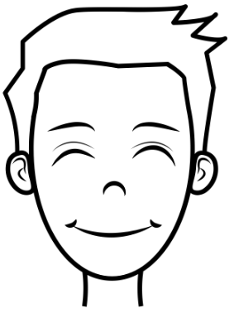
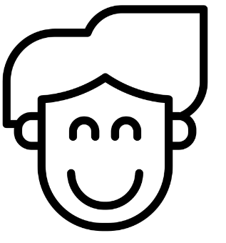
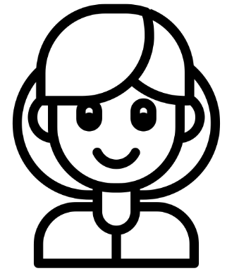
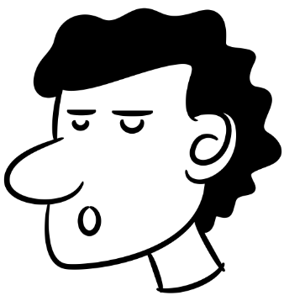
"Boxing is simply violence with rules."
"Boxing teaches discipline, respect and self-control."
Question:
"I don't know why you want to learn to beat people up."
"Whether boxing is violent depends on how people use it."
"Boxing is no more violent than sports like rugby or martial arts."
Page 80

Slide 14
Think, pair, share- 45/45/30
The people we love should be our biggest motivation.
Partner A | Partner B | Points to Consider
You MUST state that the people you love should be our biggest motivations. I agree with the statement because ____ | You MUST disagree with the statement and argue that we should be motivated by our own goals a I disagree with the statement because____ | Family and friends inspire us. Achievements mean more when shared. Helping others gives life purpose. You are responsible for your own happiness. Living someone else's dream creates pressure. You work harder for goals you choose. Everyone deserves to follow their own passions. Success is more meaningful when it comes from your own choices.
Page 83

Slide 15
Immigrant (noun)
Im-ee-grant
Definition: A person who comes from a different country to live in a new one permanently.
Variation: immigration (noun)
Morphology: the prefix of 'im' means to go into; the root word migrate means to move from one place to another.
Page 84-86

Slide 16
Page 84-86
Always, sometimes, never...
The word immigrant is a controversial word in today's society.
Always | Sometimes | Never
What does the word immigrant mean?
Where have you heard this word before?
What are the connotations (thoughts, feelings, ideas) that you associate with the word immigrant?
How are immigrants portrayed in modern society?

Slide 17
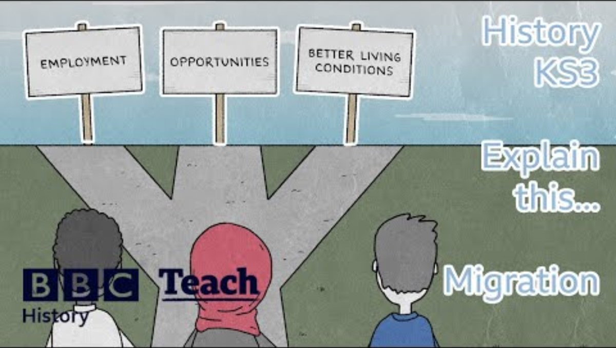
Page 84-86

Slide 18
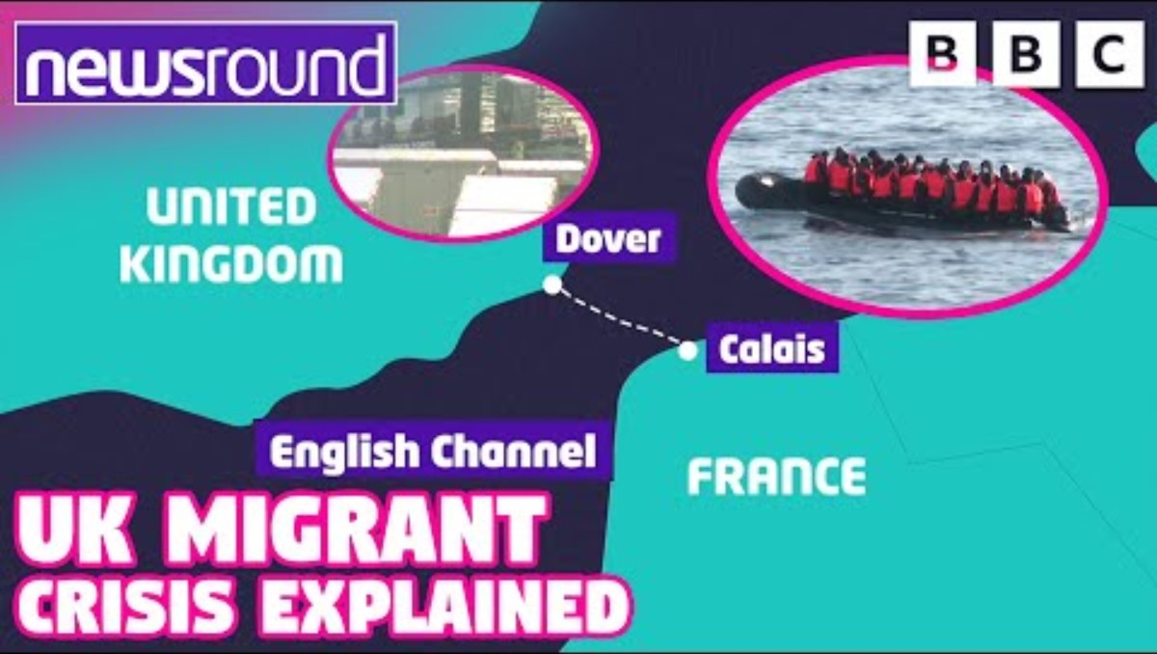
Page 84-86

Slide 19
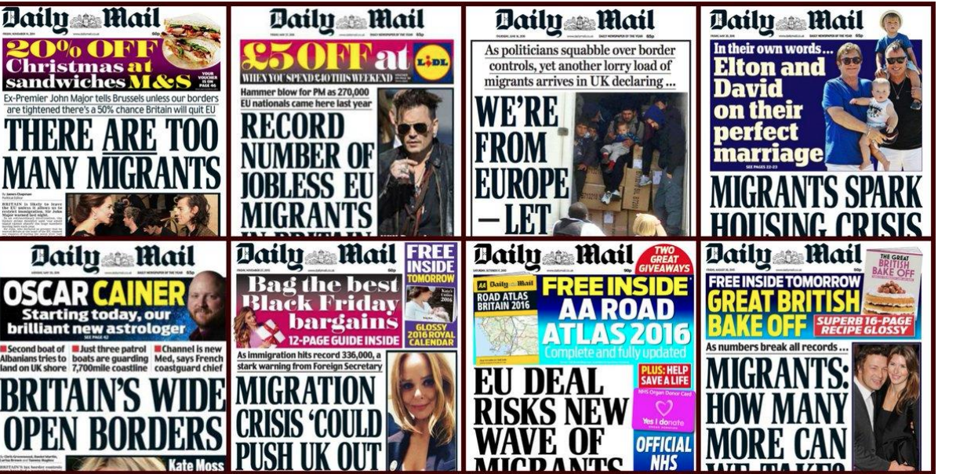
Which words are powerful in these headlines?
What message are they spreading?

Slide 20
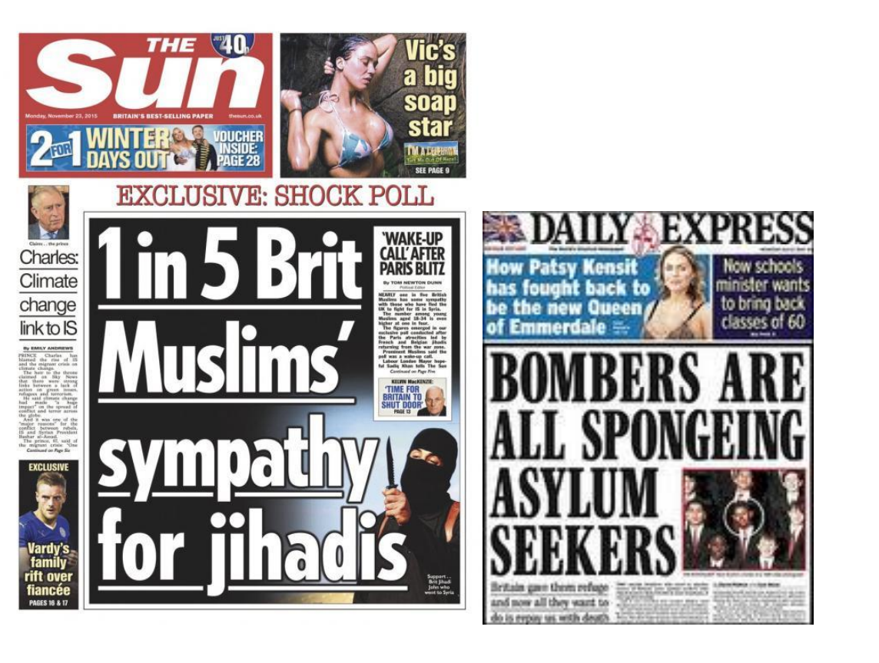
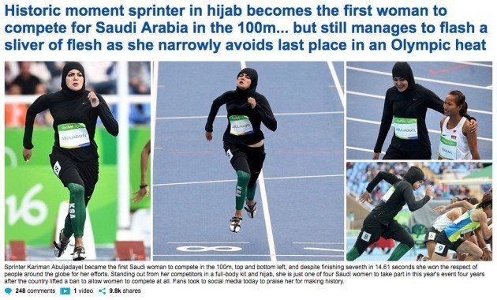
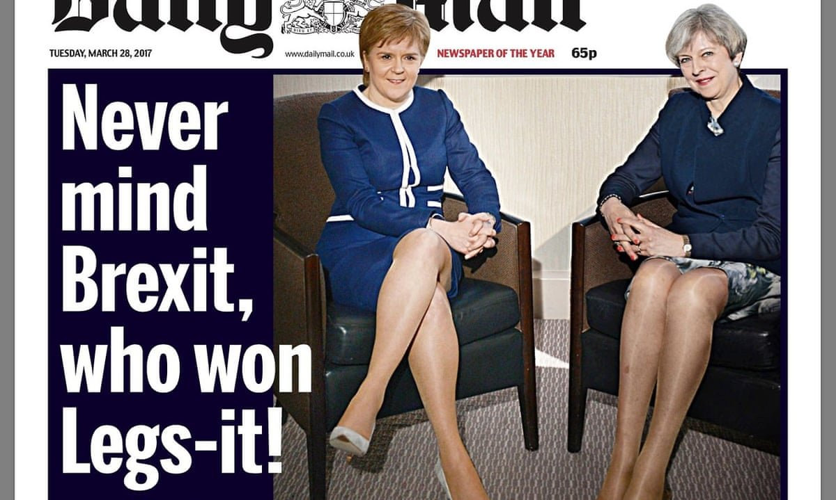
Which words are powerful in these headlines?
What message are they spreading?

Slide 21
Page 84-86
Immigration
The word immigration has become a very loaded and controversial word in modern society and certainly modern media. At its most basic level, the word is neutral. It describes movement from one country to another.
People immigrate for many reasons. They might be looking for work, escaping war, joining family members, studying, or hoping for a better future.
However, words are not only shaped by dictionary definitions. They are also shaped by the stories we hear about them.
In modern Britain, when some people hear the word immigrant, they immediately picture small boats crossing the English Channel. They may also hear claims that immigrants are "taking our jobs" or putting pressure on public services. These images and ideas appear frequently in some newspapers, television programmes and online discussions.
The problem is that this picture represents only a small part of a much bigger story.

Slide 22
Immigration
Imagine if someone described all teenagers by showing only news reports about teenagers who had been arrested. That would create a very narrow and unfair picture. Most teenagers are not involved in crime, but if that is all we see, we might begin to think otherwise.
The same thing can happen with immigration. Most immigrants do not arrive in small boats. Many arrive on planes with work visas, student visas or family visas. Some become doctors, nurses, teachers, engineers, scientists, builders, shopkeepers and business owners. Many pay taxes, start families and contribute to the communities where they live.
History also reminds us that migration is not unusual. Throughout history, people have moved between countries in search of safety, opportunity and a better life. In fact, many British families can trace stories of migration somewhere in their own family history, whether recently or generations ago.
Page 84-86

Slide 23
Immigration
This does not mean that everyone agrees about how immigration should be managed. Governments have to make decisions about borders, laws and resources. Reasonable people can disagree about these issues.
But it is important to remember that an immigrant is first and foremost a human being, not a headline or a stereotype.
When reading The Boxer, we should think carefully about the experiences of people who leave one place and begin again somewhere new. Instead of asking, "What do the media say about immigrants?", we might ask, "What would it feel like to leave your home, arrive in a new country and try to build a life there?" Or what does it feel like to be treated differently because you are an immigrant?
Page 84-86

Slide 24
Good friends should be forgiven for ignorant comments if they are willing to learn.
A single insensitive comment should not outweigh years of friendship and loyalty
"People should always speak up when they experience prejudice, even if it risks damaging a friendship."
If your values do not align with your friends, especially when it comes to predjuice, you shouldn't be their friend.
It's a friend's responsibility to challenge prejudice. -people are more likely to change their views through patient conversation than through confrontation.
Page 121

Slide 25
Think, pair, share- 45/45/45
Kier has a right to be angry. How far to you agree with this statement?
Strongly Agree
Agree
Partially Agree
Disagree
Strongly Disagree
Page 138

Slide 26
Think, pair, share- 45/45/45
Who is responsible for the fight?
Place each character on the blame line: Sunny, Kier, Joe, Madhu's family, Kier's family
100% responsible
0% responsible
Questions for thought:
Why did you place them there?
Who created the original problem?
Who made the situation worse?
Could anything have stopped the fight?
Page 138

Slide 27
Far Right Extremism in Britain
What do you already remember about far right extremism?
This clip contains very sensitive information. The clips are being used to educate and highlight things to be aware of in today's current climate. Link here.
How does this link to The Boxer and Kier's character in particular?
Page 181

Slide 28
Page 224-225
Anti-Racism
Being anti-racist means actively opposing racism by challenging racist policies, practices, and beliefs, and working towards creating an inclusive and equitable society.
It involves educating oneself, calling out discrimination, and supporting marginalized communities to dismantle systemic racism.

Slide 29
Think, pair, share- 45/45/45
"Someone needs to hold them to account. Do you tell then they are wrong?" It's not enough to be non-racist. For change to happen, we need to be anti-racist.
Key point to consider: What is the difference between being non-racist and being anti-racist? Do people have a responsibility to challenge racist comments or behaviour when they witness them? What might happen if people hear prejudice but choose to stay silent? Why might someone choose not to challenge racism, even if they disagree with it? Is it fair to expect everyone to speak up against racism, or should it be a personal choice? | Structure for argument: Arguably, we need to be anti-racist because ____ I agree/disagree with the statement because ___
Key Vocabulary: power, privilege, opportunity, racism, challenge, prejudice, voice.
Page 224-225

