Slide 1
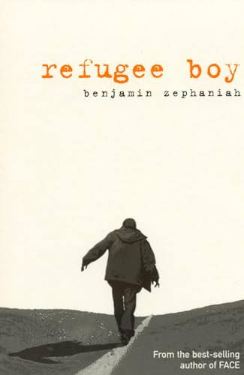
Refugee Boy- Bejamin Zephaniah

Slide 2
Expectations
During our tutor reading sessions, we will be engaging with texts that explore a range of challenging themes. In Refugee Boy, these include friendships, immigration, mistreatment and prejudice against migrants, war and conflict and family.
These are themes that, if they have not already been part of your experience, you are likely to encounter in the news, social media, or everyday life.
Through our reading and discussion, we will explore key ideas linked to these topics. The purpose is not to cause offence or judge individuals, but to develop understanding, raise awareness, and provide a safe, respectful environment in which we can learn together.

Slide 3
Expectations
We expect all students to approach these discussions with maturity, empathy, and sensitivity. Everyone has the right to feel safe and respected. Language or behaviour that causes harm to others is not acceptable, and will be addressed appropriately.
If you find any aspect of the material difficult or upsetting, you are encouraged to speak to your tutor, Mrs Wilson or another trusted member of staff. Support is always available.
By engaging thoughtfully with these themes, we aim to build your confidence in discussing important issues and to develop your understanding of the world around you.

Slide 4
Introduction
Refugee Boy tells the story of Alem Kelo, a 14-year-old boy whose mother is Ethiopian and whose father is Eritrean. Because Ethiopia and Eritrea are at war, his parents' mixed marriage becomes increasingly difficult.
During a trip to London, Alem's father abandons him and leaves a letter explaining that he cannot safely return to either country. Alem is suddenly left alone and must seek asylum in the UK.
The novel follows Alem's struggles as he navigates the British asylum system, faces uncertainty about his future, and tries to build a new life.
Despite many challenges, he finds friendship, support, and hope.
The story explores what it means to belong and highlights the difficulties faced by refugees.

Slide 5
Semantics
Interestingly, this novel was published 2001 and adapted into a play in 2003. Many of the challenges Alem faces are echoed in modern discourse and narratives surrounding refugees and migration.
  When you hear the word “refugee”, what images or ideas immediately come into your head?
  Where do you think those images come from?
  Do we tend to hear about refugees as individual people, or as a large group?
  What is lost when thousands of different people are described simply as “migrants” or “refugees”?
On the next slide are a series of statements. Read through them and consider: What is the difference between the two statements? What does each one make you imagine? Which words carry the most emotional weight?
Pre reading

Slide 6
Statement A | Statement B
People arrive in Britain in small boats. | People risk their lives crossing the Channel to seek safety.
Asylum seekers are being housed in hotels. | People seeking asylum are being temporarily housed in hotels.
Illegal immigrants have crossed the Channel. | People have crossed the Channel and are seeking asylum.
A family comes to Britain. | A family comes to Britain because they are no longer safe in their home country.
Migrants arrive hoping for a better life. | People leave their homes hoping to build a safer future.
A boat carrying migrants arrives on the Kent coast. | A boat carrying people seeking safety arrives on the Kent coast.
Britain receives another group of migrants. | Britain receives another group of people seeking asylum.
People cross the English Channel in small boats. | People make a dangerous journey across the English Channel in search of safety.
Hundreds of migrants have crossed the Channel this year. | Hundreds of people have made dangerous journeys across the Channel this year.
Pre reading

Slide 7
Refugee (noun)
Ref-u-gee
Definition: Refugees are people who have fled war, violence, conflict or persecution and have crossed an international border to find safety in another country.
Morphology: the prefix of re means to go back; from French refugie meaning to shelter or to protect; the word means to return, to go back to shelter and protection.
Pre reading

Slide 8
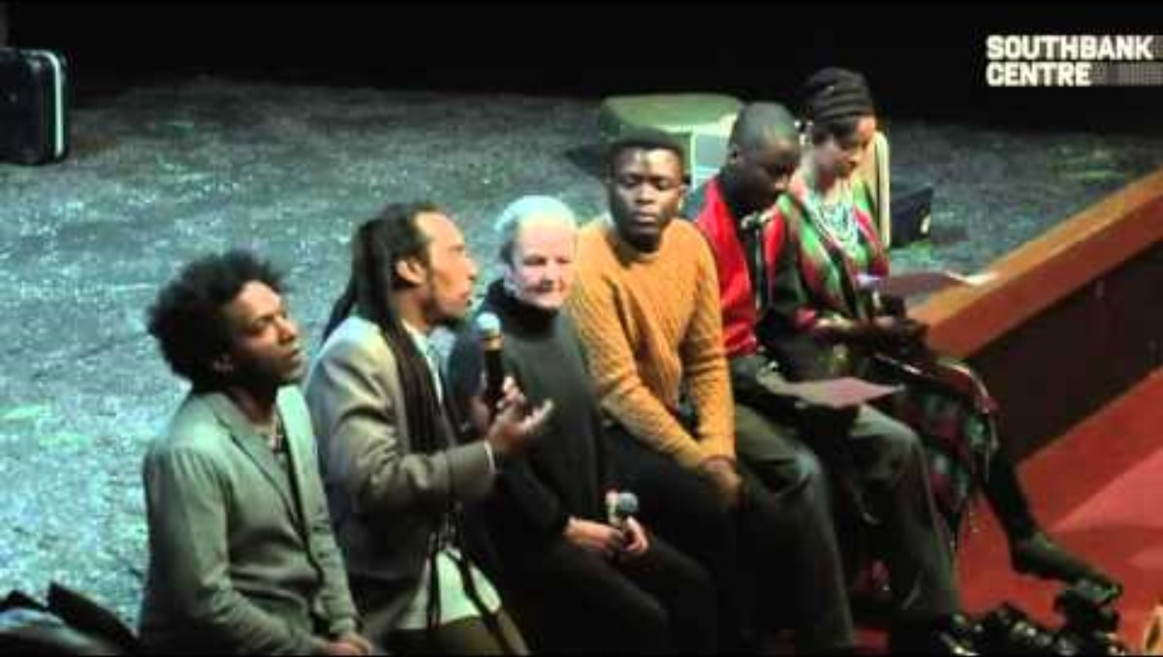
Pre reading

Slide 9
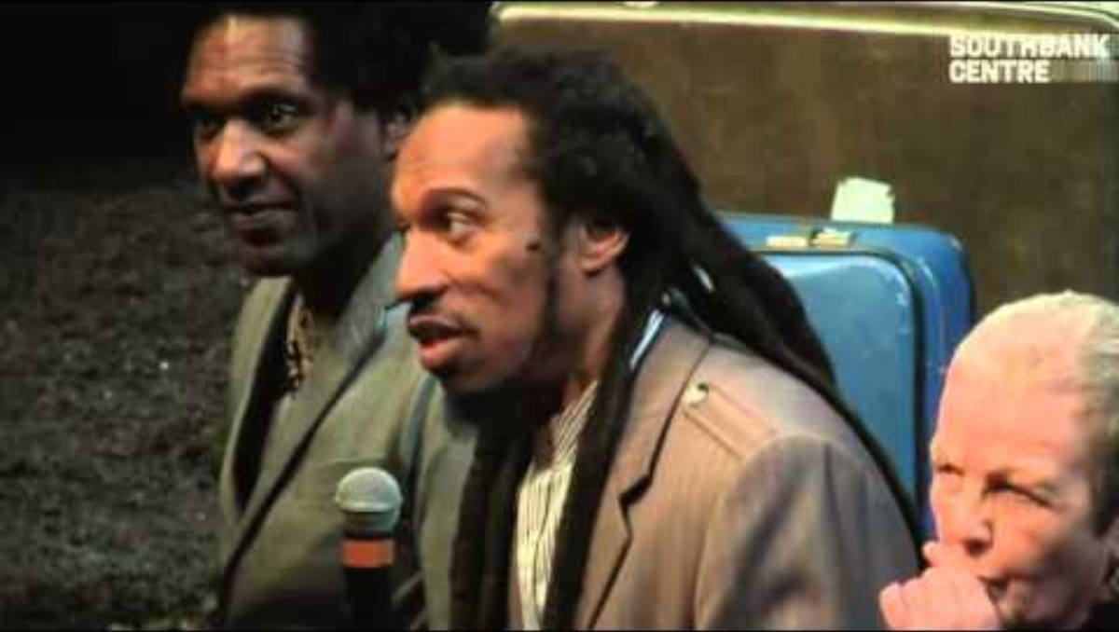
Pre reading

Slide 10
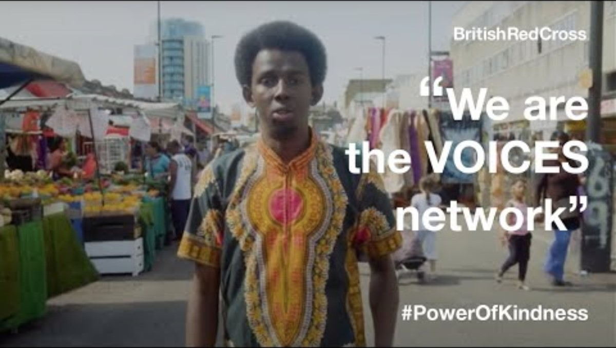
Pre reading

Slide 11
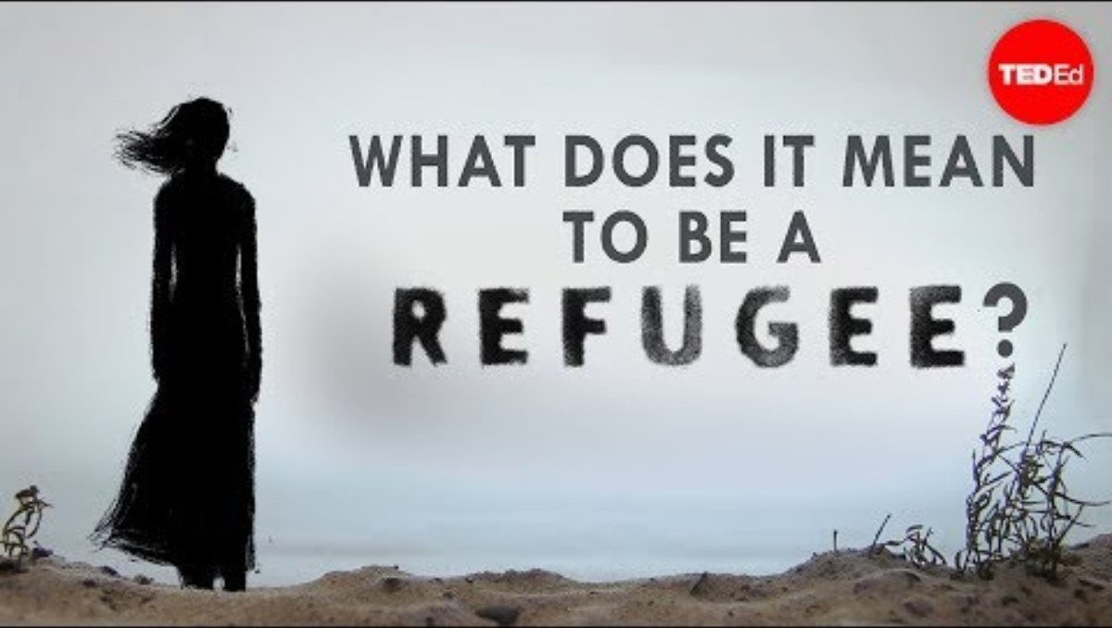
Pre reading

Slide 12
Migrant (noun)
My-grant
Definition: A migrant is a person who moves from one place to another, often to find work or a better home.
Variation: migrate (verb) immigrant (noun) emigrant (noun) migration (noun)
Morphology: migr = to depart, to move from one place to another.
Immigrant –someone who arrives at a new country to live.
Emigrant – someone who leaves one country to go into another to live.
Pre reading

Slide 13
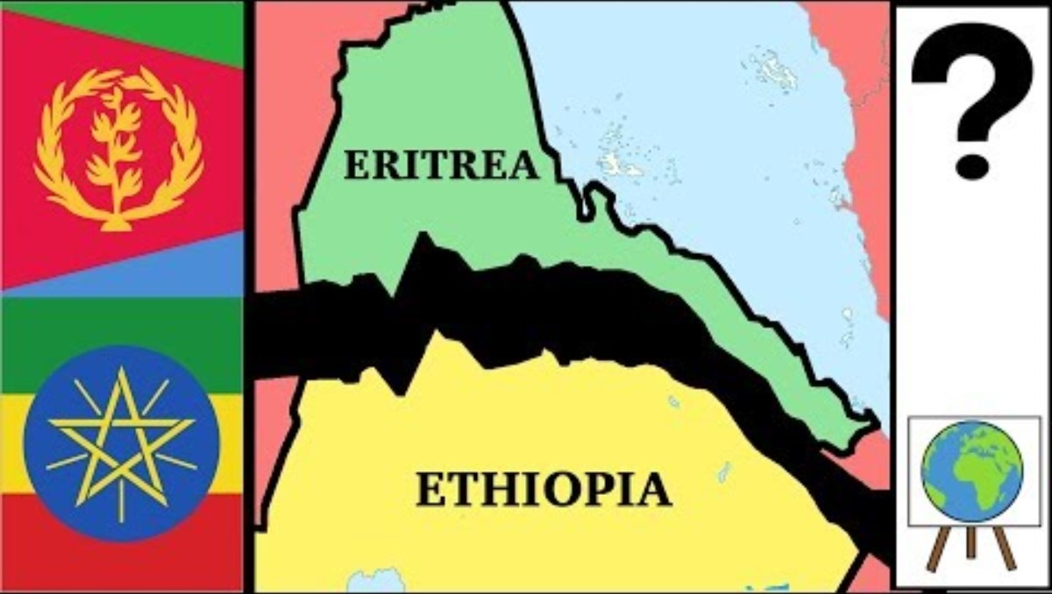
Pre reading

Slide 14
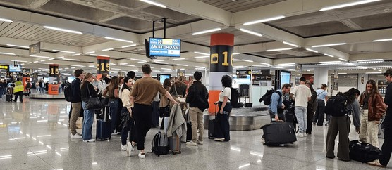
What opportunities could this offer?
What challenges could it pose?
Page 6

Slide 15
Imagine you see this as a child.
Imagine you don't speak the native language.
Does this change your experience here?
Page 6

Slide 16



Think, pair, share- 45/45/30
Has Alem's father done the right thing?
Partner A | Partner B | Points to Consider
You MUST state that the people you love should be our biggest motivations. I agree with the statement because ____ | You MUST disagree with the statement and argue that we should be motivated by our own goals a I disagree with the statement because____ | Was Alem's father protecting him, or abandoning him? Does the fact that he loves Alem make his decision more understandable? Does a parent have the right to make such a huge decision on behalf of their child? Would your opinion change if Alem were 18 rather than a young teenager? Does the danger Alem might face at home justify separating him from his father? Can someone make the wrong decision for the right reasons?
Page 25

Slide 17
Think, pair, share- 45/45/45
In a conflict between two sides, it is possible to fight for peace without choosing a side.
Agree
Disagree
Can you oppose war without supporting either side?
Is refusing to choose a side itself a choice?
If one side is clearly behaving unjustly, should you remain neutral?
Can you fight against something without fighting for the opposing side?
Is peace possible if nobody is willing to take action?
Does choosing peace make someone a coward or brave?
What might happen if everyone refused to take sides?
What does Alem’s father mean when he says he would “fight for peace”?
Page 35-36

Slide 18
Always, sometimes, never...
Having more than one cultural identity makes belonging harder.
Always | Sometimes | Never
What does it mean to have a cultural identity?
Why might having two cultural identities make someone feel that they don't fully belong to either?
Could having two cultures actually mean you have more places where you belong, rather than fewer?
Does the problem lie with the person's identity, or with the way other people respond to it?
What happens when two cultures or countries are in conflict with each other?
Is belonging about who you are, or about whether other people accept you?
Page 35-36

Slide 19
Think, pair, share- 45/45/45
Page 77
'The system is not fair. There no one more innocent than you, but look at the way you've been treated. Criminals are all over the world but the big difference between a dictatorship and a democracy is that in a democracy the criminals are voted in.'
Agree
Disagree
Can innocent people be treated unfairly?
Does having laws automatically make a society fair?
Can a system be legal but still unfair?
What is the difference between a democracy and a dictatorship?
Does voting automatically make a government fair?
Can people vote for someone who behaves badly or abuses power?
If people freely elect a government, who is responsible for its actions?
Can a democracy still be unjust?

Slide 20
Think, pair, share- 45/45/45
Refugee Boy emphasises that fact that attitudes towards refugees haven't changed over time.
Key point to consider: What attitudes do people show towards Alem? Is Alem judged because of who he is, or because of the label “refugee”? How does the treatment of refugees in the novel compare with attitudes you see or hear about today? Are refugees treated more sympathetically today? Do we have greater awareness of refugees' experiences? Are there more organisations and laws designed to protect refugees? Has social media changed the way people talk about refugees? | Structure for argument: I agree/disagree that Refugee Boy emphasises that attitudes towards refugees haven't changed over time because ___
Key Vocabulary: Refugee, prejudice, discriinatory, protection, stereotypes, belonging
Page 123

Slide 21
What shapes cultural identity?
Page 171
Makes up cultural identity | Can contribute to cultural identity | Not necessarily cultural identity
Food
Music
Language
Family
Religion
Nationality
Where you were born
Where you grew up
Friends
Traditions
Values
Hobbies​
Clothes​
History​
Memories​
Accent​
Where you feel at home​
Organise each of these contributing factors into the columns above.
Are there any that belong in more than one column?
Are there any factors missing?

Slide 22
Think, pair, share- 45/45/45
Page 171
“Cultural identity is something you choose.”
Agree
Disagree

Slide 23
Think, pair, share- 45/45/45
Page 171
“Cultural identity is something other people give you.”
Agree
Disagree

Slide 24
Think, pair, share- 45/45/45
Page 171
“You should be able to decide your own cultural identity.”
Agree
Disagree

Slide 25
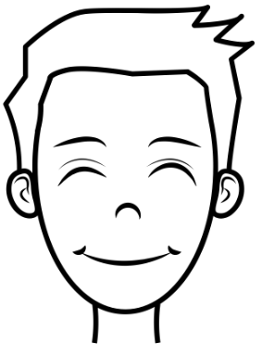
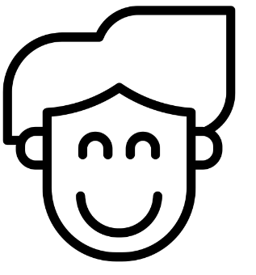
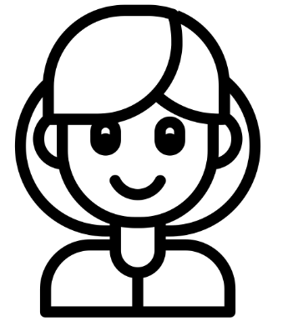
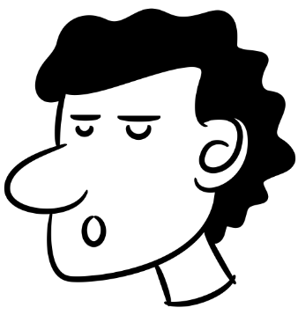
If you believe a decision is unjust, you have a responsibility to protest against it rather than simply accept it.
Alem’s friends are right to protest because standing by someone who is being treated unfairly is more important than simply following the rules.
Are Alem's friends doing the right thing?
If the law has made a decision, we respect it and abide by it, even when we disagree with it.
The protest may be understandable, but putting themselves at risk could make the situation worse. Sometimes you have to accept a decision you disagree with.
Page 232

