Slide 1
Joseph Garnett-1055
Penknife carry pouch
Notes:
lklklk

Slide 2
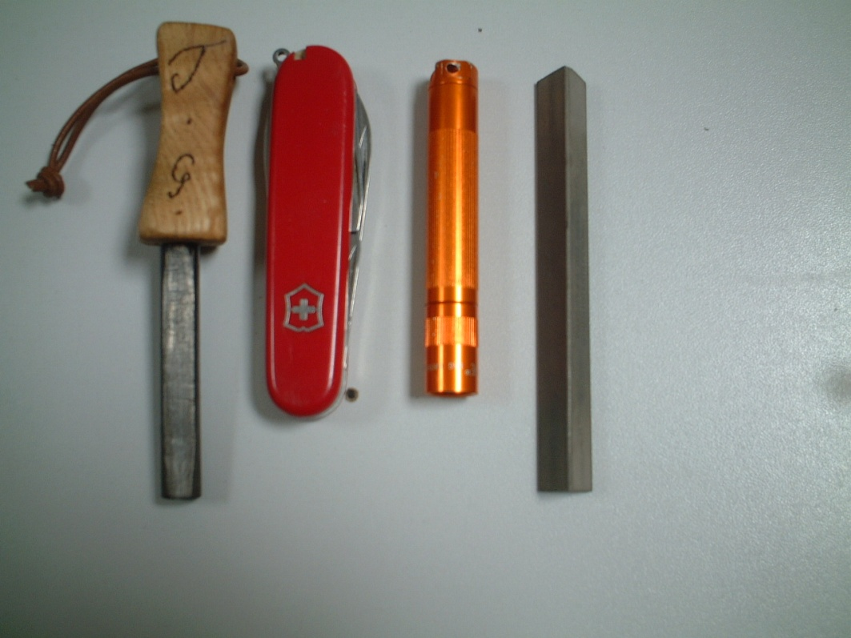
Design Brief:
Design Problem:
Currently on the market, there are only products that can hold a maximum of two items (usually a penknife and a firesteel) and I have found this to be a problem because when I am in the field, I find that I am using my penknife a lot and so I need a quick way of touching up the blade after use and usually, my sharpening rod is held in my pocket but this has proven to be risky as on more than one occasion I have nearly lost the sharpening rod.
I also find myself wanting access to a small torch that is strong enough for reading a map but not as strong as a head torch as using a bright light can ruin your night vision and so a smaller torch is more suitable.
Target Market:
My target market is people who regularly partake in bushcraft expeditions or camps who need an easier way to carry their equipment. I am aiming at an audience of people aged 16-50 as they are the people who are most likely to need this piece of equipment and their tastes in aesthetics would not differ too much. The target market is one of great knowledge and so I will need to approach some experts in the field of bushcraft in order to get a well rounded view of what to construct.
I would be aiming to sell the product either online or at bushcraft fairs where the product could be viewed in the flesh.
The product would be hand made in batches in order to preserve and maintain quality, whilst making sure the product fits every penknife that the customer owns.
Design Brief:
I have decided that the best thing to do is to make and evaluate an innovative method of carrying a penknife, a firesteel, a Maglite solitaire and a sharpening rod. The product will be compatible with belts so that it can be worn on the hip and it will also have the ability to be worn on a large knife sheath for scout or cross draw carrying positions. I will be making the product out of 3-3.5mm and 5-5.5mm leather as I have great experience in leather work and it is also a good material for the job as it is breathable, so any moisture that enters the pouch can exit and it is also an extremely strong material. Leather is also a very customizable material and so the product will be truly unique as I can emboss shapes into the leather and the leather can be dyed different colours.
Key Issues:
Some people may believe that the making of a product that is associated with violence is wrong but it is important to remind people that penknives used for bushcraft are no more and no less than tools and every person using the penknife is an expert at what they do.
Some people may also be opposed to using an animal product for the construction but it is important to remember that the leather used is the bi product of animals (usually cows) that have been killed for food and so using leather is actually preventing the hides being thrown away as waste.
ID

Slide 3
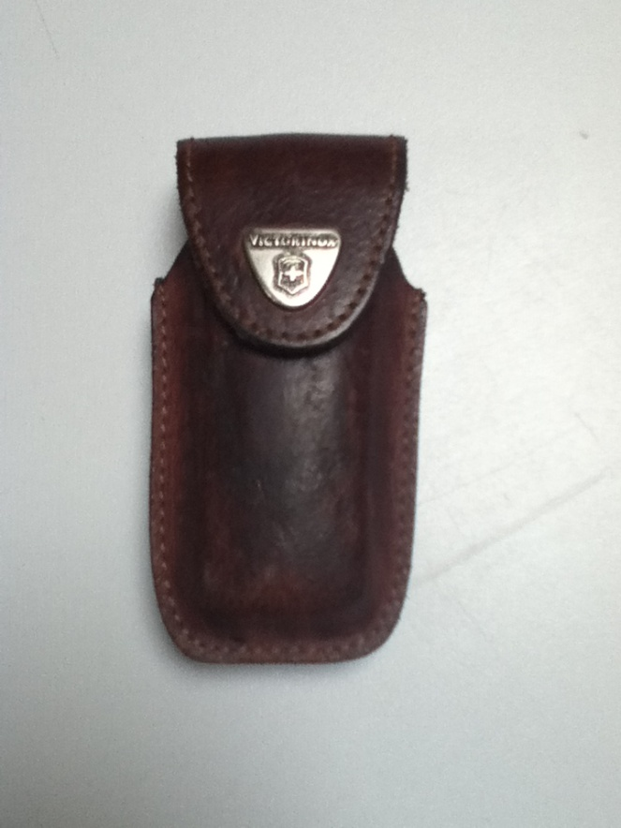
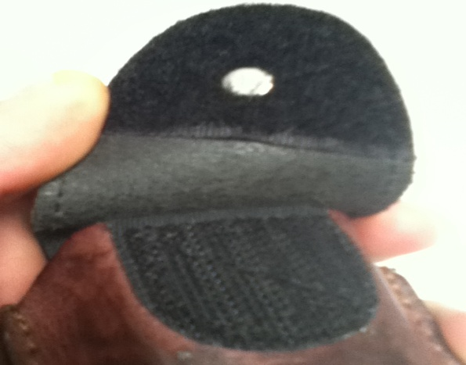
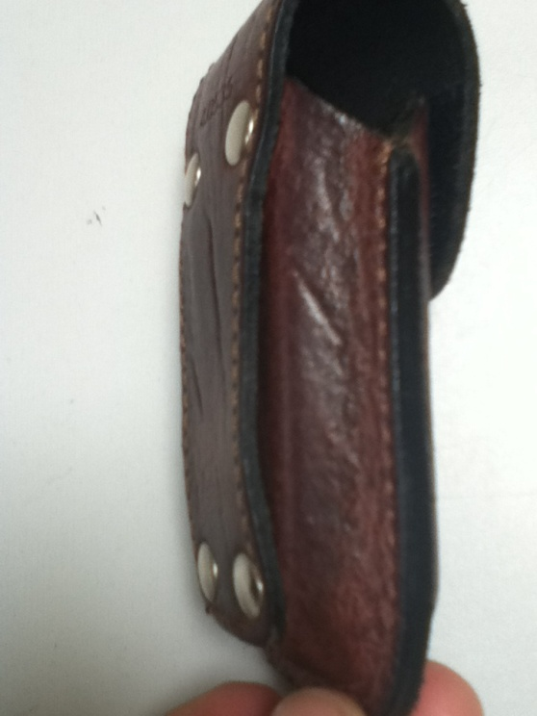
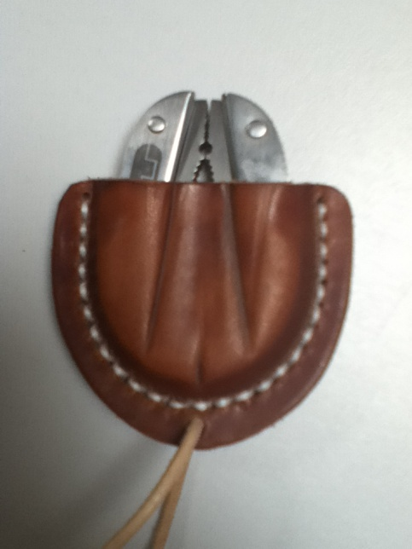
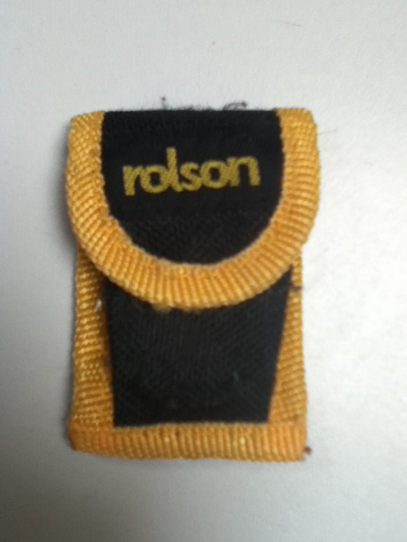
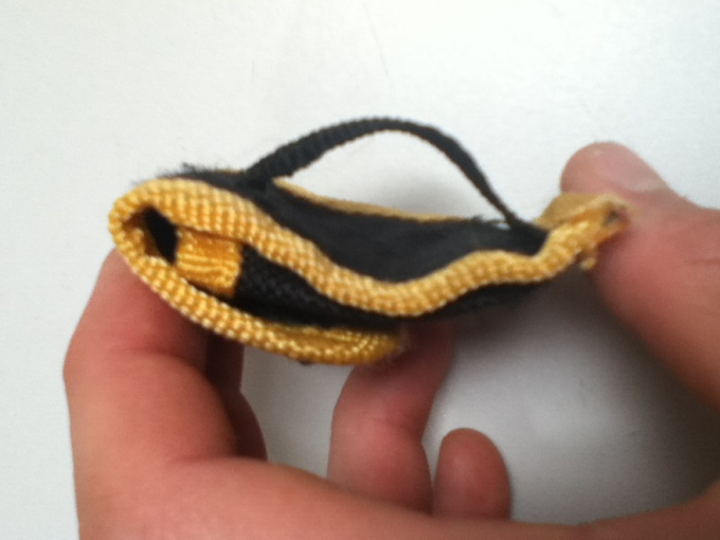
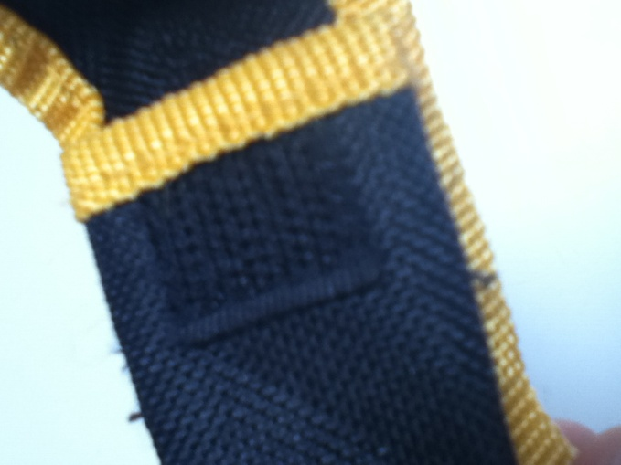
Information, Inspiration and influences
This pouch was made by Victorinox in 2008 and sold for between £11.94 and £15.20. It is a good pouch because it can be carried on the belt and accommodates several sizes of belt. It also looks good with the brown leather and the silver Victorinox logo on the flap and the brown stitching goes well with the leather. However, the belt loop is riveted on flat so it is hard to get a belt under the belt loop and the Velcro that holds the pouch shut looses its strength if it gets dirt in it (a likely occurrence in the field) which could result in the loss of the penknife. The pouch also only holds 1 item (two small items can just about fit) which means it has limited use.
This pouch is designed for a Rolson 6 In 1 Mini Multi Plier Tool and is designed to be used on a belt. It is very light and made of canvas. Although it does not have to aesthetic value of leather, it is lighter than a leather pouch and it is held shut by Velcro. The Velcro is prone to the same problems as the Victorinox pouch and the belt loop (which is very small) feels very flimsy. The pouch is held together by black nylon thread and is machined stitched which is quite strong.
I did make a friction sheath for this multi tool that hangs on a neck laniard and the sheath has been wet formed round the multi tool so it is held without a retention strap. However, neither of these pouches can carry any more than 1 item.

Slide 4
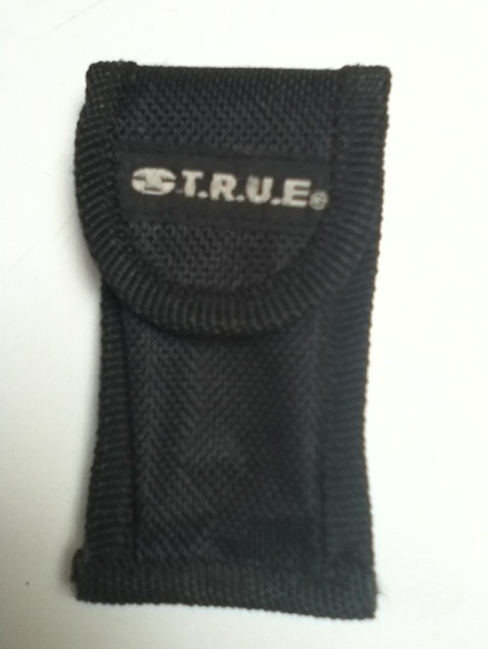
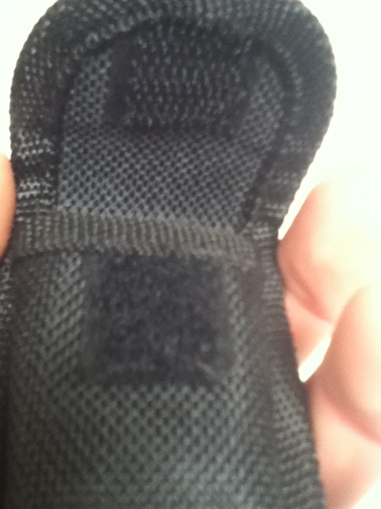
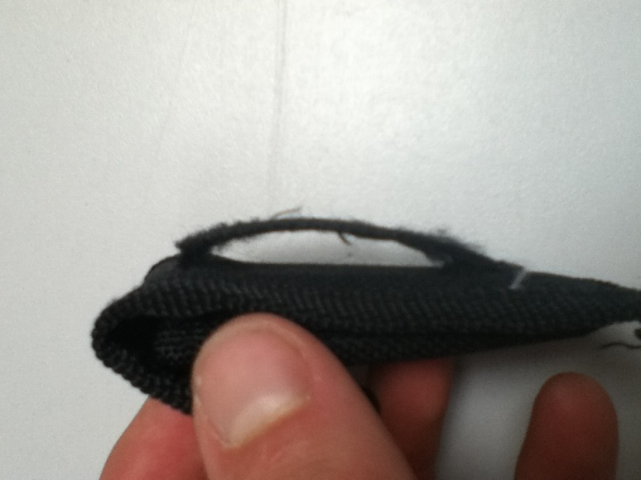
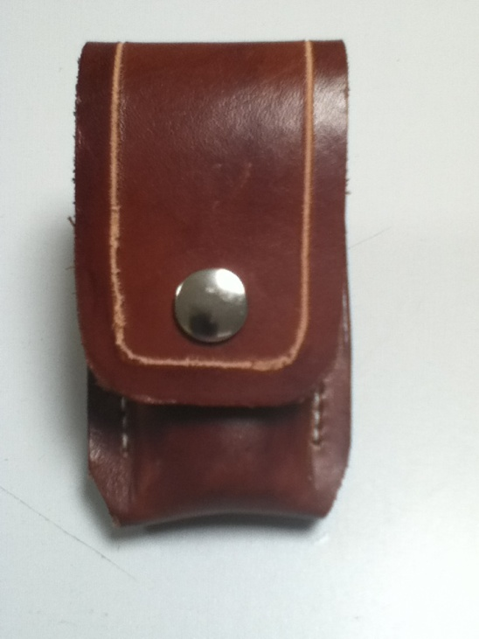
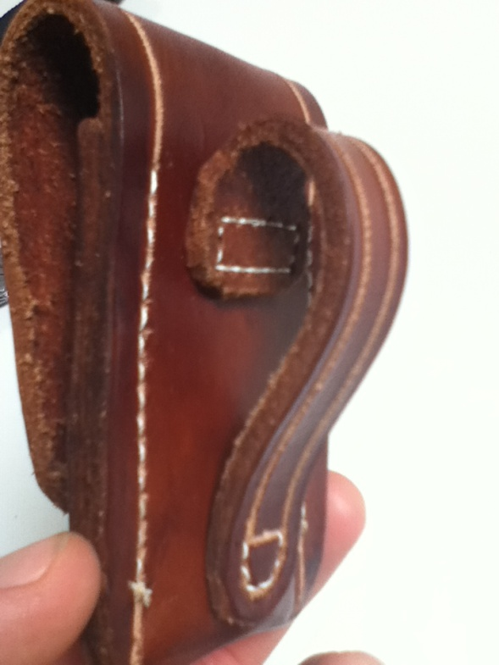
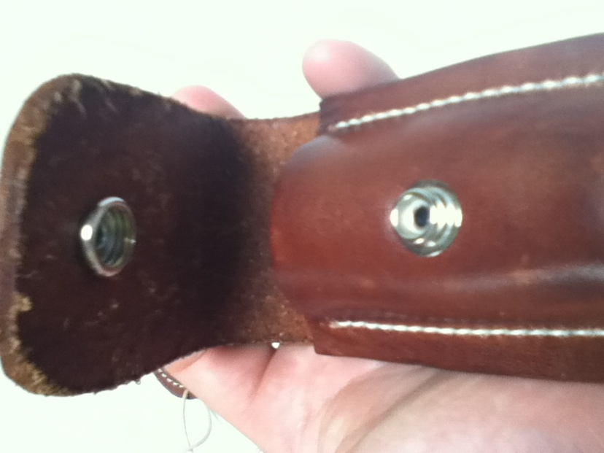
Information, Inspiration and influences
This is another canvas pouch designed for small multi tools in general and it does its job well, it has a strong design and the stitching is good quality. There is also a large belt loop that will fit most belts. However, the flap is secured by Velcro which has its own set of weaknesses. Also, the belt loop is very thin which means that it spins around on a belt which increases the risk of the belt loop being pulled off.
Again, this pouch only holds one item but the fact that a small multi tool can fit into it means that you have access to several tools anyway.
The main weakness of this product is that because the belt loop is quite loose, the pouch tends to get caught on branches or other bits of foliage which means it is more likely to get pulled off.
This pouch is one of the ones I have made and it has its uses. The flap is secured by a press stud instead of Velcro which means it is much more secure and the brown leather with the white stitching and the light coloured groove make the aesthetics quite rewarding. The belt loop is also good as it is wide enough not to spin about on the belt and as it is bent over at the top there is no strain on the stitching so it is likely to stay attached longer.
However, the pouch can only carry one item and due to the bend in the belt loop, the top of the pouch can stick out from the side of the body making it venerable to being caught on a branch or other object. If this happened several times then it could pull the belt loop off entirely.

Slide 5
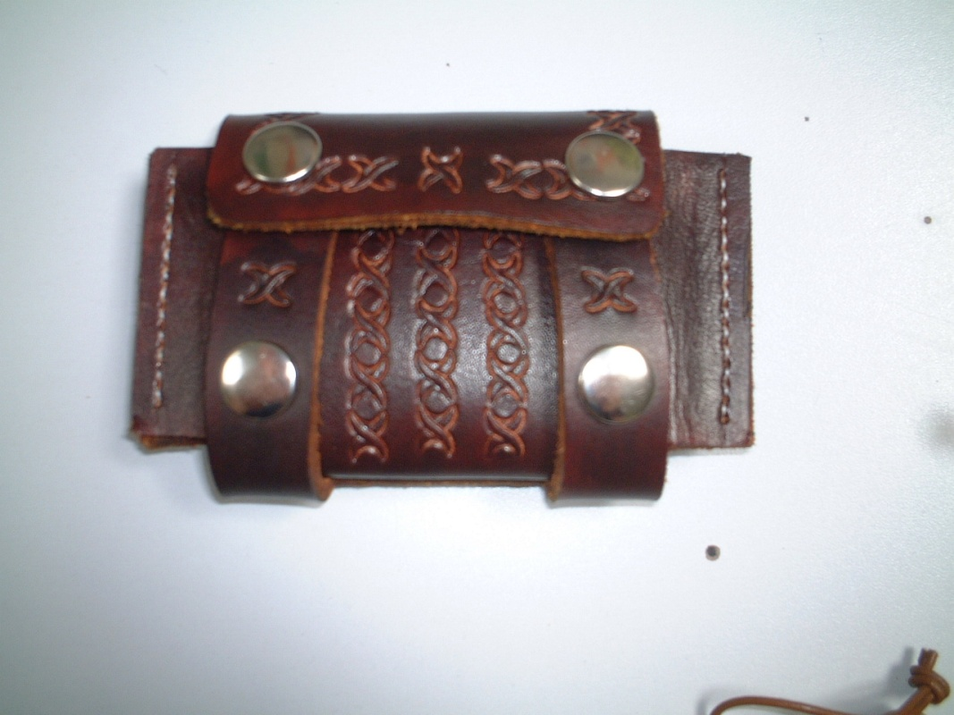
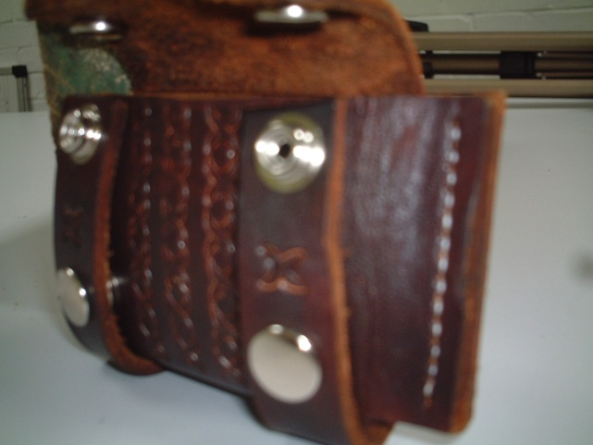
Information, Inspiration and influences
This is a pouch that I made from 3-3.5mm leather. It has been dyed brown and embossed to improve the aesthetics. This pouch was originally designed as a possibles pouch for carrying items such as tinder and a firesteel etc. I adapted it so that it could be carried on a sheath for one of my bushcraft knives. It is held shut by two press studs and the stitching is white cotton waxed thread, hand stitched.
This is a good design as it can be carried on a knife sheath and it can hold a fair amount of material in the form of tinder or equipment such as a penknife or small torch.
However, when lots of items are in the pouch, it can sometimes be hard to get them out again and the pouch also needs coating in a waterproof substance as the dye can run a bit if the pouch gets wet.
Another small issue to take into consideration is that when working with leather this thick the amount of space inside is less than might be expected so you have to be careful when designing a product such as this so that there is enough space inside to fit all that you want it to.
Finally, if you have several pieces of equipment in the pouch then it is hard to get out the piece of equipment at the bottom of the pouch when it is under other tools.

Slide 6
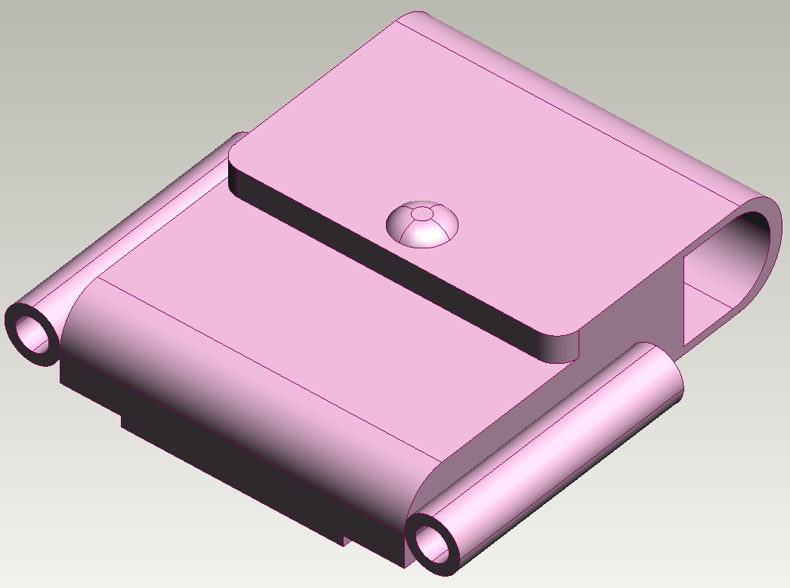
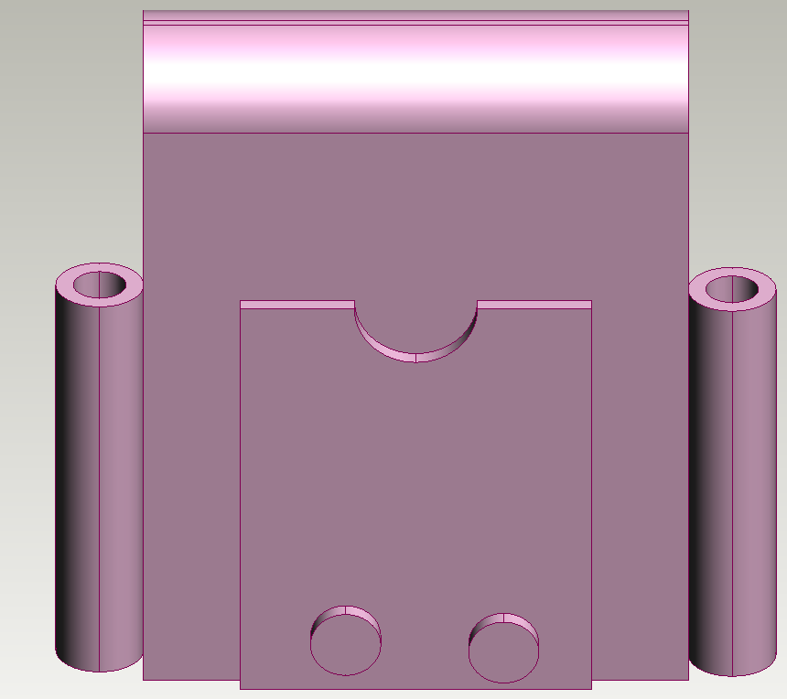
The idea behind this idea is to have the penknife in the main compartment secured by the flap and then have the torch and the firesteel in the two side loops.
The sharpening stone would go in a small ‘slip’ underneath the belt loop which is stitched at one end but on press-studs on the bottom so it can be lifted up to access the sharpening stone.
This design is good because it is able to hold all four objects in one unit and can be made entirely from leather and the metal press-studs.

Slide 8
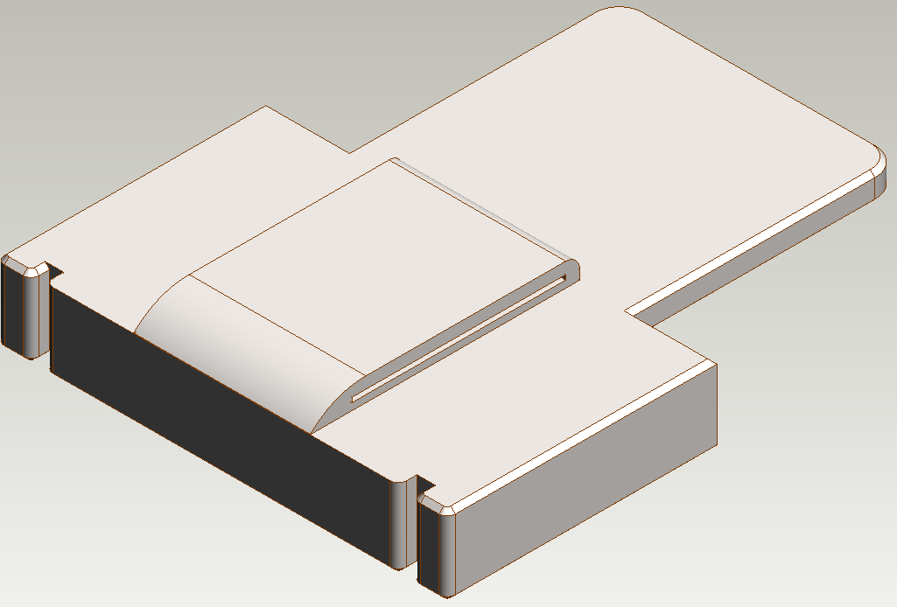

Slide 9
Changes to design
From talking to various end users, I have found that there is a larger market for a product that sheaths a fixed blade knife as opposed to a folding knife. This is because a fixed blade knife is much better for bushcraft as there is no chance of it folding onto the user’s fingers. The end users I interviewed also believed that having a pouch for a folding knife and the other accessories would be too bulky to have in one pouch on the hip. This has led me to change my design to carry a fixed blade knife, a firesteel, a sharpening stone and a Maglite solitaire.
Having made this change will also make the product easier to construct because there is much more space on the sheath of a fixed blade knife than there is on a pouch for a folding knife so it should be easier to fit all of the accessories into one module.
The sheath will also be modular so it will be possible to add or remove sections depending upon what you want to carry with you which is a useful feature as not all the features will be needed for a trip into the bush.

Slide 10
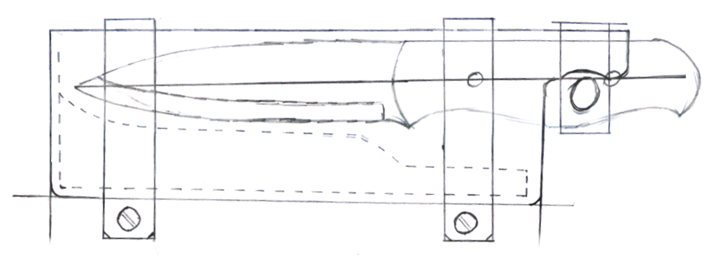

Slide 11
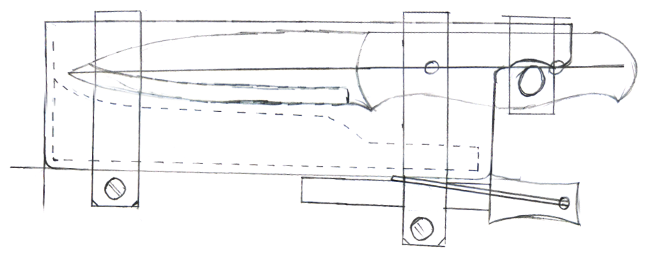

Slide 12
